Slide 1
Immunotherapy in Special Patient Populations Michael Morse, MD, MHS Medical Oncology Duke University Health System
#SITCWinterSchool

Slide 2
Topics: Immune Checkpoint Inhibitors in:
Autoimmune disorders
Organ transplants
Chronic viral infections
Concurrent immunosuppressants
Patients receiving PPI or antibiotics
Organ dysfunction
Pregnancy
Brain metastases
Pediatric
Elderly
COVID-19
#SITCWinterSchool

Slide 3
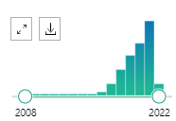
ICB in patients with pre-existing autoimmune disease
Excluded from clinical trials so minimal clinical trial data
Rapid increase in publications on this topic
Many case reports of Rx with ICB in patients with autoimmune dz
Series and reviews on individual autoimmune diseases
E.g., Halle BR, et al. Immune checkpoint inhibitors in patients with pre-existing psoriasis: safety and efficacy. J Immunother Cancer. 2021;9:e003066.
Real world evidence/Cohort studies for ICB across autoimmune diseases
Fountzilas E, et al. Real-world safety and efficacy data of immunotherapy in patients with cancer and autoimmune disease: the experience of the Hellenic Cooperative Oncology Group. Cancer Immunol Immunother. 2022 Feb;71(2):327-337.
Tison A, et al. Safety and Efficacy of Immune Checkpoint Inhibitors in Patients With Cancer and Preexisting Autoimmune Disease: A Nationwide, Multicenter Cohort Study. Arthritis Rheumatol. 2019;71:2100-2111.
Systematic reviews for ICB across autoimmune diseases
Abdel-Wahab, Ann Intern Med. 2018;168(2):121-130
#SITCWinterSchool

Slide 4
Systematic Review
N = 123 patients
Most had metastatic melanoma.
Preexisting autoimmune diseases : psoriasis and/or psoriatic arthritis, rheumatoid arthritis, autoimmune thyroid disease, ulcerative colitis, Crohn disease, multiple sclerosis, myasthenia gravis, and sarcoidosis.
83.5% received prior treatment for their autoimmune disease
46.2% had active autoimmune disease with ongoing symptoms
43.6% were receiving concomitant treatment (corticosteroids, synthetic or biologic disease-modifying antirheumatic drugs, or other immunosuppressants) at initiation of CPI therapy.
Abdel-Wahab, Ann Intern Med. 2018;168(2):121-130
#SITCWinterSchool

Slide 5
Outcome of patients with pre-existing autoimmune dz
1/2 had exacerbation of prior autoimmune disease
Generally the same manifestations as those occurring before CPI therapy.
> 1/3 experienced de novo irAEs
colitis and hypophysitis the most common
No differences in frequency of AEs in patients with active vs inactive preexisting autoimmune dz
Fewer AEs in those receiving immunosuppressive therapy at initiation of CPI therapy
Ipilimumab associated with more de novo irAEs; anti–PD-1/PD-L1 agents had more disease flares
Most AEs were treated with corticosteroids; 16% required other immunosuppressive tx
AEs improved in more than half of cases without the need to discontinue CPI therapy.
Death from a serious adverse event was reported in 2.4% of patients.
Suggest that irAEs may be more severe in patients with concomitant autoimmune disease.
Abdel-Wahab, Ann Intern Med. 2018;168(2):121-130
#SITCWinterSchool

Slide 6
French Multicenter Cohort Study
Adults with preexisting autoimmune disease who were receiving ICIs
Psoriasis (n = 31), rheumatoid arthritis (n = 20), and IBD (n = 14).
Twenty-four patients (22%) receiving immunosuppressive therapy at ICI initiation.
Autoimmune disease flare and/or other IRAE(s) in 79 patients (71%)
Flare of preexisting autoimmune disease in 53 patients (47%)
Other IRAE(s) in 47 patients (42%),
Need for immunosuppressive therapy in 48 patients (43%)
Permanent discontinuation of ICI in 24 patients (21%).
PFS shorter in patients receiving immunosuppressive therapy at ICI initiation (3.8 v 12 mo
PFS shorter in patients who experienced a flare of preexisting autoimmune disease or other IRAE,
Trend toward better survival in the subgroup without immunosuppressant use or ICI discontinuation.
Arthritis Rheumatol. 2019 Dec;71(12):2100-2111.
#SITCWinterSchool

Slide 7
Safety and efficacy of immune checkpoint inhibitors (ICI) in cancer patients with autoimmune diseases
J Immunother Precis Oncol. 2021 Nov; 4(4): 180–184.

Slide 8
Statement that sums it up
“ …..data suggest that the potential benefits of ICI treatment may outweigh the potential risks for this patient group [with autoimmune disease (AD)] as long as physicians also provide sufficient monitoring for AD exacerbations or other side effects. Therefore, it may be appropriate to include patients with advanced malignancies and preexisting AD in ICI clinical trials when no other effective cancer treatment options exist. Overall, physicians should avoid excluding patients from ICI therapy unnecessarily when the potential benefits outweigh the potential risks.”
Pantuck et al., Cancer. 2019;125(20):3506-3513.
#SITCWinterSchool

Slide 9
Use of ICB in allo-HSCT
Literature review
Most common indication for CPI use: Hodgkin lymphoma.
CPIs: ipilimumab, nivolumab, and pembrolizumab
Ijaz, Biol Blood Marrow Transplant, 25 (2019), pp. 94-99
 | aGVHD | cGVHD | Death due to GVHD | ORR/CR/PR
CPI pre-allo-HSCT (n= 107) | 56% | 29% | 11% | 68/47/21%
CPI post-allo-HSCT For relapse (n= 176) | 14% | 9% | 7% | 54/33/21%
GVHD incidence associated with ICB administered post allo-HSCT is higher if previous GVHD (55%) vs first episode of GVHD (30%) (Blood. 2017 Jul 13; 130(2):221-228.; Blood. 2018 Jul 5; 132(1):9-16).
#SITCWinterSchool

Slide 10
Graft Versus Host Disease Associated with ICI: A Pharmacovigilance Study and Systematic Literature Review
Pharmacovigilance analysis of cases of GVHD associated with ICI in allo-transplant patients
93 cases of GVHD associated with ICI (61.8% men, median age 38y).
Cases were mostly associated with nivolumab (53/93, 57.0%), pembrolizumab (23/93, 24.7%) and ipilimumab (12/93, 12.9%) monotherapies.
GVHD events occurred after 1 [1; 5.5] injection of ICI, with a time to onset of 35 [IQR = 14; 176] days.
Immediate subsequent mortality after GVHD was 24/93, 25.8%.
No significant difference in mortality depending on the molecule (p = 0.41) or the combination regimen (combined vs. monotherapy, p = 0.60).
Previous h/o GVHD present in 11/18.
Nguyen, Front Pharmacol. 2021 Feb 5;11:619649.
#SITCWinterSchool

Slide 11
Solid Organ Transplant recipients receiving ICB for malignancy
119 reported cases of ICI use among solid organ transplant recipients (cutaneous melanoma, hepatocellular carcinoma, and cutaneous squamous cell carcinoma)
ORR 35.7% for cMEL, 18.5% for HCC, and 68.2% for cSCC
ORR with increasing time from transplant to ICI and preemptive reduction in intensity of the graft maintenance immunosuppressive regimen (50.0% vs 18.5%; OR, 4.40; P =.0088).
Rejection: 41.2%, graft failure: 23.5%, irAEs 18.5% of patients
Factors significantly associated with allograft rejection: allograft PD-L1 positivity (100% vs 0%; P<.0001) and absence of tacrolimus in the immunosuppressive regimen (48.7% vs 25.6%; OR, 0.36; P =.019).
Cause of death: progressive malignancy (64.0%) > graft failure (24.0%)
? Use of mTOR inhibitor (Nat Comm 2019;10:5812)
J Natl Compr Canc Netw. 2022 Apr;20(4):406-416.e11.

Slide 12
Other observations regarding ICI in Solid Organ Transplant recipients
continuing regular immunosuppression did not appear to affect the efficacy of an immune checkpoint inhibitor, and rates of allograft rejection were lower than in previous reports (Carroll RP, The Lancet Oncology, 2022;23:1078-1086)
prescreening urinary IP-10 concentration in patients before commencement of ICI might be a predictor of early kidney allograft rejection
Donor-derived, cell-free DNA may detect subclinical kidney transplant rejection during ICI treatment (J Immunother Cancer 2019;7:182.
Plasma exchange to remove the ICB Ab may be an option in refractory cases.

Slide 13
Chronic immunosuppressants (Steroids)
Meta-analysis
Patients (studies, n = 16; patients, n = 4045) taking steroids were at increased risk of death and progression compared to those not taking steroids (HR = 1.54, 95% CI: 1.24–1.91; p = 0.01 and HR = 1.34, 95% CI: 1.02–1.76; p = 0.03, respectively).
Main negative effect on OS was associated with patients taking steroids for supportive care (HR = 2.5, 95% CI 1.41–4.43; p < 0.01) or brain metastases (HR = 1.51, 95% CI 1.22–1.87; p < 0.01).
In contrast, steroids used to mitigate adverse events did not negatively affect OS.
Cancers (Basel). 2020 Mar; 12(3): 546.

Slide 14
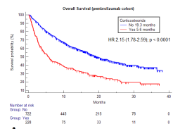
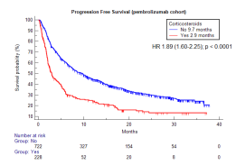
Chronic immunosuppressants
“Responses may be less frequent in patients receiving high-dose steroids or other disease-modifying therapies (15%) than in those not requiring these agents (44%)” (Reported in Cancer 2017;123:1904-11)
Lower OS and PFS for NSCLC receiving steroids who start pembrolizumab
J Immunother Cancer. 2021 Apr;9(4):e002421

Slide 15
Corticosteroids
Generally hold ICI if prednisone equivalent of >10%mg
For NSCLC treated with single agent PD-(L)1 blockade, baseline corticosteroids (>10mg) were associated with decreased overall response rate, progression-free survival, and overall survival with PD-(L)1 blockade
(J Clin Oncol. 2018 Oct 1;36(28):2872-2878).
Retrospective, single-center study of adult patients with melanoma, NSCLC, or renal cell carcinoma who received at least four cycles of nivolumab or pembrolizumab therapy
corticosteroids with more than 10 mg of prednisone equivalent for long durations (more than two weeks) during anti-PD1 therapy were associated with poorer survival. ( J Oncol Pharm Pract . 2020;26:814–822.)

Slide 16
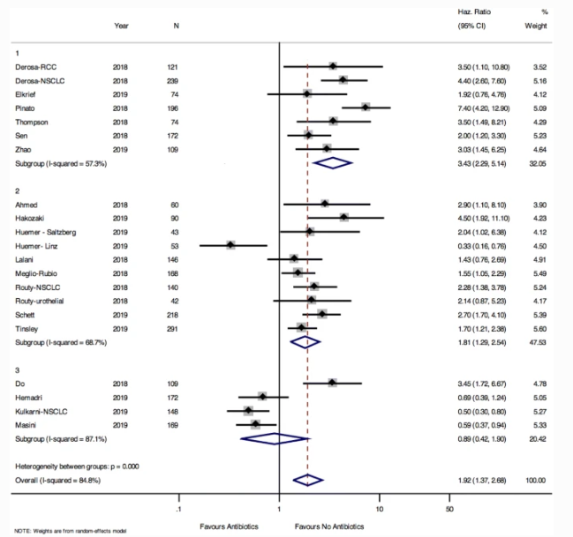
Affect of antibiotics
In patients receiving ICB, OS and PFS are longer in patients who are not exposed to antibiotics.
Antibiotic use in the 42 days before starting ICB appears to be most detrimental to outcome.
Cancer Immunology, Immunotherapy 2020;69:343–354
Notes:
Pooled hazards ratio for overall survival among those exposed and unexposed to antibiotics stratified by antibiotic exposure definition. Group 1: cohorts defining antibiotic exposure as up to 42 days before initiation of ICB. Group 2: cohorts defining antibiotic exposure as 60 days before and 42 days after initiation of ICB. Group 3: cohorts defining antibiotic exposure as 60 days before and anytime during ICB

Slide 17
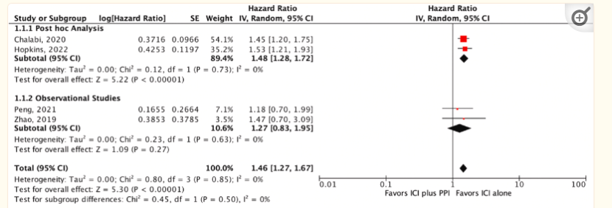
Affect of Proton Pump Inhibitor
Proton-pump inhibitors (PPIs) alter gut microbiota composition
In NSCLC, ICI usage alone was associated with significantly better OS [HR = 1.46, 95% CI = 1.27–1.67, P < 0.00001] and PFS [HR = 1.31, 95% CI = 1.17–1.47, P < 0.00001] when compared to concomitant PPI and ICI therapy.
Ann Med Surg (Lond). 2022; 78: 103752.
PPI use is not significantly associated with OS and PFS of ICI treatment.
BUT: positive effect in melanoma and a negative effect in NSCLC.
Int Immunopharmacol. 2020 Nov;88:106972.

Slide 18
ICB in HIV + patients with malignancy
Systematic review (n=73 patients)
62: anti-PD-1 therapy; 6: anti-CTLA-4, 4: anti-PD-1/CTLA-4; 1: sequential ipilimumab and nivolumab therapy
Well-tolerated (>grade 3 IRAE: 8.6%).
HIV remained suppressed in 26 of the 28 (93%) with undetectable HIV load.
CD4 cell counts increased (mean [SD] change, 12.3 [28.5] /μL).
Objective response rates were 30% for non-small cell lung cancer, 27% for melanoma, and 63% for Kaposi sarcoma.
JAMA Oncol . 2019 Jul 1;5(7):1049-1054
#SITCWinterSchool

Slide 19
Safety and efficacy of immune checkpoint inhibitors in patients living with HIV and metastatic non-small cell lung cancer: a matched cohort study from the international CATCH-IT consortium (SITC 2022; abstr 437)
Retrospective, international multi-center study: 64 HIV+ patients and 117 matched HIV- controls with metastatic NSCLC treated with ICI
89% received anti-PD-1 based therapy, and 46% received concurrent chemotherapy.
Grade ≥3 irAE occurred in 11% HIV+ vs. 9% HIV- patients.
ORR similar between both groups (28% HIV+ vs. 37% HIV-, p=0.25).
24-month OS rates were 41.7% for HIV+ vs. 42.9% for HIV- patients.
24-month PFS rates were 18.1% HIV+ vs 18.7% HIV- patients.
Notes:
At baseline, HIV+ patients had a median CD4 count = 386 cells/uL (range: 6 – 1,721), 19/31 had undetectable HIV viral load (VL) while 12/31 had a median detectable VL= 60 copies/mL (range: 10 – 223,408).

Slide 20
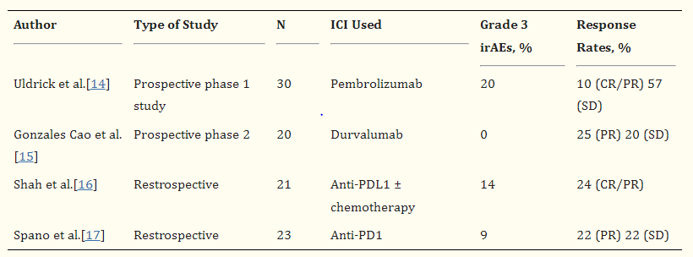
Safety and efficacy of immune checkpoint inhibitors (ICI) in in patients with HIV and cancer
J Immunother Precis Oncol. 2021 Nov; 4(4): 180–184.

Slide 21
ICB in the “elderly”
Pooled analysis: borderline significant OS benefit for ICIs vs no ICIs arms (HR = 0.84, 95% CI 0.7–1; P = 0.05) in particular in 1st line trials with HR = 0.77 (95%CI 0.61–0.96; P = 0.02) (Cancer Immunology, Immunotherapy 2021;70:1777–1780)
Meta-analysis: OS benefit with ICIs was significant in both younger and older patients (cut-off age of 65-70 years). (Cancer Treat Rev. 2016 Apr;45:30-7.
Meta-analysis: ICI therapy improves OS in both younger and older patients with advanced cancers (magnitude of improvement does not depend on age) (J Geriatr Oncol. 2020 Apr;11(3):508-514.)
#SITCWinterSchool

Slide 22
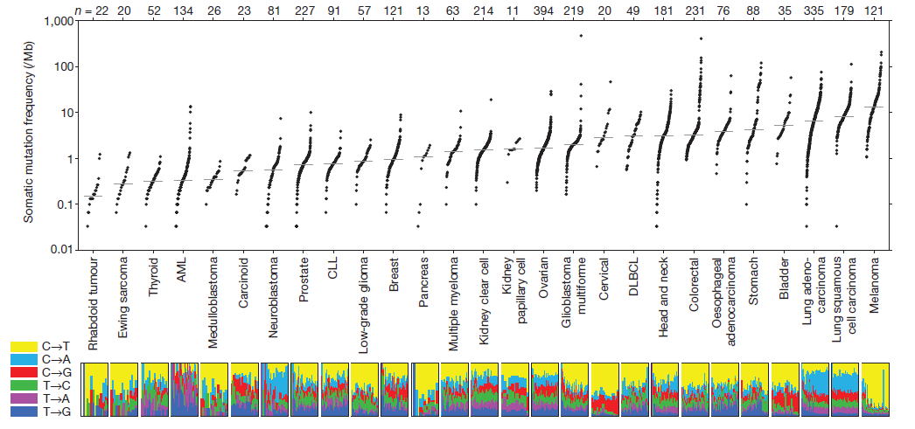
ICB in pediatrics: low rate of mutations
c
c
#SITCWinterSchool
N AT U R E | VO L 4 9 9 | 2 0 1 3 pg 214

Slide 23
ICB in pediatrics
ACCELERATE and European Medicines Agency Paediatric Strategy Forum for medicinal product development of checkpoint inhibitors for use in combination therapy in pediatric patients.
High rate of activity of monotherapy checkpoint inhibitors, including complete responses, in Hodgkin lymphoma and hypermutant tumours.
Very limited activity of checkpoint inhibitors as single agents in other pediatric tumours (overall response rate–2.8% with Hodgkin's lymphoma excluded).
Tumour-associated leucocytes of most pediatric tumours contain few T cells
PD-L1 expression is absent in the majority of tumours (except Hodgkin lymphoma)
Contain higher proportions of myeloid cells (macrophages and MDSC)
Except for hypermutation, there is no other predictive biomarker.
There is no benefit to children to be included in new monotherapy trials of other checkpoint inhibitors with the same mechanism of action unless there is more scientific knowledge.
#SITCWinterSchool
Pearson ADJ, Eur J Cancer. 2020 Mar;127:52-66.

Slide 24
ICB in organ dysfunction
No specific contraindication to ICB exists for patients with renal, hepatic, or cardiac dysfunction
These patients have been largely excluded from clinical trials
27 patients with organ dysfunction (Kanz, J Immunother Cancer. 2016 Oct 18;4:60)
Organ dysfunction was defined as cardiac (left ventricular ejection fraction ≤45 %), renal (creatinine ≥2 mg/dL or GFR ≤30 ml/min) or hepatic dysfunction (evidence of cirrhosis on imaging or AST, ALT or bilirubin ≥3x ULN).
Worsening organ dysfunction requiring hospitalization or dose delays occurred in 8 patients (30 %) although in most cases this was thought not-drug related and resolved with supportive care.
RR: 15%
#SITCWinterSchool

Slide 25
ICB in brain metastases: general statements
Lung cancer: To date only data provided by non-small-cell lung cancer subtypes are available (low level of evidence). Central response rate on these patients is estimated to be lower than primary site (ORR 17–20%) (low level of evidence).
Renal cell carcinoma: Only data for clear cell subtypes are available. Responses are achievable only in a very limited number of patients with mono-site small (<1 cm) metastases (very low level of evidence).
Melanoma: Combination between ICIs seems to be the best treatment strategy in patients with melanoma related brain metastases (BMs) (high level of evidence).
Other malignancies: Limited data about clinical efficacy on BMs are available. This also includes solid malignancies with high CNS metastases rate (breast cancer and small-cell lung cancer).
Breast cancer: Breast cancer BM had a lower immune contexture c/w melanoma and NSCLC
Radiation therapy & ICIs: Recent randomized trials show limited efficacy of the abscopal effect (low level of evidence).
Combinations between ICIs and stereotactic radiosurgery or WBI are under assessment
#SITCWinterSchool
Nunno V, Immunotherapy. 2021 Apr;13(5):419-432.

Slide 26
ICB in pregnancy
PD1/PD-L1 interactions plays a key role in maintaining fetal tolerance;
Placenta with high PD-L1 expression
Animal studies: anti-PD1/PD-L1 increased the risks of spontaneous abortions
Anti-PD1 agents are categorized as pregnancy category D* by the Food and Drug Administration
Ipilimumab is pregnancy category C*
* C: Animal reproduction studies have shown an adverse effect on the fetus and there are no adequate and well-controlled studies in humans, but potential benefits may warrant use of the drug in pregnant women despite potential risks.
*D: There is positive evidence of human fetal risk based on adverse reaction data from investigational or marketing experience or studies in humans, but potential benefits may warrant use of the drug in pregnant women despite potential risks.
#SITCWinterSchool

Slide 27
ICB in COVID-19
“Current evidence does not support the notion that ICB therapy worsens complications from COVID-19, and we conclude that it supports the continued use of ICB therapy during the COVID-19 pandemic ” (Garassino and Ribas, Cancer Immunol Res 2021;XX:XX–XX)
Use of extended dosing interval did not lead to an increase of clinically relevant toxicities resulting in dose reduction and/or treatment discontinuation (Lung Cancer. 2021 Dec 24:S1525-7304(21)00305-3.)
In a cohort of patients vaccinated while on ICB, irAEs were similar overall but 5/19 vaccinated within 72 hr before/after IO developed irAE (within 1-17 days) (Cancer Immunol Immunother. 2021 Dec 23;1-6. )
#SITCWinterSchool

Slide 28
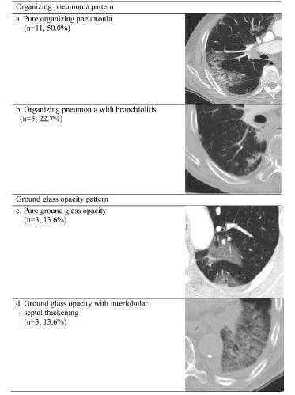
Immune related pneumonitis and COVID-19
Pt with COVID-19 (C_{T} 17)
And who recently
Initiated pembrolizumab
For NSCLC
Pt with ICB-
Related
pneumonitis
Is it possible to distinguish the two?
Cho JY, Lung Cancer. 2018 Nov;125:150-156.
Mellinghoff, Front. Immunol.,
20 December 2021
#SITCWinterSchool

Slide 29
Summary
Most “special” patient groups can be safely treated with ICB
Exception: pregnancy (category C or D) and some organ transplants
#SITCWinterSchool

