Slide 2
Principles of Data Sharing
Riyue Sunny Bao, PhD
Associate Professor of Medicine
UPMC Hillman Cancer Center & University of Pittsburgh
SITC Grant Writing Workshop, 11/09/2022
@RiyueSunnyBao

Slide 3
Disclosure
Serial #15/612,657 (Cancer Immunotherapy). Luke, J.J., Bao, R., Gajewski, T.F.
PCT/US62/577454 (Microbiome Biomarkers for Anti-PD-1/PD-L1 Responsiveness: Diagnostic, Prognostic and Therapeutic Uses Thereof). Gajewski, T.F., Luke, J.J., Bao, R., Matson, V., Fessler, J. Provisional.
PCT/US62/755945 (Compositions for treating infectious, autoimmune, and allergic disease). Nagler C.R., Bao. R. Provisional.
– and –
I will not discuss off label use and/or investigational use in my presentation.
@RiyueSunnyBao

Slide 4
Goals
Best practices of data sharing
What, When, and Where
Protection of privacy in human subject research
NIH policies on Data Management and Sharing (DMS) for grants
What is defined as “scientific data”
Data sharing approaches
NIH grant review requirements
@RiyueSunnyBao

Slide 5
Why sharing data?
Promote research transparency and reproducibility and/or validation of research fundings
Enable combination of data across studies and/or secondarily analysis of existing data for new research
Enhance trust in publicly funded research
A “culture shift” to make the practice of data management and responsible data sharing the norm
https://sharing.nih.gov/
@RiyueSunnyBao

Slide 6
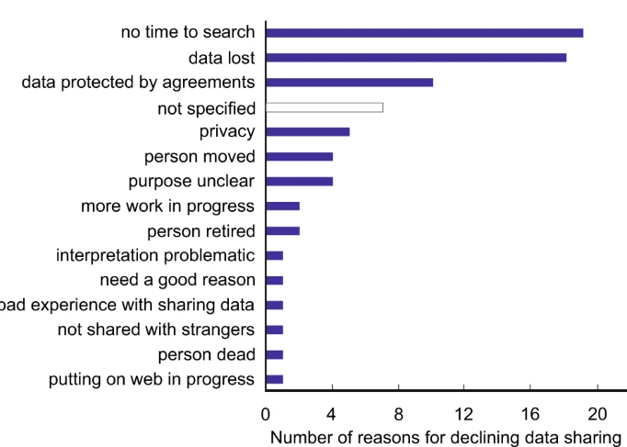
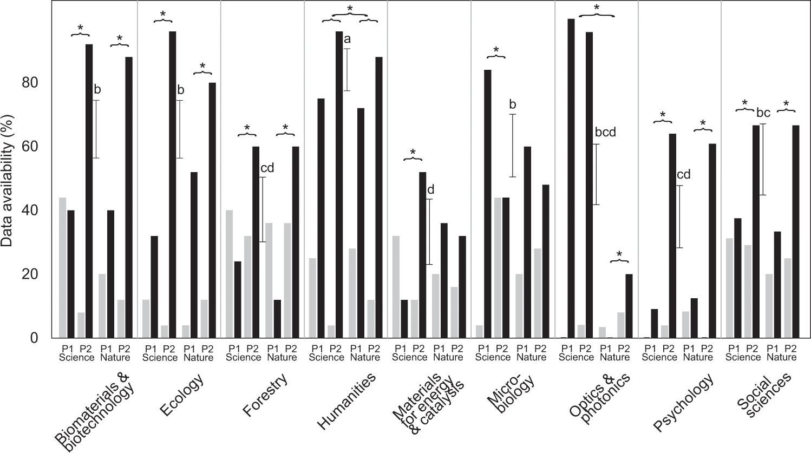
Current landscape of data sharing
Partial data
Complete data
P1: 2000-2009
P2: 2010-2019
N = 67 / 875
N = 875
Tedersoo et al., Scientific Data, 2019
@RiyueSunnyBao

Slide 7
NIH Data Management and Sharing (DMS) policy
NIH developed a Data Management and Sharing (DMS) policy to create a consistent minimum expectation for all research supported by agency.
Scientific data defined as (per NIH)
The recorded factual material commonly accepted in the scientific community as of sufficient quality to validate and replicate research findings, regardless of whether the data are used to support scholarly publications.
What to share
How to share
Where to share
When to share
Include:
Single-cell sequencing data
fMRI images
Step activity from wearables
Etc.
Does not include:
Data excluded due to low quality
Lab notebooks
Completed case report forms
Physical objects (e.g., lab specimens) etc.
Does not require sharing of software but NIH provides best practice for sharing code
@RiyueSunnyBao

Slide 8
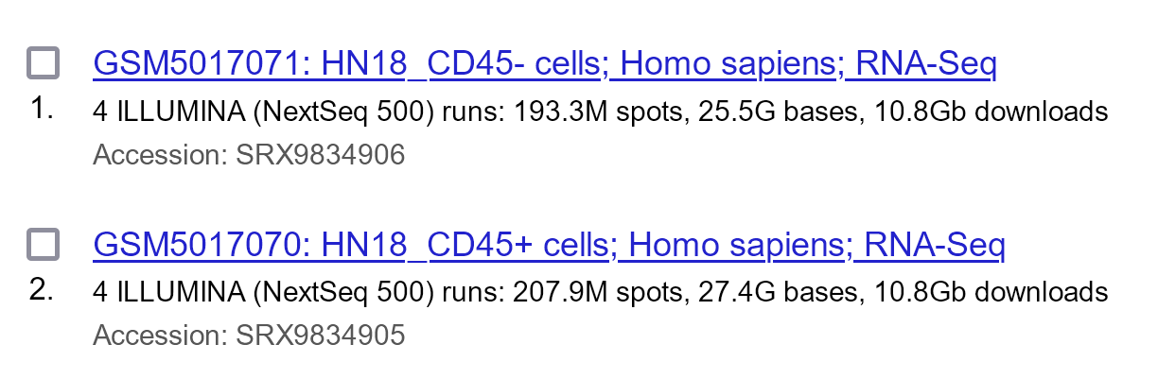
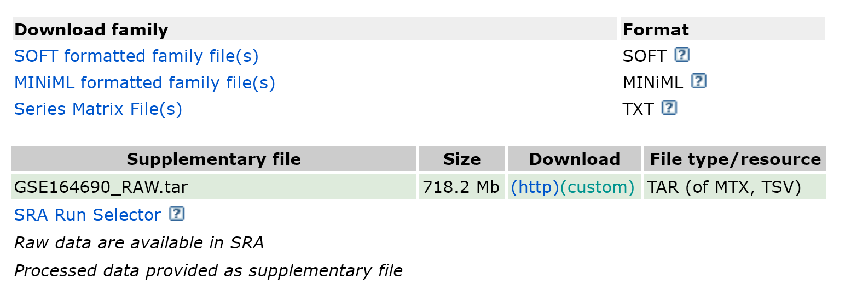
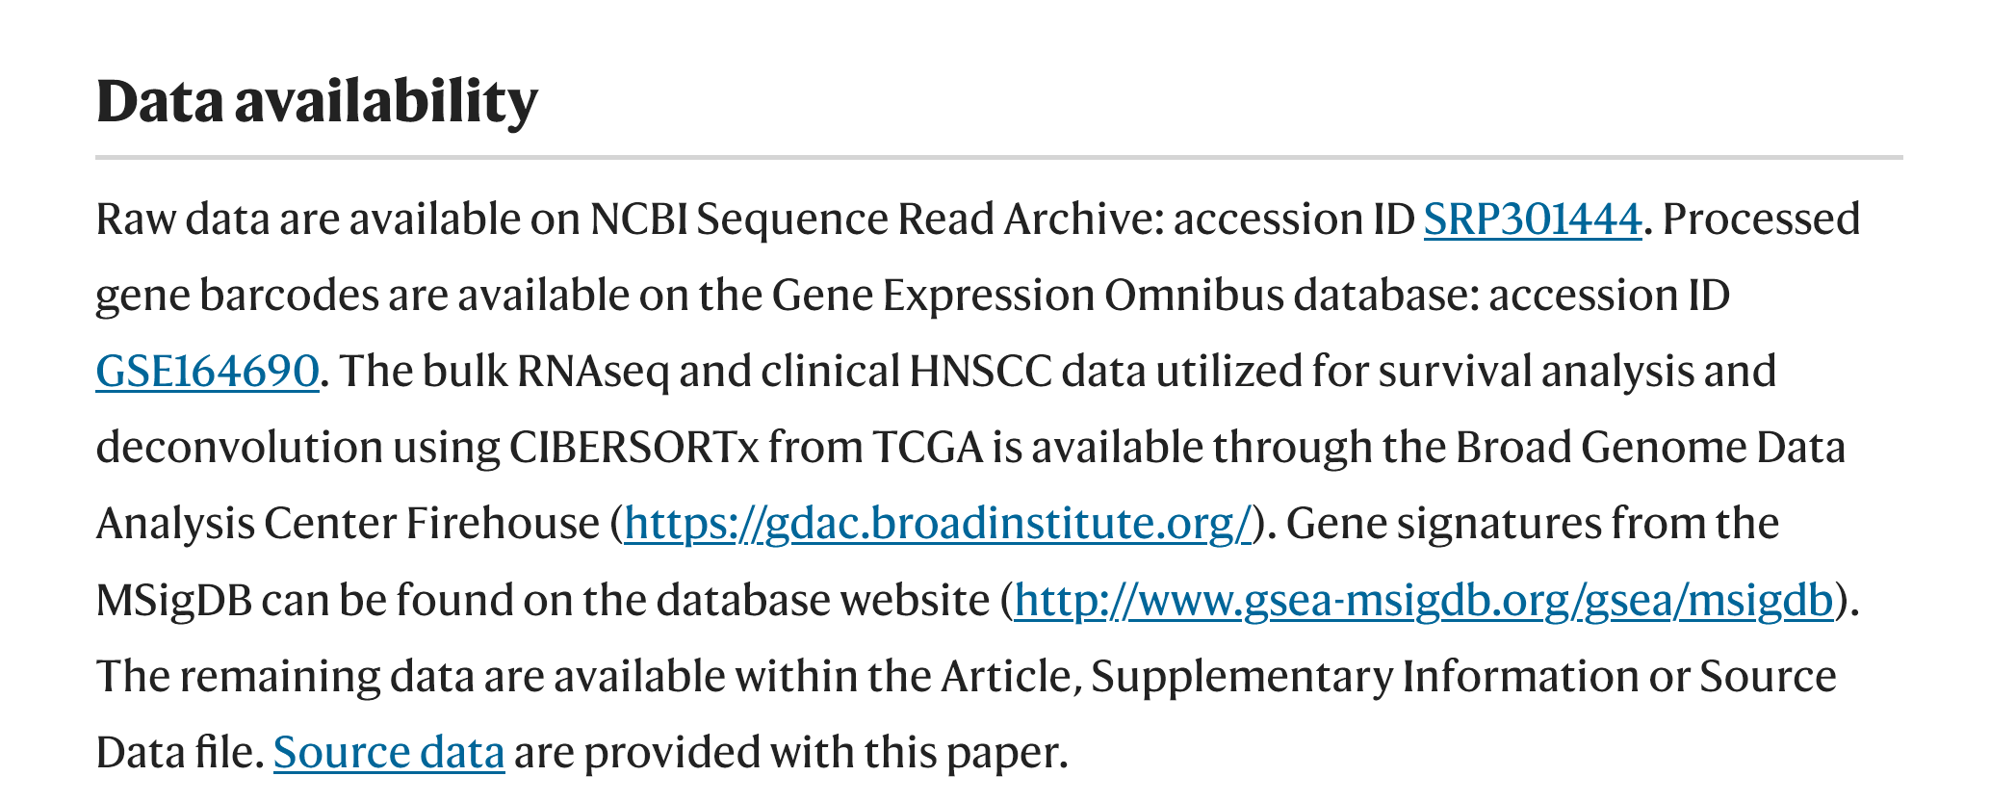
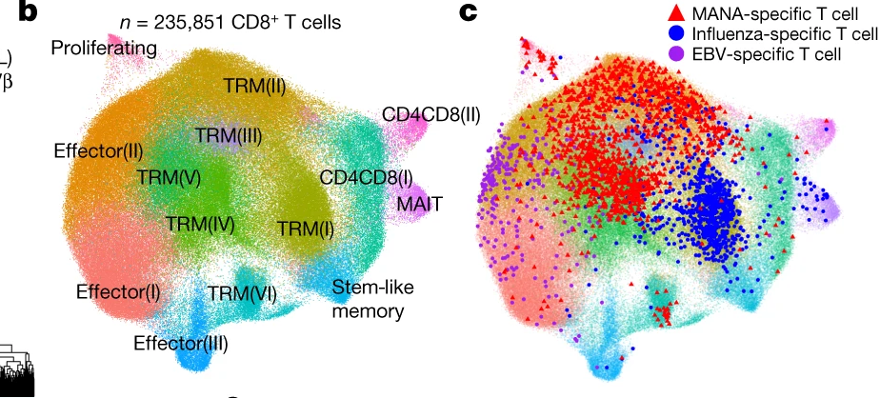
The four levels of data files
Raw data files
Processed data files
Result data files
Source files for figures
Kürten et al., Nat Comm 2021
@RiyueSunnyBao

Slide 9
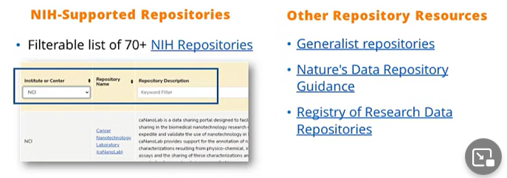
What, when, and where to share data
FIARness of data (findability, accessibility, interoperability, and reusability (FAIR))
12 characteristics of data repositories
Open-access data
Controlled-access data (human subject research)
Consult with a data scientist for data standardization and deposition!
@RiyueSunnyBao

Slide 10
What, when, and where to share data
As soon as possible!
No later than the time of a publication of findings in a peer-reviewed journal OR at the end of the award, whichever comes first
Even findings are not published or peer-reviewed, or findings are null or negative, data should be shared no later than the end of the performance period.
Reserving data for publication #2, #3 …
is not a justification for not sharing all data involved in the first publication!
@RiyueSunnyBao

Slide 11
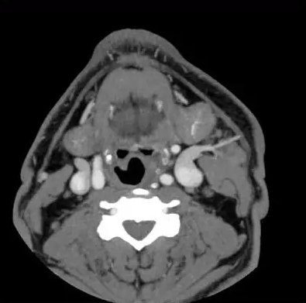
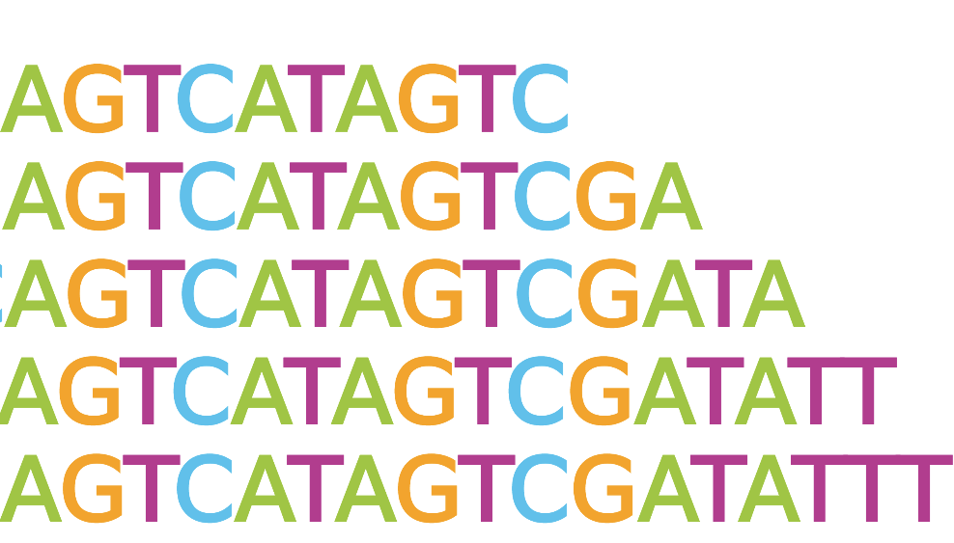
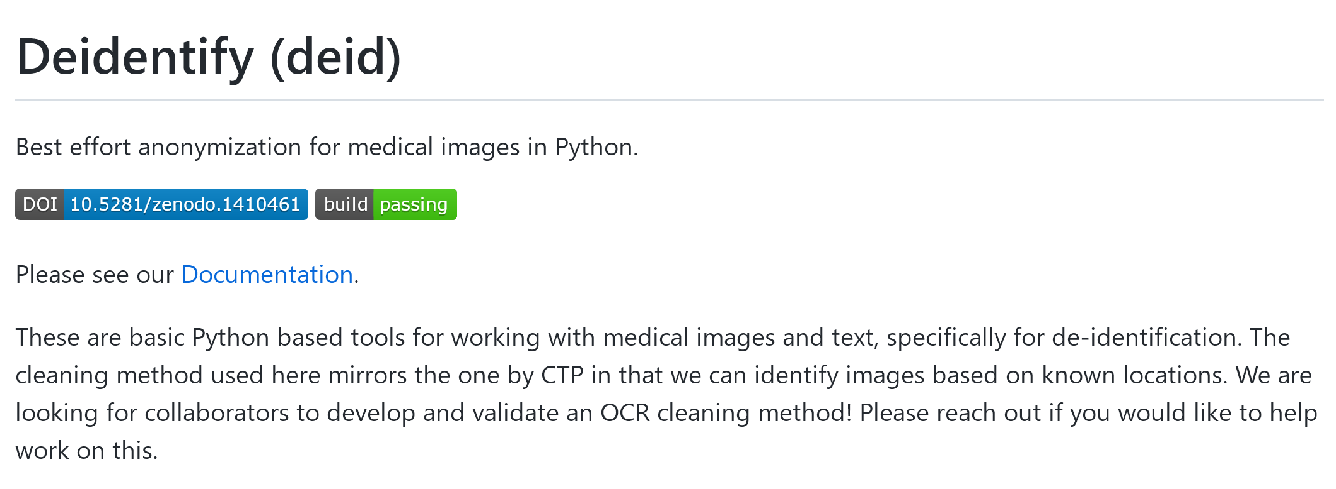
Protecting privacy when sharing human research participant data
Three basic guidelines:
1 – de-identify your data! Use Common Rule and HIPAA Privacy Rule standards
2 – patients’ consent. Share identifiable data only with explicit consent
3 – data use agreement. Communicate limitations on use, include prohibitions on re-identification or recontact. Understand applicable legal protections and limitations on disclosure
Pathology images
Medical images
Sequencing files
… and more!
@RiyueSunnyBao

Slide 12
What does the DMS policy mean to me?
The DMS policy applies to all research generating scientific data; does not apply to those not generating data or non-research projects (e.g., Training [T], Fellowships [F], Resources [G], or Infrastructure [S] etc.)
As of Jan 2023, competing applications submitted to NIH are subject to DMS policy.
Include a Data Management and Sharing Plan
Comply with the Data Management and Sharing Plan
DMS Plan Assessment
NIH program staff determine if DMS Plan is acceptable or unacceptable
Peer reviewers only consider if budget is reasonable
The DMS policy does not require all the data to be shared. Rather, it is required as a component of grant submission, and will be a Term and Condition of the Award. Researchers are responsible to maximize the appropriate sharing of data, and if not possible, to provide justification.
@RiyueSunnyBao

Slide 13
Elements of a DMS plan
Data type to be preserved and shared
Related tools, software, code needed to access and manipulate data
Data standards (FIAR)
Data preservation, access, timelines (repository, unique identifier, when/how long data will be available)
Access, distribution, reuse considerations (HIPPA compliant)
Oversight of data management and sharing (within institution)
@RiyueSunnyBao

Slide 14
Costs and budget data management and sharing
What does NIH pay for?
Curating data and developing supporting documentation
Preserving and sharing data through repositories
Local data management considerations
What does NIH not pay for?
Infrastructure costs typically included in indirect costs
Costs associated with routine conduct of research (e.g., costs of gaining access to research data)
Budget form: [Data management and sharing costs]
@RiyueSunnyBao

Slide 15
Take home messages
Best practices of data sharing
What (four levels of data)
When (upon pub or when grant ends)
Where (designed central repositories)
Protection of privacy in human subject research (!!! Use software to double check & de-identify)
NIH policies on Data Sharing and Management (DSM) for grants
What is defined as “scientific data” (genomic data, clinical data, other scientific data)
Data sharing approaches (open-access vs controlled-access)
NIH grant review requirements (promoting a “culture shift” of data sharing among researchers)
@RiyueSunnyBao

Slide 16
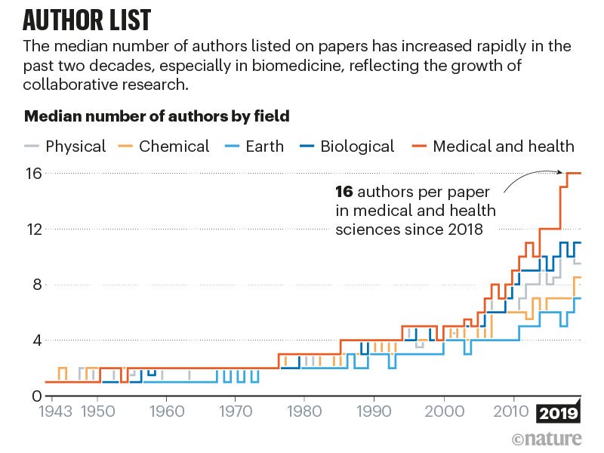
Take home messages
Re-thinking Team Science
How do we define “Scientific Contribution”?
How do we properly credit or acknowledge those who generate data and those who analyze data?
How do we build a healthy, collaborative environment between data scientists, experimental biologists, clinicians, and experts from various fields?
@RiyueSunnyBao

Slide 17
Take home messages
Re-thinking Team Science
How do we define “Scientific Contribution”?
How do we properly credit or acknowledge those who generate data and those who analyze data?
How do we build a healthy, collaborative environment between data scientists, experimental biologists, clinicians, and experts from various fields?
Data sharing in itself is part of modern science, and should never hurt your career.
@RiyueSunnyBao

Slide 18
More resources on data sharing
https://sharing.nih.gov/
@RiyueSunnyBao

Slide 19
Acknowledgment
Translational Immuno-Informatics Lab
Jason Luke (co-PI)
Ryan Augustin
Becky Dadey
Sarah Brodeur
Krishna Beer Singh
Rose Doerfler
Aofei Li
Alex Tompkins
Zane Nathaniel Gray
Nikita Patel
Arjun Mittal
Wesley Cai
Max Jameson Lee
TIIL Alumini
Daniel (Tuck) Stapor
Lilit Karapetyan
Afsaneh Amouzegar
Joe Mocharnuk
Josh Holloway
UPMC Hillman Cancer Center
Robert L. Ferris (HNSCC)
Heath Skinner (HNSCC)
Tullia Bruno (Immunology)
Oleg Akilov (Dermatology)
Yana Najjar (melanoma)
Diwakar Davar (melanoma)
Hassane M. Zarour (melanoma)
John M. Kirkwood (melanoma)
Laura Stabile (lung)
Tim Burns (lung)
Adam Soloff (lung)
Institute for Precision Medicine
Adrian Lee
Steffi Oesterreich
Center of Translational Pathology
Peter Lucas
Aatur Singhi
Flow Cytometry Facility
Tullia Bruno
E. Michael Meyer
HCC Microbiome Facility
Yuanjie Liu (Jessie)
Funding resources
NIH R01DE031729
NIH P30CA047904
NIH P50CA097190
UPMC Hillman Cancer Center
Patients and families
@RiyueSunnyBao

