Slide 1
Case Studies in Immunotherapy for the Treatment of Nonmelanoma Skin Cancer
October 28, 2022
3:30 – 4:30 p.m. ET
The Practical Management Pearls and Case Studies Webinars are part of the Cancer Immunotherapy Clinical Practice Guidelines Advanced Webinar Series supported, in part, by grants from Amgen and Merck & Co., Inc. (as of 9/15/2021)

Slide 2
Webinar Agenda
3:30 - 3:35 p.m. ET | Overview: Welcome and Introductions
3:35 - 4:10 p.m. ET | Presentations and Discussion
4:10 - 4:25 p.m. ET | Question and Answer Session
4:25 - 4:30 p.m. ET | Closing Remarks & Announcements

Slide 3
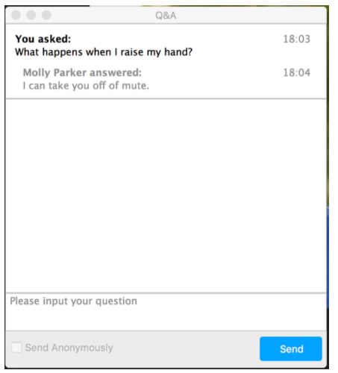
How to Submit Questions
Click the “Q&A” icon located on at the bottom of your Zoom control panel
Type your question in the Q&A box, then click “Send”
Questions will be answered in the Question & Answer session at the end of the webinar (as time permits)

Slide 4
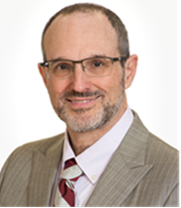
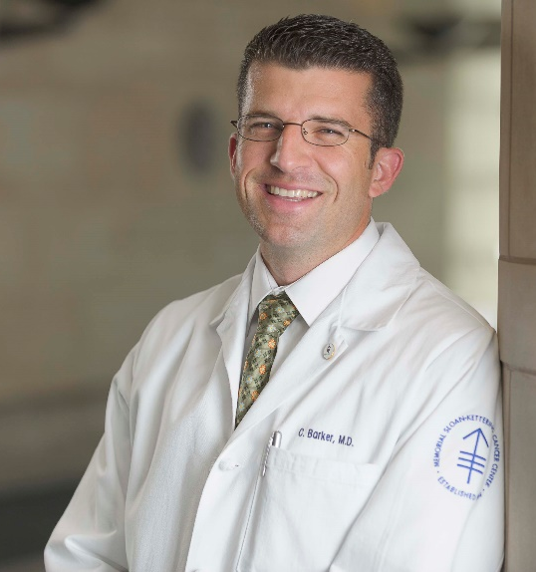
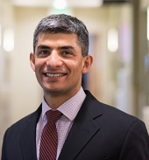
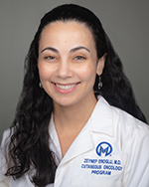
Webinar Faculty
Moderator: Vernon K. Sondak, MD
Expert Panel Chair
Moffitt Cancer Center Tampa, Florida
Christopher A. Barker, MD
Expert Panel Member
Memorial Sloan Kettering New York, New York
Shailender Bhatia, MD Expert Panel Member
Fred Hutchinson Cancer Research Center Seattle, Washington
Zeynep Eroglu, MD Expert Panel Member
Moffitt Cancer Center Tampa, Florida

Slide 5
Learning Objectives
Plan immunotherapy treatment regimens for challenging patient populations
Identify management strategies for uncommon and/or atypically responsive toxicities
Select appropriate treatment strategies for patients with relapsed and/or unresponsive disease
Articulate the potential risks and benefits for proceeding with any other possible interventions specific to a given disease setting in the context of an immunotherapy treatment plan

Slide 6
Immunotherapy for the Treatment of Cutaneous Squamous Cell Carcinoma (CSCC)
October 28, 2022
Christopher A. Barker
Memorial Sloan Kettering Cancer Center, New York, NY

Slide 7
Disclosures
MSKCC receives funding from Amgen, Elekta, Merck, AlphaTau Medical, EMD Serono, Regeneron for clinical trials that I lead
–I receive no personal funds from these entities
I have received personal funds from Regeneron for providing scientific advice

Slide 8
Outline
Current uses of immunotherapy for CSCC
Adjuvant immunotherapy
Neoadjuvant immunotherapy
Future directions

Slide 9
Immunotherapy a standard for some CSCC patients
Cemiplimab
Pembrolizumab
Blocks programmed death-1 (PD1)
Phase 1/2 study in metastatic CSCC: 47- 50% response rate
Phase 2 study in locally advanced CSCC: 44% response rate
FDA approved “for the treatment of patients with locally advanced or metastatic CSCC who are not candidates for curative surgery or curative radiation.”
Blocks programmed death-1 (PD1)
Phase 2 study in locally advanced or recurrent/metastatic CSCC: 50% or 35% response rate
Phase 2 study in unresectable CSCC: 41% response rate
Phase 2 substudy in advanced, refractory CSCC: 32% response rate
FDA approved “for patients with recurrent or metastatic CSCC that is not curable by surgery or radiation.”
Migden NEJM 2018; Migden Lancet Onc 2020
Hughes Ann Onc 2021; Maubec JCO 2020; Ferrarrotto Adv Ther 2021

Slide 10
Adjuvant immunotherapy being studied in 2 randomized trials: Neither trial has completed – role of immunotherapy undefined!
Cemiplimab: C-POST
Pembrolizumab: Keynote-630
Rischin ASCO 2020
Geiger ASCO 2018

Slide 11
Neoadjuvant immunotherapy studied in a “pilot phase II trial”
Single arm, single center (MDACC), “pilot phase II trial” of 44 patients
Started 7/3/18
Preliminary report at ESMO 2019 (LBA74)
Primary objective: Determine overall response rate (ORR) using RECIST v1.1 to neoadjuvant cemiplimab (anti-PD-1 inhibitor) in patients with advanced-stage CSCC of the head and neck who are planned for definitive local surgery and radiation
Gross ESMO 2019

Slide 12
Patients with resectable locally advanced enrolled
20 patients reported, 90% men
Median age 69
35% recurrent CSCC
45% with regional nodal metastases
30% response rate (radiographic)
70% response rate (pathologic)
Median follow up: ~12 months
Patient # | Gender | Age | Clinical Stage | Imaging Response | Pathologic Response | Adjuvant Therapy | Disease Status
1 | M | 88 | TxN2b (IV) | PR | MPR | RT** | NED
2 | M | 64 | TxN1 (III) | SD | pCR | None | NED
3 | M | 69 | rT2N1 (III) | SD | pCR | None | NED
4 | M | 83 | rT1N2b (IV) | PR | pCR | None | NED
5 | M | 76 | T3N2b (IV) | SD | MPR | None | NED
6 | M | 69 | TxN2b (IV) | PD | pPR | CRT | NED
7 | M | 62 | TxN1 (III) | PR | pCR | None | NED
8 | M | 70 | rT4N0 (IV) | PD | pSD/PD | RT | NED
9 | M | 66 | TxN2b (IV) | PR | pPR | RT | NED
10 | M | 77 | rT3N0 (III) | SD | pCR | RT | NED
11 | M | 66 | rT3N0 (III) | SD | pCR | None | NED
12 | M | 64 | T3N0 (III) | PR | pCR | None | NED
13 | M | 80 | TxN2b (IV) | SD | pCR | None | NED
14 | M | 76 | T3N0 (III) | SD | pCR | None | NED
15 | F | 71 | rT1N2c (IV) | SD | pCR | None | NED
16 | M | 65 | TxN2b (IV) | SD | pSD/PD | RT | NED
17 | F | 47 | T4aN2b (IV) | SD | pSD/PD | CRT** | *POD*
18 | M | 71 | TxN1 (III) | SD | pCR | None | NED
19 | M | 42 | rT3N2b (IV) | SD | pPR | RT | NED
20 | M | 61 | TxN3b (IV) | PR | MPR | RT | NED
Pathologic complete response (pCR) is 0% viable
Major pathologic response (MPR) is ≤10% viable
Pathologic partial response (pPR) is 11-60% viable
Pathologic stable disease/progressive disease (pSD/PD) is >50% viable
Gross ESMO 2019

Slide 13
Stage associated with pathologic response?
Patient # | Gender | Age | Clinical Stage | Imaging Response | Pathologic Response | Adjuvant Therapy | Disease Status
1 | M | 88 | TxN2b (IV) | PR | MPR | RT** | NED
2 | M | 64 | TxN1 (III) | SD | pCR | None | NED
3 | M | 69 | rT2N1 (III) | SD | pCR | None | NED
4 | M | 83 | rT1N2b (IV) | PR | pCR | None | NED
5 | M | 76 | T3N2b (IV) | SD | MPR | None | NED
6 | M | 69 | TxN2b (IV) | PD | pPR | CRT | NED
7 | M | 62 | TxN1 (III) | PR | pCR | None | NED
8 | M | 70 | rT4N0 (IV) | PD | pSD/PD | RT | NED
9 | M | 66 | TxN2b (IV) | PR | pPR | RT | NED
10 | M | 77 | rT3N0 (III) | SD | pCR | RT | NED
11 | M | 66 | rT3N0 (III) | SD | pCR | None | NED
12 | M | 64 | T3N0 (III) | PR | pCR | None | NED
13 | M | 80 | TxN2b (IV) | SD | pCR | None | NED
14 | M | 76 | T3N0 (III) | SD | pCR | None | NED
15 | F | 71 | rT1N2c (IV) | SD | pCR | None | NED
16 | M | 65 | TxN2b (IV) | SD | pSD/PD | RT | NED
17 | F | 47 | T4aN2b (IV) | SD | pSD/PD | CRT** | *POD*
18 | M | 71 | TxN1 (III) | SD | pCR | None | NED
19 | M | 42 | rT3N2b (IV) | SD | pPR | RT | NED
20 | M | 61 | TxN3b (IV) | PR | MPR | RT | NED
Stage | # with pCR or MPR / # with stage
III | 8/8 (100%)
IV | 6/12 (50%)
T1 | 2/2 (100%)
T2 | 1/1 (100%)
T3 | 5/6 (83%)
T4 | 0/2 (0%)
Tx | 6/9 (67%)
N0 | 4/5 (80%)
N+ | 10/15 (67%)
de novo | 9/13 (69%)
recurrent | 5/7 (71%)
Gross ESMO 2019

Slide 14
Pathologic non-responders selected for adjuvant therapy
Patient # | Gender | Age | Clinical Stage | Imaging Response | Pathologic Response | Adjuvant Therapy | Disease Status
1 | M | 88 | TxN2b (IV) | PR | MPR | RT** | NED
2 | M | 64 | TxN1 (III) | SD | pCR | None | NED
3 | M | 69 | rT2N1 (III) | SD | pCR | None | NED
4 | M | 83 | rT1N2b (IV) | PR | pCR | None | NED
5 | M | 76 | T3N2b (IV) | SD | MPR | None | NED
6 | M | 69 | TxN2b (IV) | PD | pPR | CRT | NED
7 | M | 62 | TxN1 (III) | PR | pCR | None | NED
8 | M | 70 | rT4N0 (IV) | PD | pSD/PD | RT | NED
9 | M | 66 | TxN2b (IV) | PR | pPR | RT | NED
10 | M | 77 | rT3N0 (III) | SD | pCR | RT | NED
11 | M | 66 | rT3N0 (III) | SD | pCR | None | NED
12 | M | 64 | T3N0 (III) | PR | pCR | None | NED
13 | M | 80 | TxN2b (IV) | SD | pCR | None | NED
14 | M | 76 | T3N0 (III) | SD | pCR | None | NED
15 | F | 71 | rT1N2c (IV) | SD | pCR | None | NED
16 | M | 65 | TxN2b (IV) | SD | pSD/PD | RT | NED
17 | F | 47 | T4aN2b (IV) | SD | pSD/PD | CRT** | *POD*
18 | M | 71 | TxN1 (III) | SD | pCR | None | NED
19 | M | 42 | rT3N2b (IV) | SD | pPR | RT | NED
20 | M | 61 | TxN3b (IV) | PR | MPR | RT | NED
Receipt of adjuvant therapy by pathologic response*
–
–
–
–
pCR=1/11 (9%)
MPR=2/3 (66%)
pPR=3/3 (100%)
pSD/PD=3/3 (100%)
(*p<0.05 on Fisher exact test)
Gross ESMO 2019

Slide 15
Study published with limited follow up, incomplete accrual
Median follow up of 22.6 months
3/20 recurred
2/3 had no pathologic or radiographic response (1 before RT, 1 after RT)
1/3 had pathologic response and was selected to omit adjuvant therapy
2-year disease free survival rate was ~83% (95% CI ~70-100%)
For reference, a prior phase III trial (TROG POST) reported:
78% (95% CI 72-85%) after RT alone
83% (95% CI 77-89%) after carboplatin-RT
Gross Clin Cancer Res 2021 Porceddu JCO 2018

Slide 16
Neoadjuvant immunotherapy studied in another trial
Single arm, multi-center (n=20 centers), phase II trial of 76 patients
Started 3/20/20
Primary objective: evaluate the efficacy of neoadjuvant cemiplimab as measured by pCR rate per independent central pathology review
Adjuvant therapy left to discretion of treating physicians
This study will not help us understand optimal adjuvant therapy after surgery because part 2 is an uncontrolled experiment
Prediction: patients more advanced disease who do not respond to immunotherapy will be selected for adjuvant therapy and will have inferior disease control rates

Slide 17
Radiographic response rate higher, path response rate similar
79 patients enrolled, 85% men
Median age 73 (range 24-93)
60% with regional nodal metastases
Prior study was 45%
68% response rate (radiographic)
Prior study was 30%
64% response rate (pathologic)
Prior study was 70%
Grade 3-5 adverse events in 18%
5 deaths while on treatment
Gross NEJM 2022

Slide 18
Cases of neoadjuvant immunotherapy
Case 1
71-year-old with cT3N2bM0 CSCC of right hand with epitrochlear and axillary lymph node metastases
Treated with 2 doses of cemiplimab to reduce size of bulky hand tumor prior to surgery to maximize tissue sparing
Partial clinical response

Slide 19
Cases of neoadjuvant immunotherapy
Case 1
Wide excision of primary tumor and therapeutic epitrochlear and axillary lymphadenectomy demonstrated residual carcinoma in primary tumor but not nodes
Should neoadjuvant immunotherapy have been given longer?
What if there was no response to neoadjuvant immunotherapy?
Should adjuvant immunotherapy be continued?
Should adjuvant radiotherapy be considered?

Slide 20
Cases of neoadjuvant immunotherapy
Case 2
82-year-old with rcT0N2bM0 CSCC of left frontal scalp with preauricular and cervical lymph node metastases
Treated with 2 doses of cemiplimab to reduce size of lymph node near facial nerve and avoid injury during surgery
Near complete clinical response

Slide 21
Cases of neoadjuvant immunotherapy
Case 2
Superficial parotidectomy and therapeutic cervical lymphadenectomy demonstrated small (≤2 mm) foci of carcinoma in 4/15 lymph nodes
Should neoadjuvant immunotherapy have been given longer?
What if there was no response to neoadjuvant immunotherapy?
Should adjuvant immunotherapy be continued?
Should adjuvant radiotherapy be considered?

Slide 22
Is neoadjuvant immunotherapy for CSCC a new standard?
Evidence limited to 2 single-arm, phase II trials without randomization to standard of care (surgery +/- adjuvant radiotherapy)
– Similar disease-free survival rate in pilot phase II trial and control arm of large phase III trial (TROG POST study)
Not a new standard for all patients with CSCC, but may be helpful in select patients with anticipated morbidity from surgery and/or radiotherapy
Randomized controlled trials required to define best practices

Slide 23
What about unresectable locally advanced CSCC that can be treated with RT?
 | University of Southern California | University of Florida | University of Oklahoma | MSKCC
Study period | 1956-1978 | 1964-1997 | 2004-2010 | 1990-2016
Number patients | 23 | 85 | 21 | 71
Mean/median age | 64 years | n/r | 63 years | 78 years
Recurrent | 39% | 51% | 44% | 41%
Average radiation dose | 55 Gy | 65-75 Gy | 67 Gy | 60 Gy
5-year local control | 80% | 53%* | 57%** | not reported
SCC 5-year local control | 66% | not reported*** | 36% | not reported
5-year cause-specific survival | not reported | 76% | not reported | 74%
*49% at 10 years
**crude local control with 12 month median follow-up
***no significant difference between BCC and SCC
Petrovich Am J Clin Oncol 1988; Al-Othman Am J Otol 2001 Matthiesen J Med Imag Rad Onc 2011; Kim Br J Derm 2019

Slide 24
Study of radiotherapy and immunotherapy for CSCC
Single arm, multi-center (n=6 centers), phase II trial of 34 patients
Primary objective: determine the efficacy of radiotherapy and cemiplimab immunotherapy for locally advanced (T3/4, N+) unresectable cutaneous squamous cell carcinoma
Open to accrual in October 2022; completion estimated October 2023
Barker, PI; NCT05574101

Slide 25
Study of chemoradiotherapy and immunotherapy for CSCC
Single arm, single-center, phase II trial of 15 patients
Primary objectives: assess safety and rate of complete response in patients with stage III-IVA unresectable CSCC
First accrual 9/5/19; completion anticipated February 2022
Lin Rad Onc 2021

Slide 26
Conclusions
Immunotherapy is approved for CSCC that cannot be treated with curative intent surgery or radiotherapy
Adjuvant immunotherapy is being studied in 2 randomized controlled trials after the completion of standard surgery and adjuvant radiotherapy
Neoadjuvant (presurgical) immunotherapy is being studied in single-arm studies, with the uncontrolled application of adjuvant therapy
Definitive radiotherapy and chemoradiotherapy with neoadjuvant/adjuvant immunotherapy is being studied in single-arm studies
Future randomized, controlled studies should be designed to guide clinical practice

Slide 27
Thanks!
Questions?

Slide 28
Case Studies for Immunotherapy for the Treatment of NMSC
Case II - Therapy Selection for Relapsed/Progressive or Unresponsive Disease
October 28, 2022
3:00 – 4:30 p.m. ET
The Practical Management Pearls and Case Studies Webinars are part of the Cancer Immunotherapy Clinical Practice Guidelines Advanced Webinar Series supported, in part, by grants from Amgen and Merck & Co., Inc. (as of 9/15/2021)

Slide 29
Overcoming Immune Evasion in MCC:
Beyond Anti-PD-1
Shailender Bhatia, MD
October 28th, 2022
Professor
Medical Oncology, University of Washington
Fred Hutchinson Cancer Center, Seattle, WA

Slide 30
80 yrs-old man with multi-focal, MCPyV-ve MCC on the scalp
Initial therapies included:
Radiation Therapy (RT)
Intra-tumoral (IT) Interferon
Topical imiquimod (TLR-7 agonist)
Baseline
10/2014

Slide 31
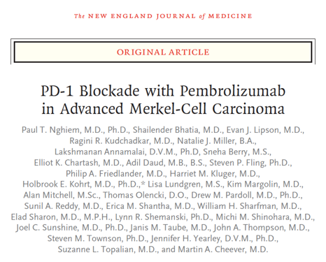
80 yrs-old man with multi-focal, MCPyV-ve MCC on the scalp
Pembrolizumab
[CITN-09 trial]
N = 24
ORR = 56%
01/2015
Pembrolizumab
{Nghiem P, Bhatia S et al NEJM 2016}

Slide 32
Progressive disease despite PD-1 blockade
Pembrolizumab
[CITN-09 trial]
01/2015
05/2015

Slide 33
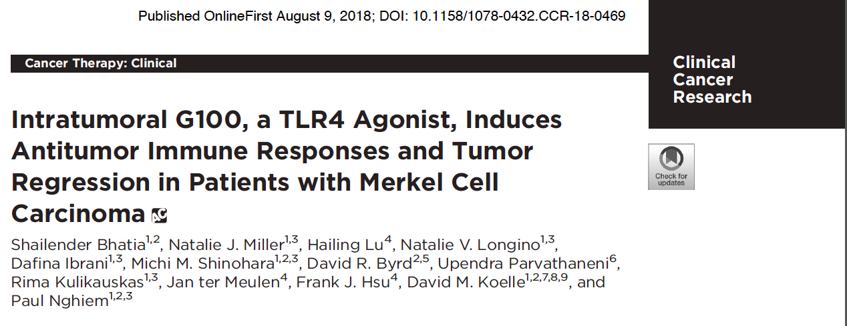
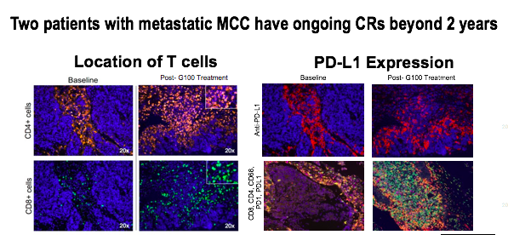
Next, IT TLR-4 injections were tried on a clinical trial
Intra-tumoral TLR4
05/2015
{Bhatia S et al CCR 2018}

Slide 34
Progressive disease with significant symptoms
Intra-tumoral TLR4
05/2015
07/2015

Slide 35
Salvage Neutron RT resulted in disease control
07/2015
Upendra Parvathaneni, MD
Rad Onc, UW
09/2015

Slide 36
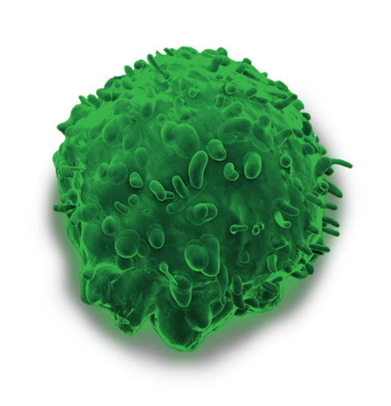
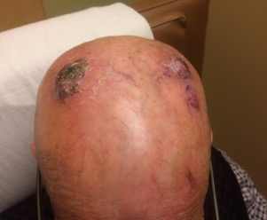
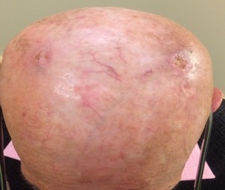
A few months later, had PD outside the RT fields, and enrolled on a trial using NK cells
CD2
CD69
CD94
Inhibitory Receptors
Innate CARS
NKG2
Universal Off the Shelf
NKG2D
2B4
aNK
CD16
NKp30, 44, 46
LFA-1
Baseline (Day 1)
O3/14/2016
Day 14
3 months
4 months
{Bhatia S et al SITC Annual Mtg 2019}

Slide 37
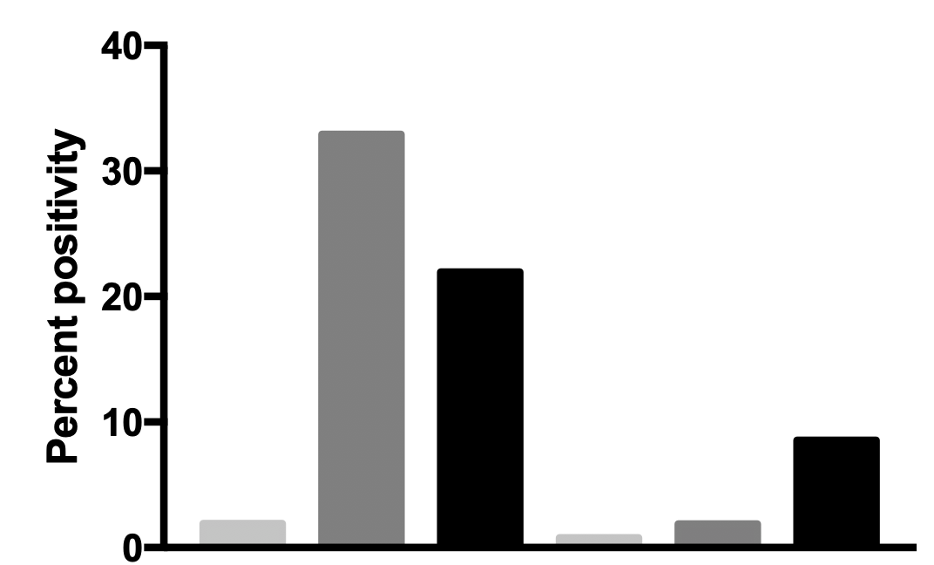
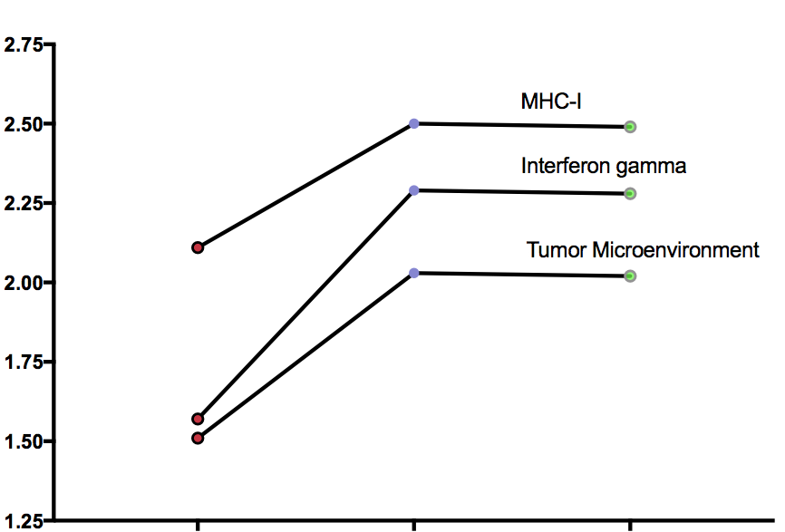
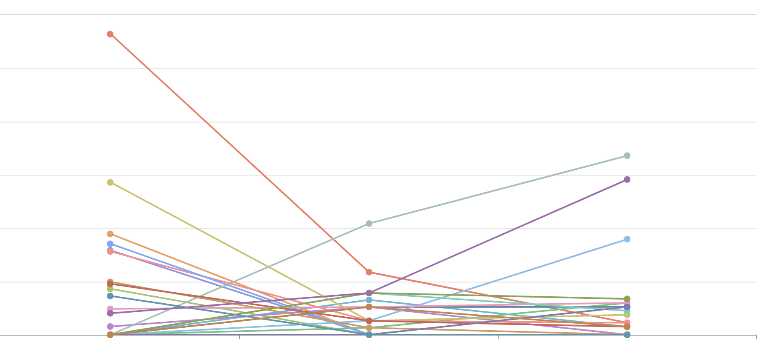
A
B
● CD8
● PD-L1
● Nuclei
Tumor
Stroma
Tumor
Tumor
Tumor
Stroma
Stroma
Pre
1.8
4.5
PD-L1
CD8
C
Months from Start of Therapy
D
15
MHC class I signature
12.5
Interferon gamma signature
10
Tumor inflammatory signature
TCR Beta clones
Productive frequency (%)
Gene Expression score
7.5
5
2.5
0
pre
1.8
4.5
pre
1.8
4.5
Time since treatment initiation
(months)
Time since treatment initiation (months)
Notes:
Figure 4: Immune related tumor microenvironment changes after treatment with aNK cells. A) Representative 20x magnified images of mIHC staining of FFPE tumor sections for 3 different timepoints (baseline, 1.8 months and 4.5 months post-therapy). Blue = cell nuclei, magenta = PD-L1, yellow = CD8. Tumor edge is denoted by a green line. B) HALO quantification showing percent of PD-L1 or CD8 expressing cells within the tumor at baseline, 1.8 months post treatment initiation and 4.5 months post-treatment initiation. C) Gene expression scores from NanoString PanCancer Immune Panel demonstrating an increase in expression of the adaptive immune response in the tumor microenvironment. MHC class I, Interferfon gamma and tumor microenvironment gene sets are shown over the course of therapy. D) Productive frequency of unique T cell receptor (TCR) beta chains sequenced from tumor biopsies from pre-treatment, 1.8 months post treatment initiation and 4.5 months post-treatment initiation. Top 10 clones for each timepoint is shown and each clone is tracked and connected by a unique colored line.

Slide 38
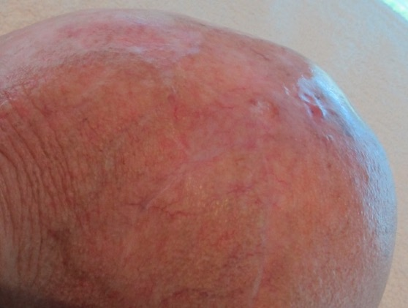
Despite radiologic CR, he had residual disease at 6 months and hence was rechallenged with pembrolizumab.
Pembro
6 months on aNK
Durable clinical and radiologic CR ensued
Pembrolizumab re-challenge led to durable CR, ongoing at >5 years later in 2022, when patient died from a non-MCC cause

Slide 39
Lessons learnt

Slide 40
Be relentless in the pursuit of a successful immune response against cancer cells
Required 6 different treatment regimens before achieving durable disease control!

Slide 41
Prioritize immunotherapy clinical trials whenever feasible and appropriate
3 clinical trials were attempted before achieving durable disease control!

Slide 42
Kinetics of successful immunotherapy responses demand patience
Baseline (Day 1)
O3/14/2016
Day 14
3 months
4 months

Slide 43
Optimize disease control prior to immunotherapy: Value of debulking
vs.

Slide 44
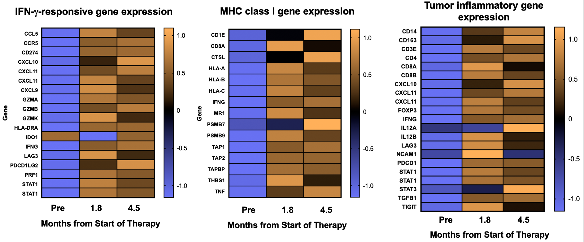
Most cancers are “immunogenic” – we just need to find the right immunotherapy for each patient!
4 different immunotherapy regimens were tried before demonstration of “immunogenicity” in our patient.

Slide 45
Thank you for your attention!
Questions or comments:
sbhatia@uw.edu
connectED@sitcancer.org
The Practical Management Pearls and Case Studies Webinars are part of the Cancer Immunotherapy Clinical Practice Guidelines Advanced Webinar Series supported, in part, by grants from Amgen and Merck & Co., Inc. (as of 9/15/2021)

Slide 46
Case III - Immunotherapy in Challenging Populations in NMSC
Zeynep Eroglu
Moffitt Cancer Center, Tampa, FL
October 28, 2022
The Practical Management Pearls and Case Studies Webinars are part of the Cancer Immunotherapy Clinical Practice Guidelines Advanced Webinar Series supported, in part, by grants from Amgen and Merck & Co., Inc. (as of 9/15/2021)

Slide 47
Disclosures
Advisory boards: Regeneron, Pfizer, Genentech, Natera, Eisai, OncoSec, Novartis
Research funding: Pfizer, Boehringer-Ingelheim

Slide 48
Case presentation
51 year old lady with of reflux nephropathy s/p a living-related donor kidney transplant in 1984 & deceased donor kidney transplantation in 2012
On tacrolimus, mycophenolate, and prednisone. Started to have cSCCs ~ 7 years ago
In 12/2018 - Diagnosed with multifocal, fungating squamous cell carcinoma of the chest area initially not felt to be resectable
Underwent radiation therapy chest/breast area and mid sternal early 2019
Given recurrent disease, she underwent bilateral mastectomies on 4/2019, along with resection of a neck SCC, and multiple other skin lesions
After further recurrence of SCCs in the mastectomy bed, presented for systemic treatment options

Slide 49
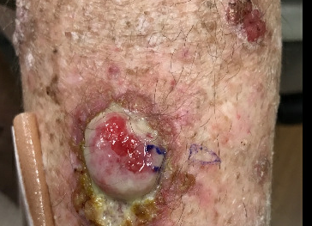
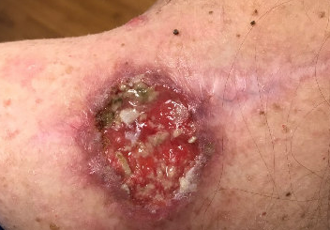
Case presentation

Slide 50
Higher risk of cSCC in immunosuppressed patients
Immunosuppression, directly from disease or its treatment → the strongest host risk factor for poor outcomes in cSCC
Immunosuppressed populations: organ transplant recipients (OTRs), CLL, lymphoma, drug-induced immunosuppression, HIV
CLL (impairs host immune function) → 8X increased risk of cSCC)
Non-Hodgkin lymphoma → 5X increased risk
HIV→ 2.6X increased risk - correlates inversely with CD4 count
Rheumatoid arthritis on MTX – 2 to 4X increased risk
OTR → 65 to 200X increased risk of cSCC
Levine et al., JAMA Derm 2015

Slide 51
Higher risk of cSCC in organ transplant recipients
cSCC burden in OTRs strongly correlates with increasing time after transplant and intensity of immunosuppression
Correlating with intensity of immunosuppression needed → highest risk in cardiac and lung transplants, then pancreas and/or kidney, then liver transplants
Pre-transplant history of skin cancer
Higher in sunnier climates (DNA damage caused by UV radiation augmented by direct effects of immunosuppressive agents and decreased immune surveillance → reduced ability to eradicate precancerous changes in the skin)
Direct or contributory carcinogenic effects of immunosuppressive agents
Levine et al., JAMA Derm 2015

Slide 52
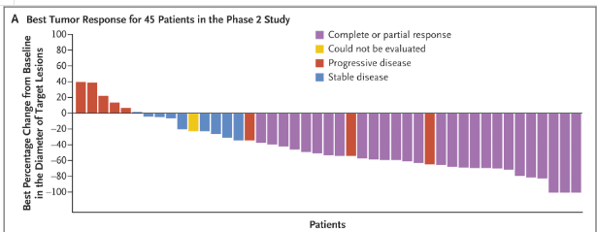
Cemiplimab in advanced cSCC –
Migden et al., NEJM 2018
NCCN Guidelines, nccn.org 2022

Slide 53
Immunotherapy in Organ Transplant Recipients
CTLA-4 and PD-1 axes have an important role in influencing balance between Treg induction and effector T cell function to restrain or promote allograft responses
Case reports acute graft rejection and subsequent graft failure with immunotherapy
39 pts with OTR - 15% cSCC, 77% tx anti-PD-1 - 59% with renal, 28% hepatic, and 13% cardiac transplants
Transplant rejection in 41% of patients - similar rates for anti-CTLA-4 and anti-PD-1 therapy
Median time to rejection - 21 days
31% of permanently discontinued immunotx because of rejection
Graft loss in 81%
Death in 46% (from organ rejection or rejection complications)
Of the 12 with transplantation biopsies, 75% had acute rejection, and 5 of these rejections T cell-mediated
Abdel-Wahab et al, Journal for Immunotherapy of Cancer, 2019
Abdel-Wahab, Journal for Immunotherapy of Cancer, 2019

Slide 54
Case presentation
Patient started on cetuximab May to August 2019
 | Monoclonal antibodies |  | Tyrosine kinase inhibitors
 | Cetuximab¹ | Panitumumab² | Erlotinib³ | Gefitinib⁴
Eligibility | Unresectable laCSCC or mCSCC | laCSCC, mCSCC or recurrent CSCC | Unresectable locoregional recurrent or mCSCC | Unresectable locoregional recurrent or mCSCC
N | 36 | 16 | 39 (29 evaluable) | 40 (37 evaluable)
ORR, % (n/N) | 28 (10/36) | 31 (5/16) | 10 (3/29) | 16 (6/37)
DCR, % (n/N) | 69 (25/36) | 69 (11/16) | 72 (21/29) | 51 (19/37)
Median OS, months (95% CI) | 8.1 (6.9–9.3) | 11 (NR) | 13 (8.4–20.5) | 12.9 (8.5–25.0)
Median PFS, months (95% CI) | 4.1 (1.7–5) | 8 (NR) | 4.7 (3.5–6.2) | 3.8 (2.2–5.7)
Median DOR, months (95% CI) | 6.8 (4.1–8.3) | 6 (5–17.5) | NR | 31.4 (3.91–NR)
1. Maubec E, et al. JCO 2018, 2. Foote MC, et al. Ann Oncol 2014, 3. Gold KA, et al. Cancer 2018, 4. William Jr WN, et al. J Am Acad Dermatol 2017 5. Ribero S, et al. Curr Opin Oncol 2017

Slide 55
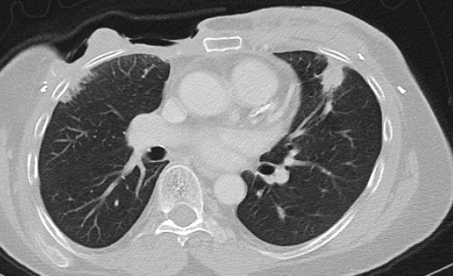
Case presentation
No response to cetuximab
Treated with chemotherapy: carboplatin/paclitaxel – no benefit
Biopsy proven pleural metastases diagnosed 8/2020
Enrolled into clinical trial for kidney transplant patients
Started on nivolumab 9/2020
No rejection
Response of lung mets
Progression of pectoral/axillary mets

Slide 56
Nivolumab + tacrolimus + prednisone +/- ipilimumab for kidney transplant recipients with advanced cutaneous cancers
Immunosuppressive regimen
TACRO
(serum trough goal 2-5 ng/mL)
+
PRED 5 mg daily
CR/PR/SD
NIVO for up to 96 weeks
NIVO 480 mg IV q4 weeks
IPI 1 mg/kg
+
NIVO 3 mg/kg
q3 weeks
PD
CR, complete response; SD, stable disease; PD, progressive disease; PR, partial response
Schenk, et al., ASCO 2022

Slide 57
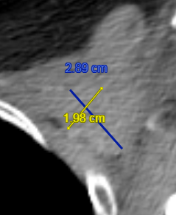
Case presentation
1/2021 - Switched to ipilimumab 1 mg/kg + nivolumab 3 mg/kg on trial
With treatment response after ipi/nivo– with subsequent progression on nivo monotherapy 7/2021

Slide 58
IPI + NIVO: Complete tumor regression in 2/6 patients
Marked tumor regression by 6 weeks in 2 patients (33%) with eventual complete response (CR)
Progressive disease (PD) in 4 patients (67%)
2 patients with treatment-related allograft loss
 |  | NIVO |  | CD8+ IHC (0-3+)* |  | IPI + NIVO
Pt ID | Diagnosis | Tumor response | Allograft loss | TACRO + PRED | TACRO + PRED+ NIVO | Tumor response | Allograft loss
1 | MCC | PD | N | 1 | 1 | PD | N
2 | CSCC | PD | N | 1 | 2 | CR | N
3 | MCC | PD | N | 1 | 0 | PD | Y
4 | CSCC | PD | N | 1 | ND | PD | N
5 | CSCC | PD | N | 1 | ND | N/A | N/A
6 | CSCC | PD | N | 3 | 2 | CR | Y
7 | MEL | PD | Y | 1 | 1 | PD | N
8 | CSCC | PD | N | 1 | ND | N/A | N/A
*infiltrate was graded as none (0), mild (1), moderate (2), or severe (3). Taube, et al. Sci Trans Med 2012
CR, complete remission; ND, not done; N/A, not applicable
Schenk, et al., ASCO 2022

Slide 59
Case presentation
Underwent excision of select SCC lesions
9/2021 - re-challenged with ipilimumab 3 mg/kg + nivolumab 1 mg/kg x4 cycles
Stopped immunotherapy given new skin lesions
2/2022 – scans with improvement in all lesions
In 1/2022 – also switched tacrolimus to sirolimus
Disease overall remains under control since then

Slide 60
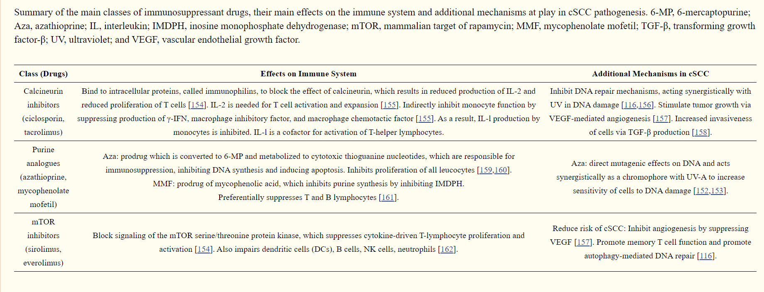
Types of immunosuppressive drugs
Bottomley et al., Int Journal of Molecular Sciences, 2019

Slide 61
Immunotherapy in Challenging Populations
Need more information on safety and efficacy of immunotherapy drugs in patients with solid organ transplants
If immunotherapy needs to be utilized, strong consideration for clinical trials and treatment at academic centers – multiD approach with surgeons, dermatologists, Rad-Oncs, Med-Oncs
Must involve transplant physicians in decision-making
Consider minimizing and optimizing immunosuppression
May need to consider surgery and radiation for select resistant lesions
May need to consider combination immunotherapy despite increased risk of allograft rejection

Slide 62
Thank you
The Practical Management Pearls and Case Studies Webinars are part of the Cancer Immunotherapy Clinical Practice Guidelines Advanced Webinar Series supported, in part, by grants from Amgen and Merck & Co., Inc. (as of 9/15/2021)

Slide 63
Q&A
How to Submit Questions
Click the “Q&A” icon located on at the bottom of your Zoom control panel
Type your question in the Q&A box, then click “Send”
Questions will be answered in the Question & Answer session at the end of the webinar (as time permits)

Slide 64
Notes:
Our Advances in Cancer Immunotherapy series has accredited online courses available now. Visit sitcancer.org/aci for more information.

Slide 65
Notes:
Get direct, easy, portable access to our immunotherapy guidelines with the SITC Clinical Practice Guidelines (CPG) Mobile App, available for free on the App Store and Google Play Store. Learn more at sitcancer.org/CPG-app

Slide 66
Thank you for attending the webinar!
Questions or comments: connectED@sitcancer.org
The Practical Management Pearls and Case Studies Webinars are part of the Cancer Immunotherapy Clinical Practice Guidelines Advanced Webinar Series supported, in part, by grants from Amgen and Merck & Co., Inc. (as of 9/15/2021)
Notes:
And finally, a recording of this webinar and the presentation slides will be made available on the SITC website. All attendees will receive information on how to access these in the coming days. If you have any questions or comments about this webinar, please email connectED@sitcancer.org.

