Slide 1
Development of Grant / Translational Idea
SITC Cancer Immunotherapy Winter School
January 20, 2023
Sumit K. Subudhi, MD, PhD
Associate Professor
Genitourinary Medical Oncology

Slide 2
Disclosures
Consulting or Advisory Role: Amgen, Apricity Health, Arcus Biosciences, Bayer, Boxer Capital, Breaking Data, Bristol-Myers Squibb, Cancer Expert Now, Dava Oncology, Dendreon, Exelixis, InProTher, Kahr Bio, Janssen Oncology, Javelin Oncology, MD Education Limited, and The Clinical Comms Group
Research Funding: AstraZeneca, Bristol-Myers Squibb, and Janssen Oncology
Other (Joint Scientific Committee): Amgen, Janssen Oncology, and Polaris
I will be discussing non-FDA approved indications during my presentation.

Slide 3
Where Do You Start?
Mentors
Colleagues
High profile papers / Journal clubs
Scientific meetings
Request for applications (RFA)

Slide 4
Ideas
Importance of an issue (e.g., Reducing mortality of immune-mediated myocarditis)
Resolving a question (e.g., Why are bone and liver metastases resistant to immune checkpoint therapies)
Find something surprising (e.g., B cells play an important role in response and toxicities to immune checkpoint therapies)

Slide 5
Request for Application (RFA)
Details
Funding
Years

Slide 6
Define Translational Research
Bench-Bedside
Bedside-Bench-Bedside
Bedside-Bedside

Slide 7
Approach
Collaborators
Resources (cell lines, animal models, patient samples, clinical trials)
Technology (scRNA seq, ATAC-seq, CyTOF, CODEX)
Feasibility

Slide 8
Cases and Fatality Rates for Different Types of irAEs
Wang DY et al, JAMA Oncol 2018

Slide 9
Co-Occurring Fatal irAEs
Wang DY et al, JAMA Oncol 2018

Slide 10
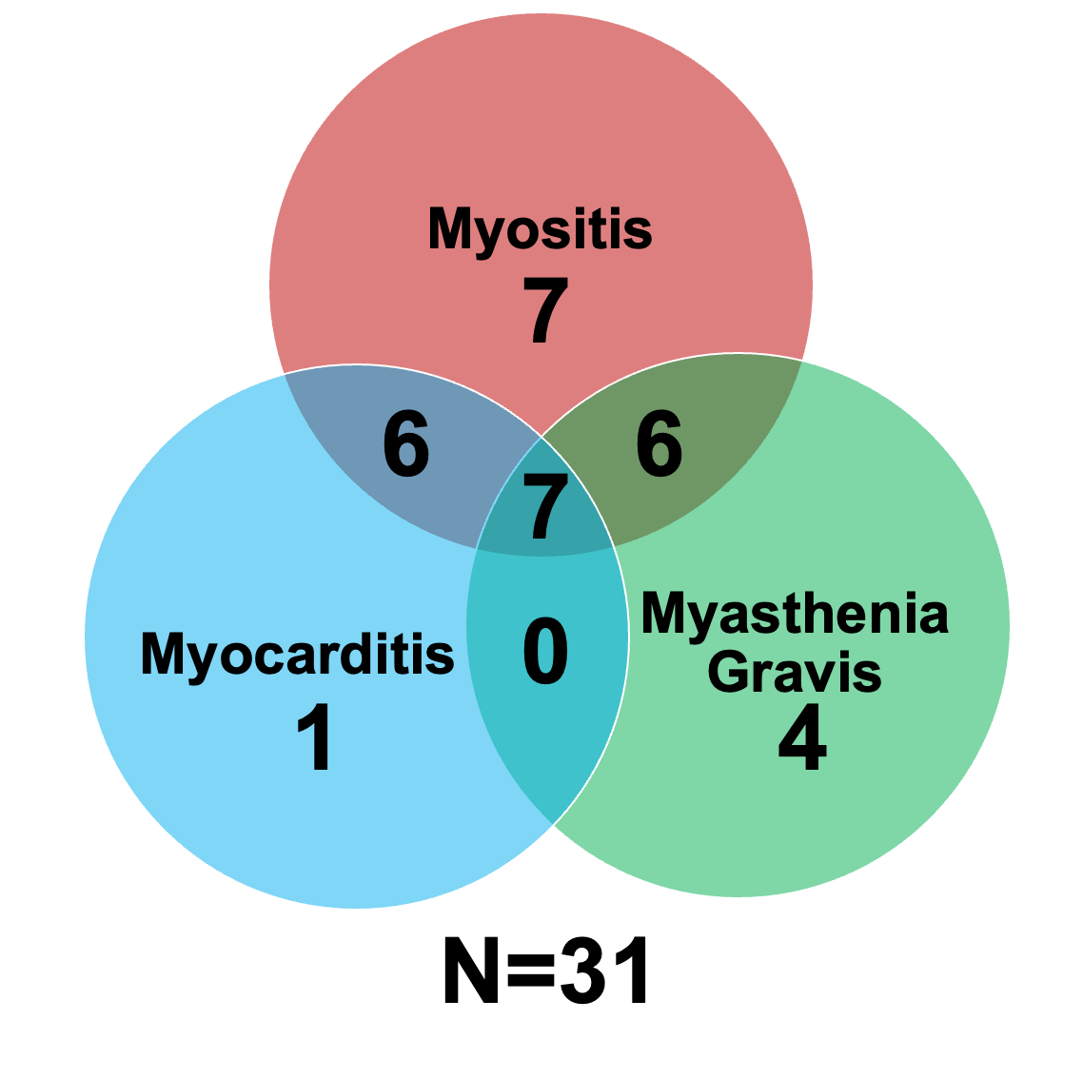
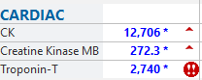
Series of Neuromuscular (NM) and Cardiac Toxicities

Slide 11
Shared Symptoms

Slide 12
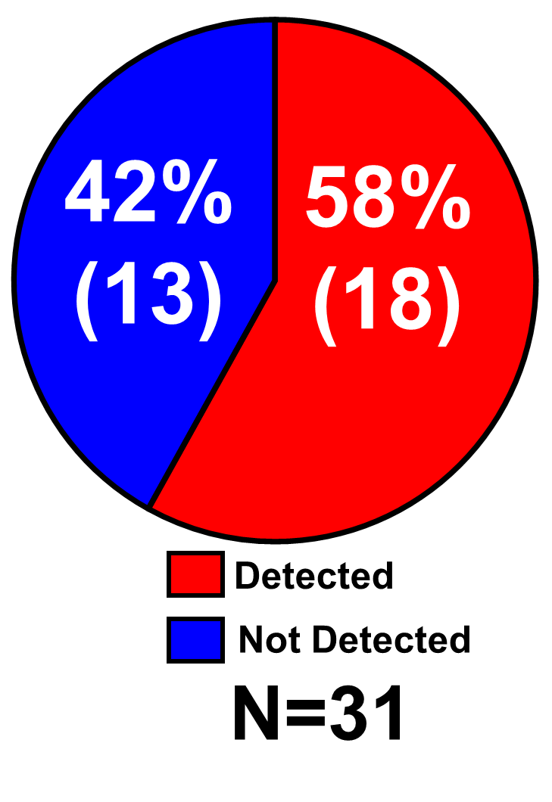
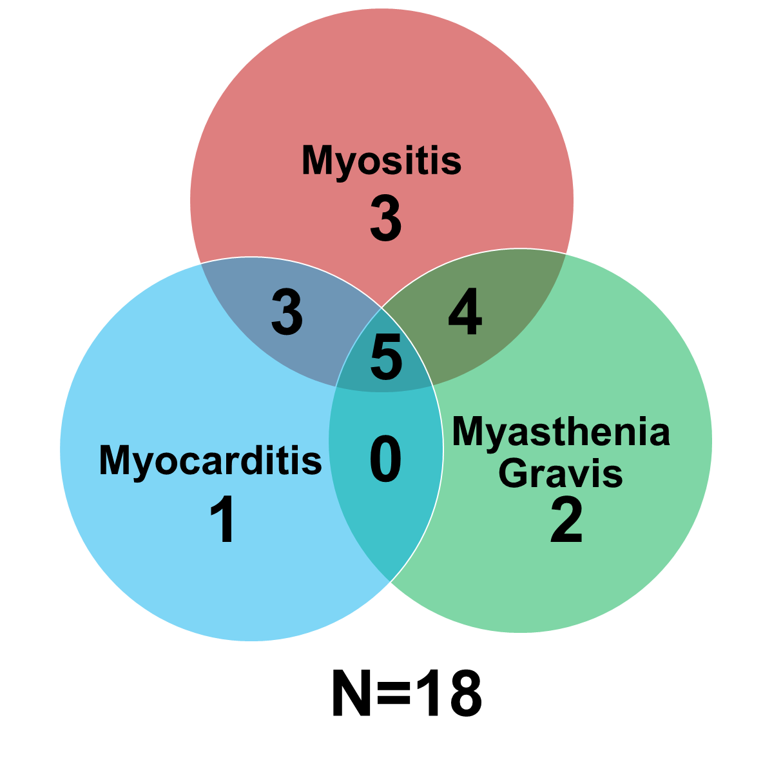
Autoantibodies

Slide 13
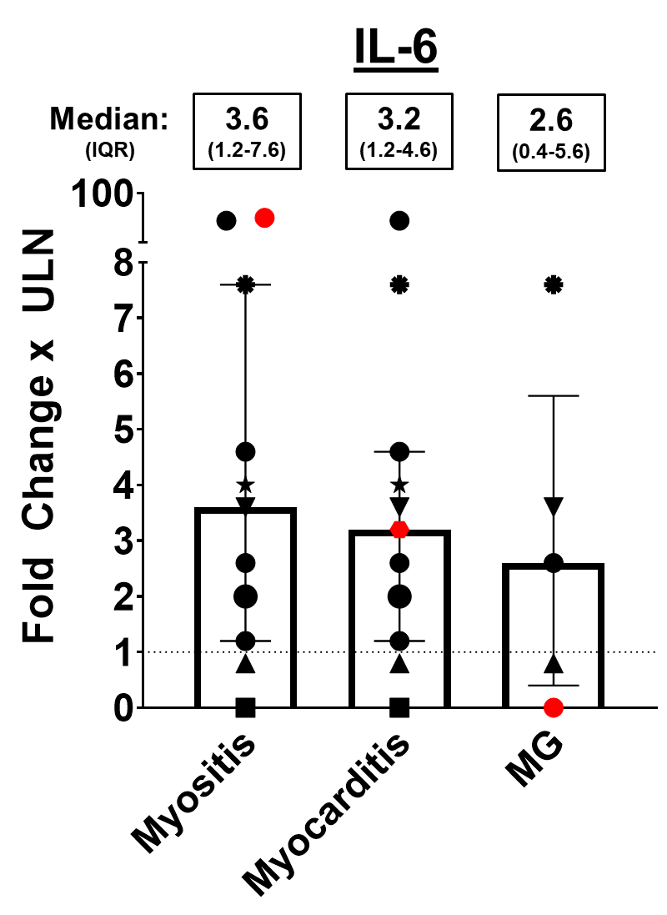
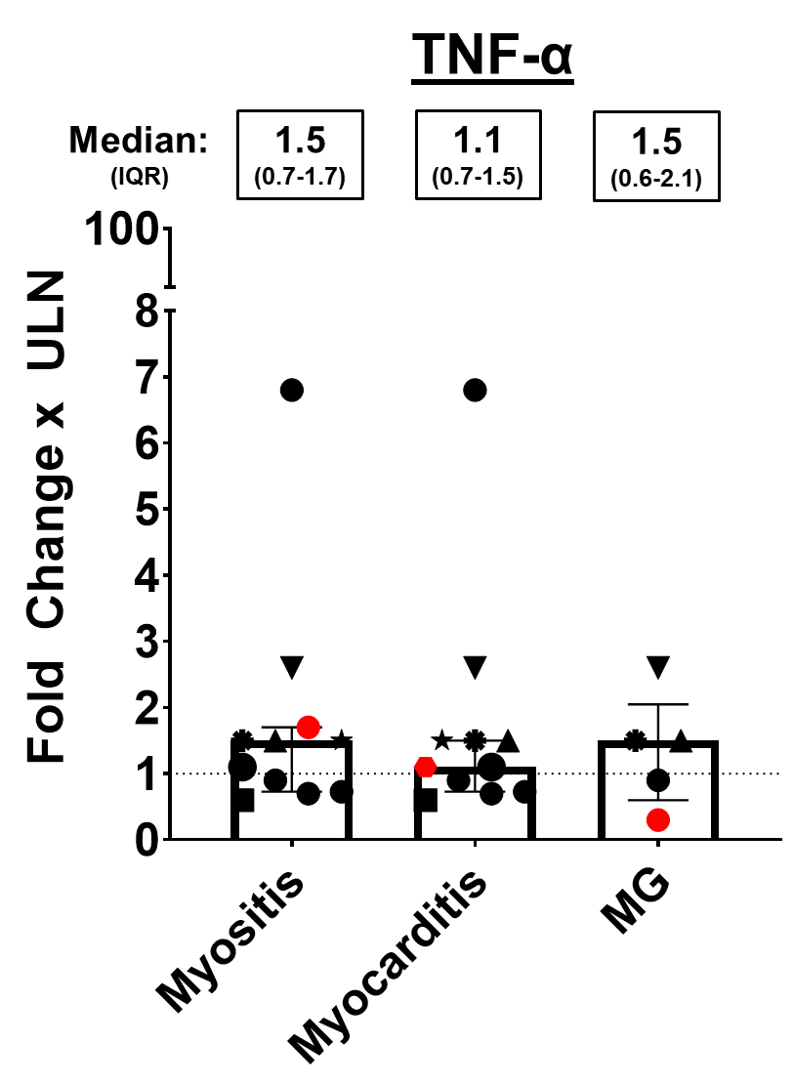
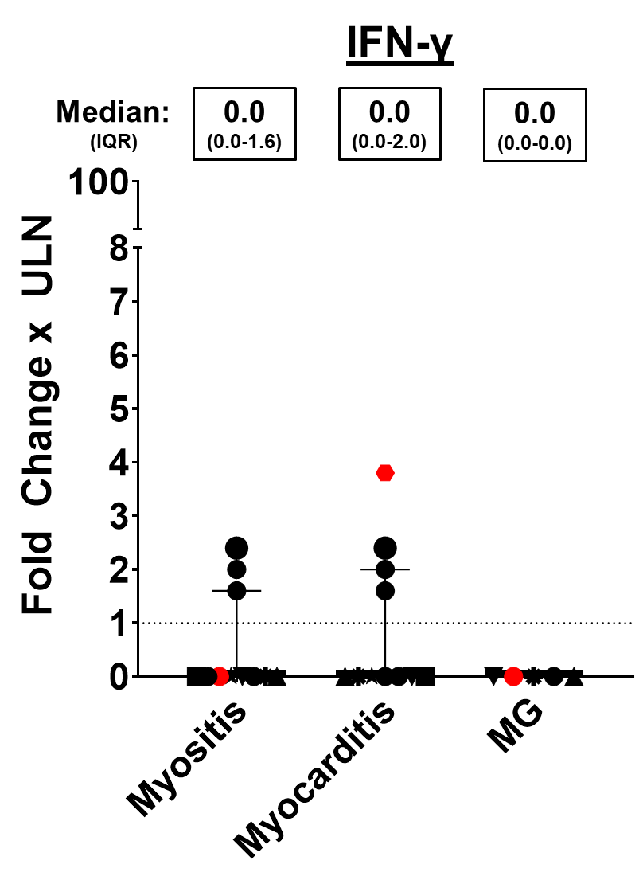
Serum Cytokines

Slide 14
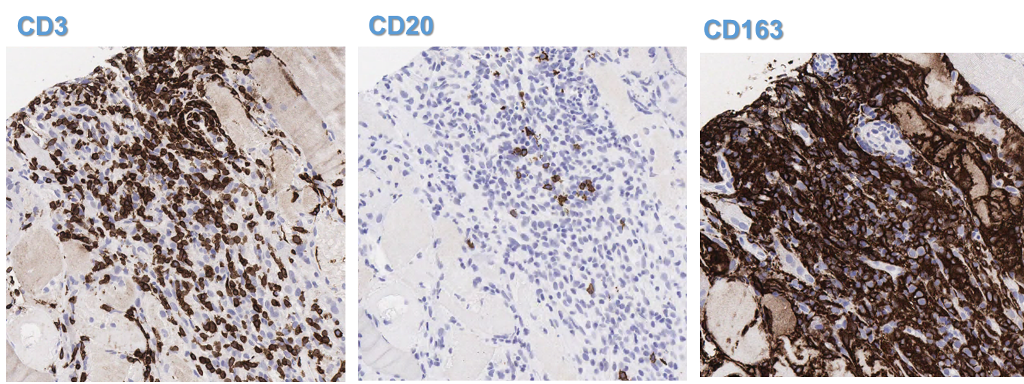
Immunohistochemistry of Myocarditis Tissue

Slide 15
Title / Specific Aims
Identifying Predictive Biomarkers for Early Detection and Intervention to Improve
Outcomes in Severe Cardiac and Neuromuscular Immune-Related Adverse Events (irAEs)
Aim 1: To define immune pathways associated with ICT-induced myocarditis, myositis, and MG in inflamed cardiac and skeletal muscles to inform rational immunosuppressive strategies.
Aim 2: To identify candidate predictive immune blood biomarkers for ICT-induced myocarditis, myositis, and MG, informed by the inflamed muscle tissue microenvironment.
Aim 3: To detect ICT-induced myocarditis, myositis, and MG earlier using a digital health platform for patient-reported symptom monitoring.

Slide 16
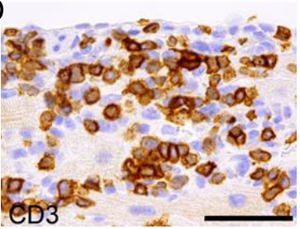
Immune-Related Myocarditis: Co-Clinical Approach
Patient
Mouse Model
Balanescu et al, Cardiovasc Path 2020
Wei SC et al, Cancer Discov 2020

Slide 17
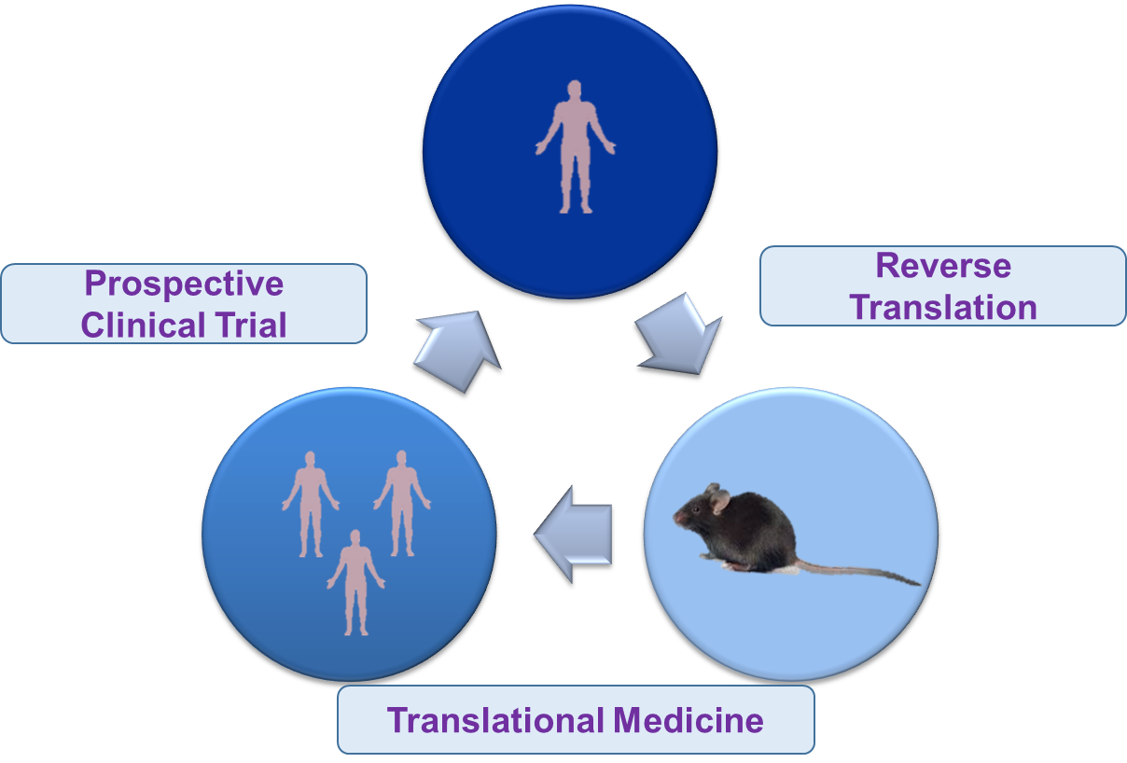
Reverse Translation Enables Efficient Identification of Biologically Relevant Biomarkers

