Slide 1
Operationalizing Delivery of TIL Therapy at Your Institution
Brian Gastman, MD
Professor of Surgery
Departments of Plastic Surgery, ORL and Immunology
Surgical and Co-director of the CCF Melanoma and High Risk Skin Cancer Program

Slide 2
Disclosures
Dr. Gastman is a consultant and researcher for Instil Bio, Inc. and Iovance, Inc.

Slide 3
Why melanoma?

Slide 4
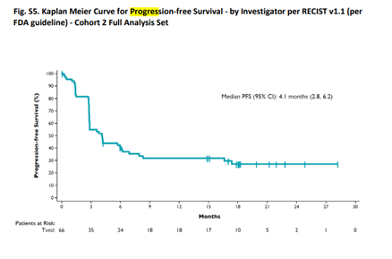
Melanoma is also the standard in immunotherapy
Highly sensitive
Most studied tumor
Likely 50% of Stage IV are cured
Led to Nobel Prizes and still….
Yet to date, only one large, published, multi-institutional study of SOC refractory melanoma with a significant ORR
The ORR was 36% (95% CI, 25 to 49), with two complete responses and 22 partial responses

Slide 5
TIL Therapy for Treatment of Advanced Melanoma

Slide 7
Workflow
Patient assessment
Patient assessment
Surgery + tumor handling
TIL expansion
Lymphodepletion
TIL + IL2 administration
Observation period
Disease assessment and survival period

Slide 8
Potential candidate for TIL therapy
Clinical trials
After FDA approval:
Will I give TILs to patients with different indications?
Advanced (unresectable or metastatic) melanoma
Failed all SOC therapies (ICI, targeted therapies,…)
Expected survival > 3 months
Will I offer TILs as a first choice?
Physicians clinical judgment instead of eligibility criteria by screening
conservative?
aggressive?
RISK

Slide 9
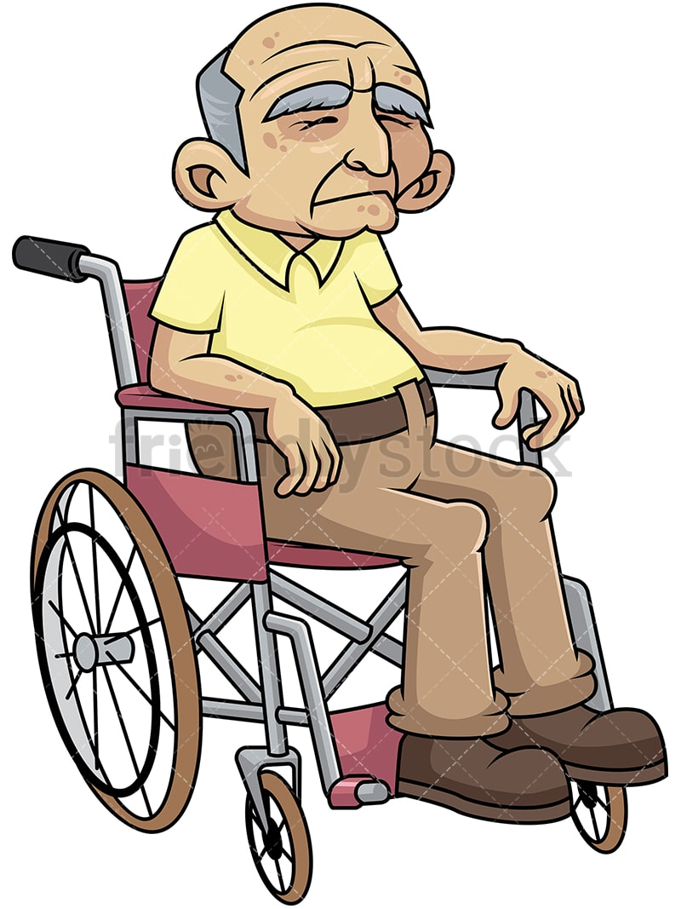
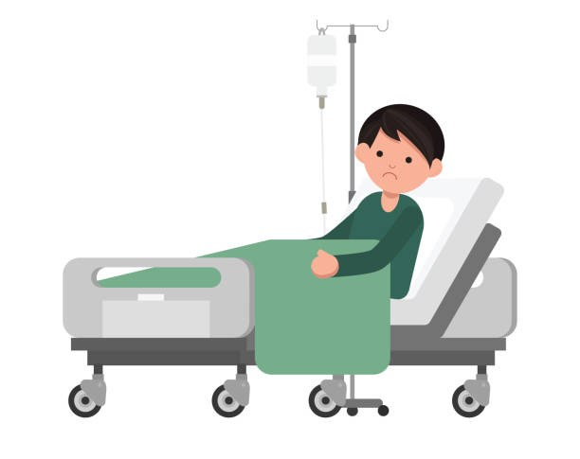
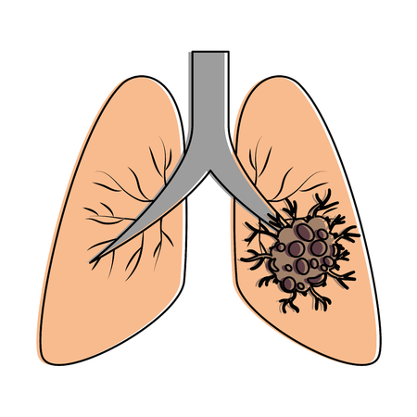
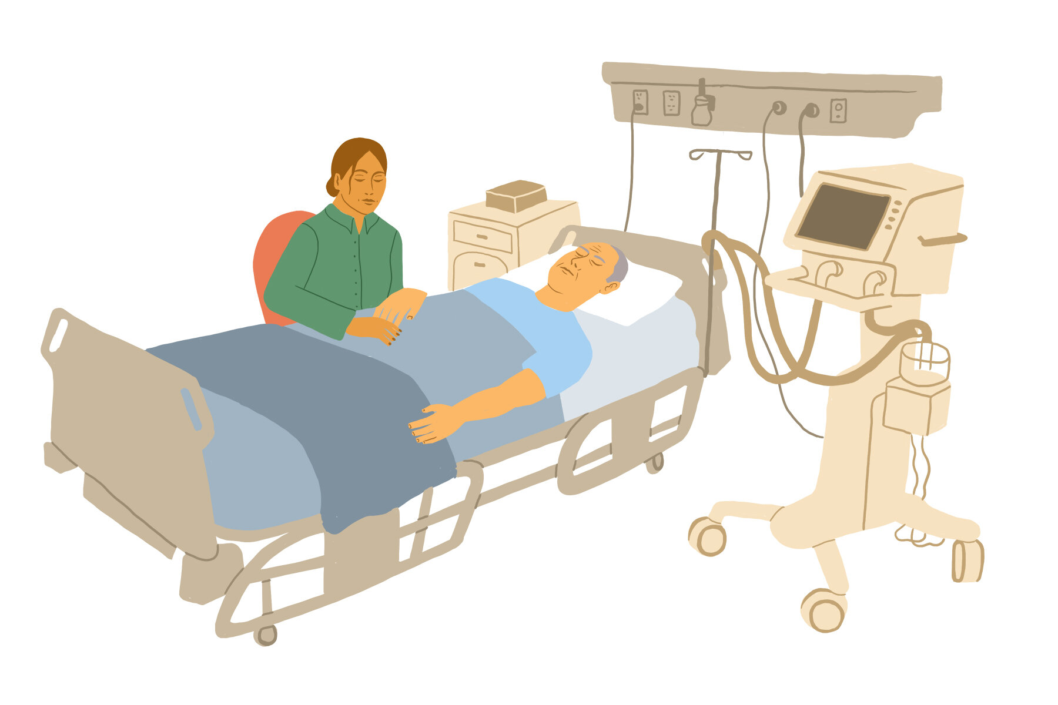
Who do we treat?

Slide 10
Clinical trial exclusion criteria
AI disease
ECOG
?
?
Previous malignancy
?
Age
?
Tumor size
?
Pregnancy
?
Cardiac function
?
CNS metastases
?
?
GFR
Non-melanoma cancer
?
Medical oncologist – Surgeon

Slide 11
Workflow
Surgery + tumor handling
Patient assessment
Surgery + tumor handling
TIL expansion
Lymphodepletion
TIL + IL2 administration
Observation period
Disease assessment and survival period

Slide 12
Surgery
Clinical trials
After FDA approval:
Sample of >2g / > 1.5 cm in diameter post-resection
Can be comprised of samples from multiple lesions at minimum 1 remaining measurable lesion as identified by CT or MRI per RECIST v1.1
Will a smaller size be sufficient for treatment?
OR team(s)

Slide 13
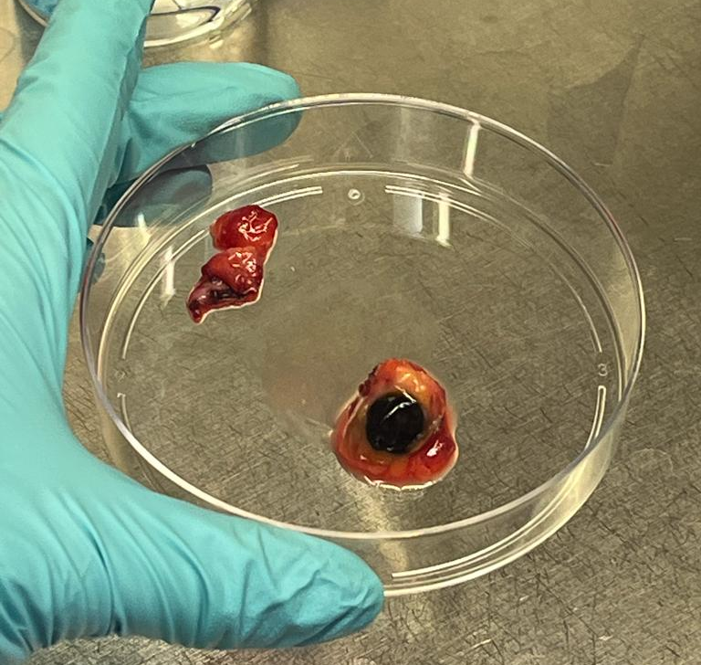
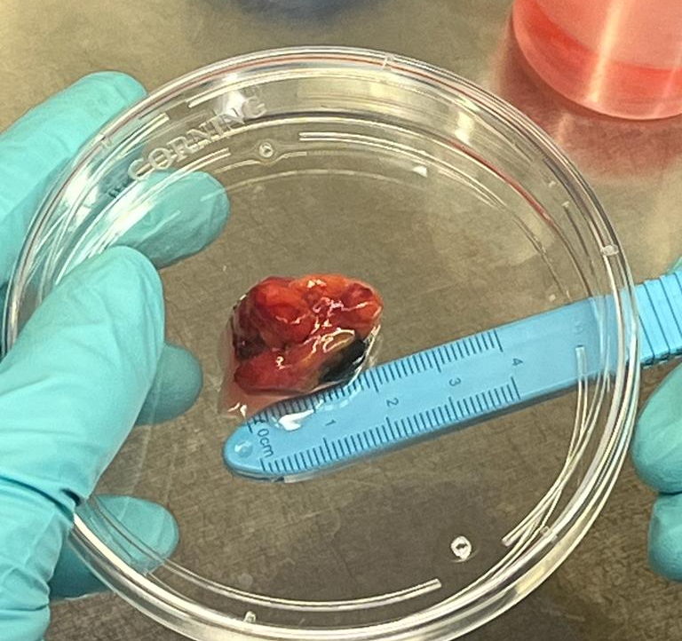
SIZE: 2.9g
TUMOR CELLS total:10.5x10⁶
TILs total: 7x10⁶
IO status: ICI experienced
SIZE: 650g
TUMOR CELLS total: 980x10⁶
TILs total: 168x10⁶
IO status: ICI experienced

Slide 14
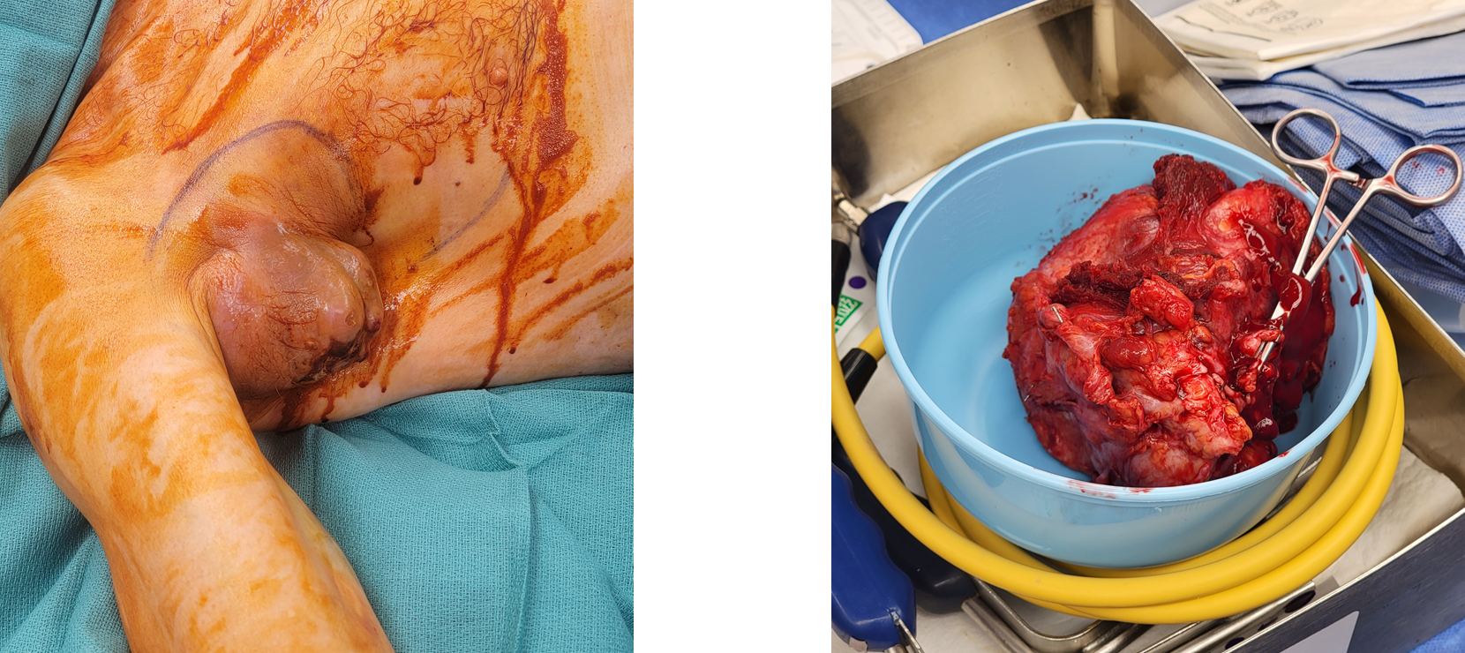
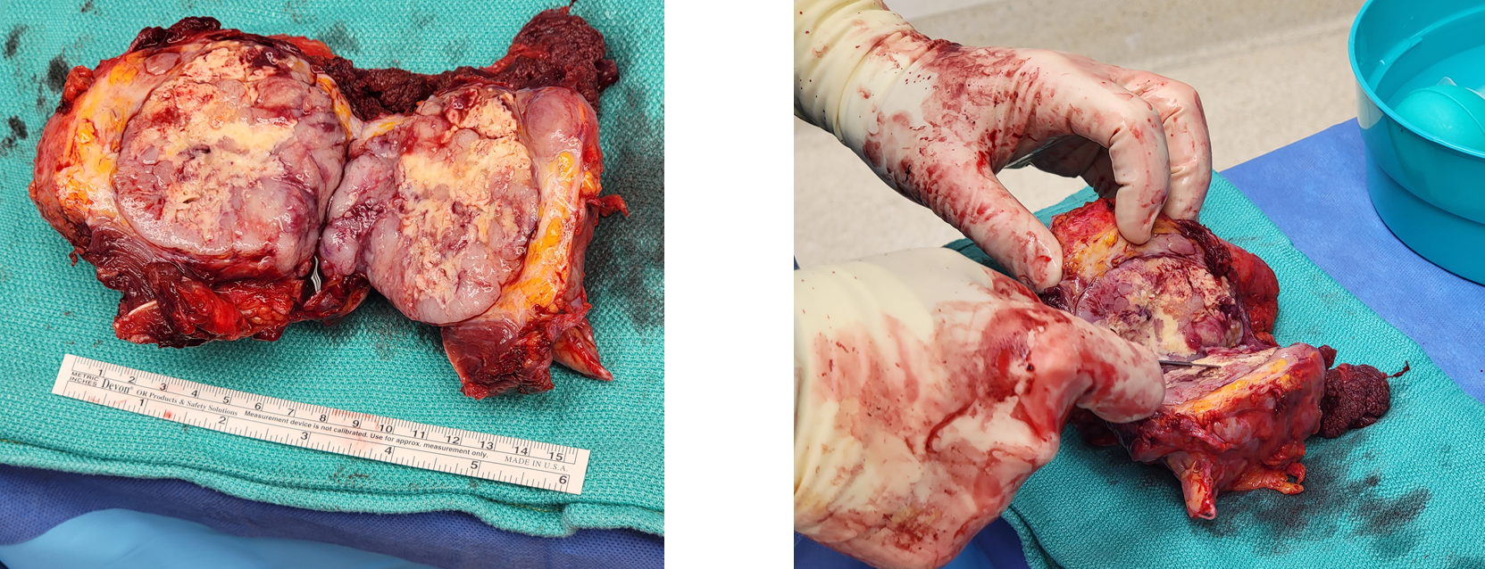
Should we remove the whole tumor or just enough for TIL expansion? Which part of the tumor do we send for TIL expansion?
Pre-op palliative R TLND/Axilla; stage IV disease
7 months post-op still with stage IV disease

Slide 15
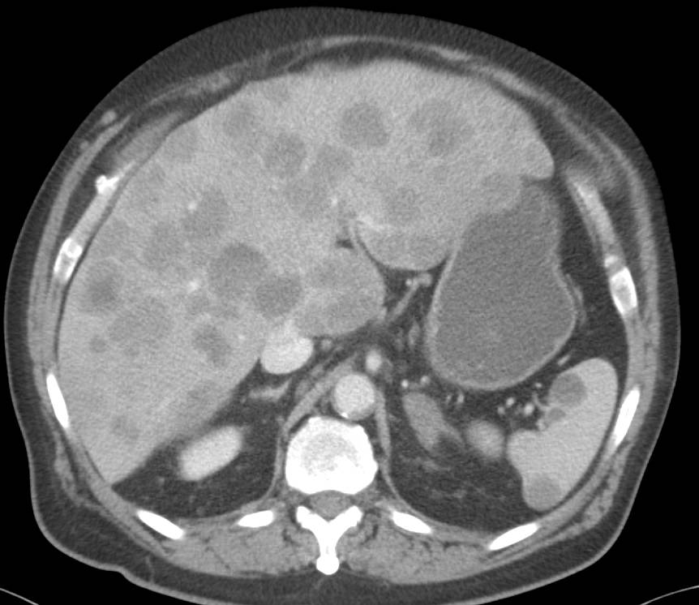
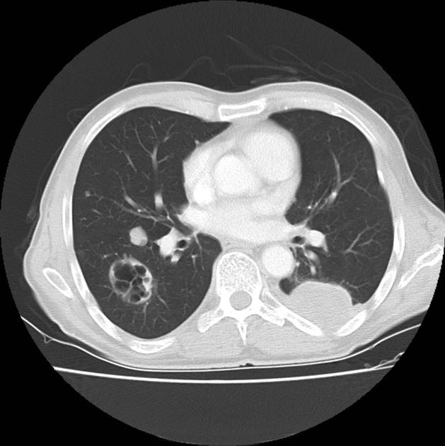
Coordination with specialized surgeons based on tumor location
Will these surgeons be on board?
conservative?
aggressive?
RISK

Slide 16
Tumor handling and hand-off
Tumor is collected in the OR. Will it be on the day your surgeon can operate?
Processed the same day at the institution -> schedule surgery for AM hours
Coordinate with company for tumor pick-up
Multiple reasons to talk with pathology
Company tissue procurement specialist
Clinical coordinator
OR team (s)
Pathologist

Slide 17
Workflow
Patient assessment
Surgery + tumor handling
TIL expansion
Lymphodepletion
TIL + IL2 administration
Observation period
Disease assessment and survival period
TIL expansion

Slide 18
Differences in tumor handling
Different companies use different processes and not always will they have capacity.
This could affect who you work with.
https://patents.google.com/patent/EP3730608A1/en?q=Processes+for+production+of+tumor+infiltrating+lymphocytes+and+uses+same+in+immunotherapy&oq=+Processes+for+production+of+tumor+infiltrating+lymphocytes+and+uses+of+same+in+immunotherapy

Slide 19
TIL expansion (GMP facility)
Minimum of 5 x10⁹ viable T cells
→ not sufficient TILs? Second tumor resection
Can take up to 6-8 weeks
Will a smaller number of TILs be as effective?
Should we treat patients in the meantime?
Clinical trials
After FDA approval:
Once hospital receives expanded TILs from the manufacturing facility, patient can start LD
Notes:
It mandates that ATMP production requires compliance with the Good Manufacturing Practices (GMP) guideline (2003/94/EC).4 This translates into a requirement for a solid quality system, suitable investments, and effective logistical preparation

Slide 20
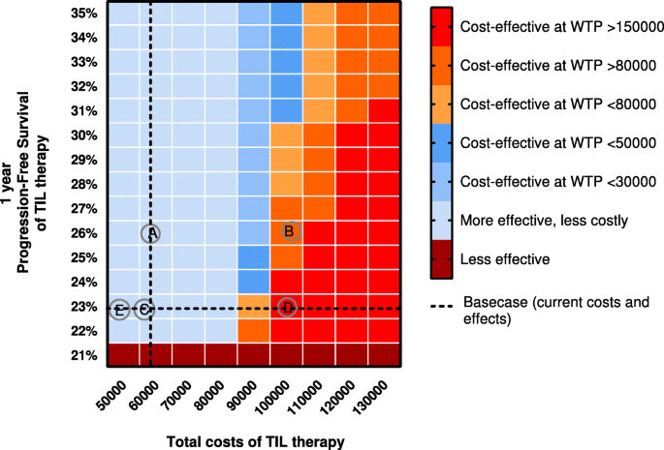
Where do I expand the TILs?
Outsourcing (D) vs Automatic (E) TIL expansion
Likely multiple companies in the future:
Availability
Processing differences
Cost
Experience with company – interval communication – managing expectation
Published ORR, which settings (refractory, primary, in combination)
Lindenberg, M., Retèl, V., Rohaan, M. et al. Evaluating different adoption scenarios for TIL-therapy and the influence on its (early) cost-effectiveness. BMC Cancer 20, 712 (2020). https://doi.org/10.1186/s12885-020-07166-9
Notes:
a = “TIL more effective”, b = “Combination therapy”, c = “Less IL2 treatment”, d= “TIL production outsourced”, e = “Automatic TIL production”.
Biologics license application
https://www.fool.com/investing/2021/04/29/at-a-recent-cancer-research-conference-instil-bio/
https://seekingalpha.com/news/3740071-iovance-gains-over-10-with-readthrough-from-instil-bios-regulatory-win
https://ir.iovance.com/news-releases/news-release-details/iovance-biotherapeutics-announces-regulatory-and-clinical

Slide 21
Workflow
Lymphodepletion
Patient assessment
Surgery + tumor handling
TIL expansion
Lymphodepletion
TIL + IL2 administration
Observtion period
Disease assessment and survival period

Slide 22
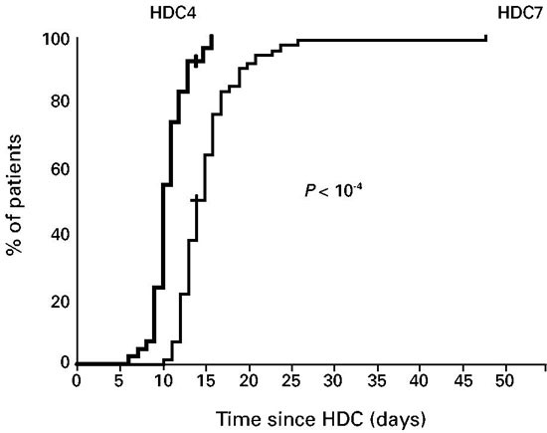
Reassessment (Day -10)
Patient will return to the hospital prior to starting lymphodepleting chemotherapy to confirm patient’s ability to tolerate the treatment
Cyclophosphamide i.v. 20-30 mg/kg (divided over 2-5 days)
Cyclophosphamide i.v. 120 mg/kg (divided over 2 days)
Time to achieve 0.5 × 10⁹ neutrophils/l in patients after high-dose cyclophosphamide (HDC) treatment at the dose of either 7 g/m² (HDC7) or 4 g/m² (HDC4).
HDC4 patients had a shorter median duration of neutropenia and only 28.6% had a thrombopenia compared to 75.7% in the HDC7 group
BMT team
Medical oncologist
Fitoussi, O., Perreau, V., Boiron, J. M., Bouzigon, E., Cony-Makhoul, P., Pigneux, A., ... & Marit, G. (2001). A comparison of toxicity following two different doses of cyclophosphamide for mobilization of peripheral blood progenitor cells in 116 multiple myeloma patients. Bone marrow transplantation, 27(8), 837-842.

Slide 23
Nonmyeloablative Lymphodepleting Chemotherapy
• Outpatient setting
• Prophylaxis:
Infection management: antibiotics
Urotoxicities: Mesna (IV and/or oral)
Nausea and vomiting: anti-emetics
Clinical trials
After FDA approval:
Some M-F, some M-Sunday
Some delay TIL a couple days
Cyclophosphamide, i.v. 60 mg/kg x 2 days (day -7 and day -6)
Fludarabine, i.v. 25 mg/m2 x 5 days (day -7 to day -3)
LD inpatient vs outpatient?
Should we give TILs immediately after LD?
Should we change the dosing regimen?
BMT team
Outpatient nursing
Physician

Slide 24
Workflow
TIL + IL2 administration
Patient assessment
Surgery + tumor handling
TIL expansion
Lymphodepletion
TIL + IL2 administration
Observation period
Disease assessment and survival period

Slide 25
Other requirements to think about
Is your institution cell therapy approved by the FDA for commercial therapy
Do you report the outcomes to

Slide 26
TIL Infusion and IL-2 (Day 0)
Premedication: acetaminophen and anti-emetic
The current FDA-approved dose of high dose IL-2 is 600,000 IU/kg (i.v., q 8h)
How many doses? Max 14 doses / discontinued when the patient has reached a dose-limiting toxicity
Pharmacy with HD IL-2 availability
ICU have symptomatic therapies?
Floor nurse
Physician
BMT team
Lab assistant
ICU
Company
Clinical coordinator
ALL HANDS ON DECK!
Notes:
See comments on IL-6

Slide 27
Workflow
Observation period
Patient assessment
Surgery + tumor handling
TIL expansion
Lymphodepletion
TIL + IL2 administration
Observation period
Disease assessment and survival period

Slide 28
Observation Period (How long?)
Hospitalization – provision of supportive care for toxicity / AEs
Patients should not be discharged from the hospital until all toxicities resolve to CTCAE grade ≤ 1 or return to baseline
Patients then return back home or are admitted to a skilled nursing facility
97% of patients (64/66) had grade 3 or 4 TEAEs Thrombocytopenia 82%, Anemia 56%, Febrile Neutropenia 55%, Neutropenia 39%, Hypophosphatemia 35%, Leukopenia 35%, Lymphopenia 32%
Floor nurse
Physician
BMT team
ICU team
Sarnaik, A. A., Hamid, O., Khushalani, N. I., Lewis, K. D., Medina, T., Kluger, H. M., ... & Chesney, J. A. (2021). Lifileucel, a tumor-infiltrating lymphocyte therapy, in metastatic melanoma. Journal of Clinical Oncology, 39(24), 2656-2666.

Slide 29
Workflow
Disease assessment and survival period
Screening
Surgery
TIL expansion
Lymphodepletion
TIL + IL2 administration
Observation period
Disease assessment and survival period

Slide 30
Disease Assessment and Survival Period
Clinical trials
After FDA approval:
- CT scans at week 6, week 12, every 3 months
How should we monitor these patients?
For how long?
What do you do with SD?
CR
Long term follow-up
Tumor is shrinking
PR
Do I offer other SOC therapies?
How long do I wait before I start another therapy?
Pseudoprogression?
What if LDH and imaging are not congruent?
Tumor’s size doesn’t change (SD)
Tumor is growing (PD)
Notes:
it can take weeks or months to see a measurable response to immunotherapy.

Slide 31
Should we treat patients with other IO therapies?
Treatment included:
1 dose of pembrolizumab (200 mg or 400 mg) after tumor resection
TIL infusion (1 × 109 to 150 × 109 cells)
Continued pembrolizumab every 3 weeks (200 mg) or 6 weeks (400 mg) for ≤24 months
ORR
In the ICI-naïve setting, TIL + pembrolizumab produced encouraging efficacy in patients with advanced melanoma.

Slide 32
What are the options for a patient that didn’t respond to TIL therapy?
Did LD restart the immune system? Would our patient benefit from repeating SOC therapies like ICIs? What would be the next trial for these patients?
Interestingly, both the patients with confirmed PRs on this study, Patients 1 and 8, subsequently went on to have durable responses to anti-PD-1 therapy after progression on TIL therapy. This was particularly notable for Patient 8 as his disease had progressed previously on anti-PD-1 therapy before TIL treatment, suggesting a potential synergy between the transferred TIL and the subsequent anti-PD-1 therapy.
Patient 8 - refractory
Patient 1 – naïve
Durable response to anti-PD1 after progression on TIL Tx
Nguyen LT, et al.Phase II clinical trial of adoptive cell therapy for patients with metastatic melanoma with autologous tumor-infiltrating lymphocytes and low-dose interleukin-2. Cancer Immunol Immunother. 2019 May;68(5):773-785. doi: 10.1007/s00262-019-02307-x. Epub 2019 Feb 11. PMID: 30747243.
Notes:
Interestingly, patients 1 and 8 with confirmed PRs on this study, subsequently went on to have durable responses to anti-PD-1 therapy after progression on TIL therapy. This was particularly notable for Patient 8 as his disease had progressed previously on anti-PD-1 therapy before TIL treatment, suggesting a potential synergy between the transferred TIL and the subsequent anti-PD-1 therapy

Slide 33
Timeline
Patient assessment
Surgery + tumor handling
TIL expansion
Lymphodepletion
TIL + IL2 administration
Observation period
Disease assessment and survival period
Within 21d from consent
Within 30d from consent
6-8 weeks from surgery
Starts Day -7
Day 0
Day 0-7
Starts Week 6
2 – 3 months overall

Slide 34
Can I provide therapy at my institution?
Hospital requirements
OR
Outpatient oncology care (LD)
Inpatient unit
Pathology
ICU
Pharmacy with HD IL-2 availability
Tissue procurement facility
IT TAKES A VILLAGE!
Personnel
OR team = Surgeon + assistants + nurses
BMT team = Medical oncologists + infusion nurses
Physicians assistants
NPs
Pathologists
Coordinator
Lab assistants

Slide 35
Thank you!

