Slide 1
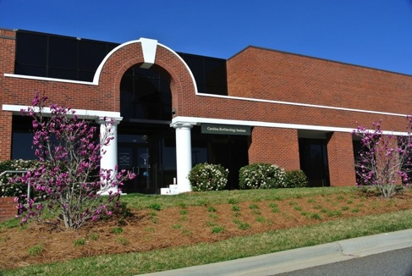
Cancer Immunotherapy by Checkpoints & NonCheckpoints John Powderly MD, President, Carolina BioOncology Institute, PLLC Adjunct Clinical Assistant Professor Medicine Duke & UNC

Slide 2
Financial Disclosures
BioPharma Trial Sponsors
Abbvie
Amgen
Amplimmune
Bristol-Myers Squibb
Corvus
Celldex
Fluxion
Genentech/Roche
GSK
Imclone/Lilly
Incyte
Macrogenics
Merck
Millennium
NovaRx
Peregrine
Progenics
Regeneron
Sanofi-aventis
Speakers Bureau
BMS
Genentech
Dendreon
Merck
Stock Ownership: BioCytics, Lion Biotechnology, BlueBird Bio, Kite Pharma, ZioPharm Oncology
Honoraria: BMS, Genentech

Slide 3
Overview
Background & History Immunotherapy
Immune self tolerance
Melanoma, vitiligo, animal models
Pharmacologic Self Tolerance Blockade
Central (priming phase) vrs Peripheral (effector phase)
PD1 & case presentation
PDL1 & case presentation
Correlates, Predictors, Biomarkers
New Immunotherapies (checkpoint & noncheckpoint)

Slide 4
2013 Science “Breakthrough of the Year” 2014 Special Nature Edition

Slide 5
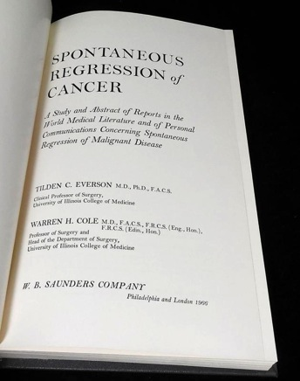
Historical Cases of Spontaneous Regression of Cancer
Rohdenburg summarized 185 spontaneous regressions, 1918
Fauvet reported 202 cases between 1960–1964
Boyd reported 98 cases in 1966
Everson and Cole described 176 cases between 1900–1960
Challis summarized 489 cases between 1900–1987
Hobohm, in a meta-analysis, investigated about 1000 cases
Frequency was estimated to be about 1 in 100,000 cancers

Slide 6
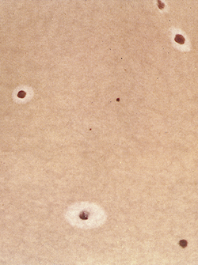
Why Study Malignant Melanoma in Tumor Immunology? Can See It
Model for Melanoma regression
Human and animal models
Occurs with auto-immunity to melanocyte self-antigens (vitiligo) easily seen
Specific T-cell and humoral responses occur
“Break self-tolerance”
Vitiligo patterns may be a template of antigen repertoire
Immune system can recognize any tumor (not just melanoma)
Halo Nevi

Slide 7
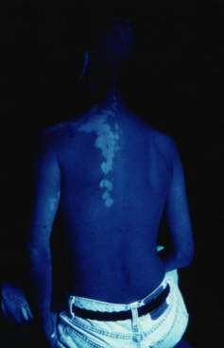
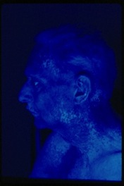
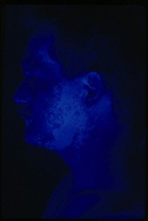
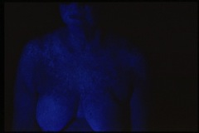
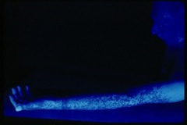
IL-2 Melanoma Immunotherapy
Breaking self tolerance with vitiligo, Strongest clinical marker of melanoma regression

Slide 8
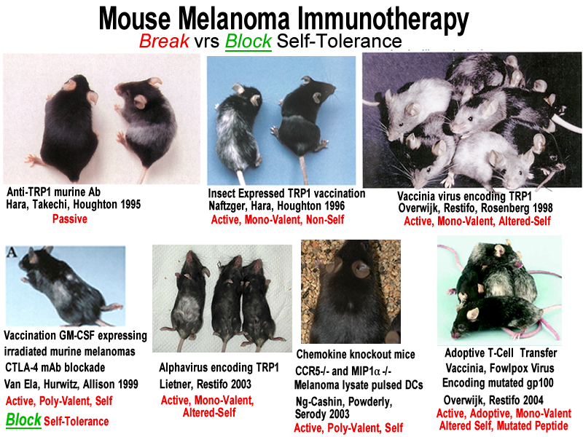

Slide 9
CTLA-4 & PD1/PDL1: The Brakes on T cell Activation
T-cell receptor: Antigen-MHC
CD28: B7
IL-2
IFN
CTLA-4: B7
PD1: PDL1
Vaccine?
Adapted from Hodi

Slide 10
Immune Recognition & Tolerance Adapted from “Cancer Immunotherapy Comes of Age” Topalian, Weiner, Pardoll, JCO 2011

Slide 11
Tumor Immune Evasion
Immune system is exponentially more adaptable then tumor
Vaccines Are The greatest success story of modern medicine by eradicating infectious diseases.
So why haven’t cancer vaccines work?
Infections
Discriminate self from non-self (obvious)
Tumors
Discriminate self from altered-self (subtle)
Self Tolerance = Self Preservation
98% anti-self lymphocytes undergo apoptosis
Remaining T-cells >90% tolerizing surveillance
Our immune system balance favors self tolerance

Slide 12
Immune Checkpoint CTLA4
CTLA-4 “Cytotoxic T Lymphocyte Antigen 4”, receptor expressed on T cells
Got it’s name before knew what it did
James Allison PhD discovered in 1990s,
Most important “break” (tolerance) during antigen presentation in LN
Double gene knockout mouse model: develop lymphoproliferative disease and fulminant auto-immunity toxicity and die by 6 weeks of life.
Human polymorphisms are associated with familial tendency towards autoimmune diseases.
Ipilimumab first checkpoint inhibitor developed, anti-CTLA4 mAb

Slide 13
Immune Checkpoint: PD1/PDL1
PD “Programmed Death” (got it’s name because it was discovered that other immune cells with this receptor/ligand axis were prevented from destroying each other).
PD1 receptor (on lymphocytes) has two ligands: PDL1 & PDL2
PDL1: typically expressed on immune cells so they don’t destroy each other in inflammation. Also expressed in tissue (and tumors) during inflammation.
PD1-PDL1 axis: most important “break” (tolerance) at peripheral site of inflammation
PDL1 is like and “invisible shield for tumors to hide from immune cells”
During inflammation, interferon gamma will upregulate PDL1 expression
PD1 or PDL1: double gene knockout mouse model develop mild tendancy towards auto-immunity with inflammatory stimuli.
Nivolumab & Pembrolizumab first anti-PD1 mAbs developed

Slide 14
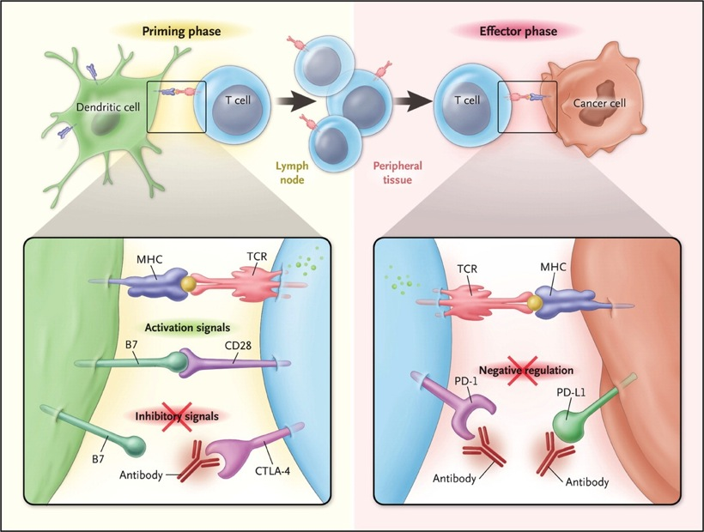
Tumor Immunotherapy CTLA4 vrs PD1/PDL1 Antoni Ribas, NEJM epub June 2012
Notes:
PD-1 and CTLA-4 play distinct roles in regulating T cell immunity. CTLA-4 modulates the early phases of activation of naı¨ve or memory T cells in response to TCR stimulation by MHC-peptide complexes displayed by antigen presenting cells (‘signal 1’). In contrast, PD-1 is expressed on antigenexperienced T cells in the periphery, and serves to limit the activity of T cells at the time of an inflammatory response, thereby protecting normal tissues from collateral destruction. DC, dendritic cell.

Slide 15
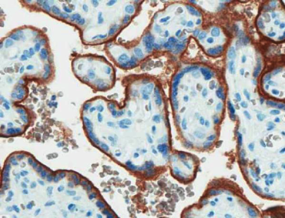
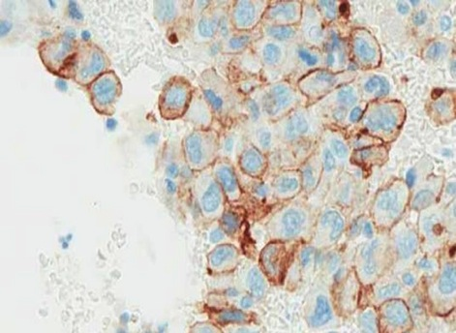
Placenta & tumors express PDL1
to evade immune recognition
PD-L1
lymphocyte
cancer cell
Placenta
Tumor

Slide 16
PD1-PDL1 Blockade Drugs in Development
Anti-CTLA-4
Ipilimumab (Fully human IgG1) FDA Approved 2011
Tremelimumab (Fully human IgG2) Phase III
Anti-PD-1
MDX-1106, Nivolumab, (Fully human IgG4) FDA Approved Melanoma & Squamous Lung
CT-011 Pidilizumab (Humanized IgG1) Phase II
MK3475 Pembrolizumab (formerly Lambrolizumab) (Humanized IgG4) FDA Approved 2014
AMP-224 (B7-DC/IgG1fusion protein) Phase I-II
MEDI0680, AMP514 Phase I
REGN2810 (phase I)
BGB-A317 (phase I)
Anti-PD-L1
MDX-1105, (Fully human IgG4) Phase I
MPDL3280A, RG7446, Atezolizumab, Phase II
MEDI4736 Phase III
MSB0010718C Avelumab Phase I
CA-170 (oral inhibitor, phase I)

Slide 17
Lung Cancer Immunotherapy
Lawrence MS et al. Nature. 2013;499:214-218.
Chen DS et al. Clin Cancer Res. 2012;18:6580-6587.

Slide 18
Melanoma

Slide 19
Pembrolizumab (Formally Lambrolizumab)
2013

Slide 20
Safety and Tumor Responses with Lambrolizumab (Pembrolizumab, Anti-PD1) in Melanoma Hamid NEJM 2013
135 Stage IV melanoma patients (both Ipi naïve and Ipi failures)
38% RECIST response rate in all dose cohorts
52% RECIST highest in cohort of 10mg/kg Q2 weeks.
No statistical significant difference in response rate with prior Ipi exposure (but trend favored prior Ipi exposure)
Median progression free survival > 7 months
79% any grade drug related adverse events (fatigue, asthenia, fever, chills, myalgias, HA). 21% had rash & pruritis, 20% diarrhea, 8% hypothyroidism, 9% vitiligo.
13% grade 3-4 drug related adverse events
Auto-immune adverse events: 4% pneumonitis

Slide 21
Pembrolizumab Melanoma Hamid NEJM 2013

Slide 22
Pembrolizumab Responders NEJM 2013

Slide 23
Lancet July 2014
Randomized Expansion cohort of original Phase I, additional 173 patients
Dedicated to Ipilimumab “refractory” patients (received at least 2 doses Ipi). Excluded prior Ipi grade 3,4 toxicities. Allowed prior grade 2 toxicity, if resolved to grade 0-1, and off steroids. Stable brain mets allowed.
2mg/kg IV Q3 weeks vrs 10mg/kg IV Q3 weeks
Results: ORR 26% in both doses, similar safety profiles, no drug related deaths, fatigue (33%), pruritus (26%), rash (18%). Only grade 3 drug AE was fatigue (3%).

Slide 24
Pembrolizumab Survival Robert Lancet 2014

Slide 25
Nivolumab & Pembrolizumab FDA Approved Melanoma (After Ipilimumab, and BRAF inhibitor if BRAF mutant)
Pembrolizumab FDA Approved September 2014
Phase IB Randomized trial 2mg/kg vrs 10mg/kg (KEYNOTE-001)
2mg/kg IV over 30 minutes Q3 weeks
Interim analysis ORR = 24%, of which 86% durable
Nivolumab FDA Approved December 2014
Phase III Randomized trial vrs Dacarbazine (CHECKMATE 037, CA209-037)
3mg/kg IV over 60 minutes Q2 weeks
Interim analysis ORR confirmed = 32%, of which 87% durable
Class Toxicity of PD1 mAb (all grades): pneumonitis 2-3%, colitis 2%, hepatitis 1%, nephritis 0.7%, hypo-hyperthyroidism 10%, potential embryofetal toxicity;
Other common immune symptoms: tumor flare, fatigue, fever, pruritus, cough, diarrhea transaminitis, thyrombocytopenia, lymphopenia, hyponatremia, hyperkalemia,
Continue “until disease progression or unacceptable toxicity”

Slide 26
Ipilimumab + Nivolumab Melanoma Wolchok NEJM 2013
Metastatic Melanoma, n = 88
Concurrent cohort: n = 53,
Nivo 1mg/kg + Ipi 3mg/kg, ORR 53%,
Clinical Benefit SD+PR+CR = 65%
Grade 3-4 drug related AEs 53% (lipase, transaminitis, colitis), most were reversible with steroids.

Slide 27
Rapid Eradication of a Bulky Melanoma Mass with One Dose of Immunotherapy Chapman et al, NEJM April 2015
49yo WF BRAF Mutant
Ipilimumab 3 mg/kg &
Nivolumab 1 mg/kg

Slide 28
Lung Cancer

Slide 29
Nivolumab 2nd line Squamous Cell Lung Cancer FDA Approved March 2015
CHECKMATE 017 Phase 3 randomized
Docetaxel vrs Nivolumab 3mg/kg Q2w
Interim analysis:
Median OS 6 months vrs 9 months.
1 year OS 22% vrs 41%
41% reduction risk of death
Hazard ratio 0.59 (p = 0.00025)
ORR = 15%, of which 76% durable
Nivolumab

Slide 30
Nivolumab Squamous Lung Adverse Events

Slide 31
Nivolumab Squamous Lung Adverse Events, cont

Slide 32
Nivolumab Squamous Cell Lab Abnormalities

Slide 33
CheckMate 057: Nivolumab vs Docetaxel 2nd-line Non-squamous NSCLC
Phase III, 582 patients randomized
Nivolumab 3 mg/kg Q2W vs docetaxel 75 mg/m² Q3
Primary endpoint OS
Trial stopped early by DSMC, met its primary endpoints at interim analysis
 | Nivolumab (n=292) | Docetaxel (n=290)
ORR | 19% | 12%
P-value | 0.0246
Median DOR, mos | 17.2 | 5.6
71 (24%) patients on nivolumab were treated beyond RECIST v1.1-defined progression Non-conventional benefit was observed in 16 patients (not included in best overall response)
Paz-Ares L et al. Presented at: American Society of Clinical Oncology, 2015 Annual Meeting; (Abstract LBA109).

Slide 34
CheckMate 057: Nivolumab vs Docetaxel 2nd-line Non-squamous NSCLC
Paz-Ares L et al. Presented at: American Society of Clinical Oncology, 2015 Annual Meeting; (Abstract LBA109).

Slide 35
CheckMate 057: Nivolumab vs Docetaxel 2nd-line Non-squamous NSCLC
Paz-Ares L et al. Presented at: American Society of Clinical Oncology, 2015 Annual Meeting; (Abstract LBA109).

Slide 36
CheckMate 057: Nivolumab vs Docetaxel 2nd-line Non-squamous NSCLC
Paz-Ares L et al. Presented at: American Society of Clinical Oncology, 2015 Annual Meeting; (Abstract LBA109).

Slide 38
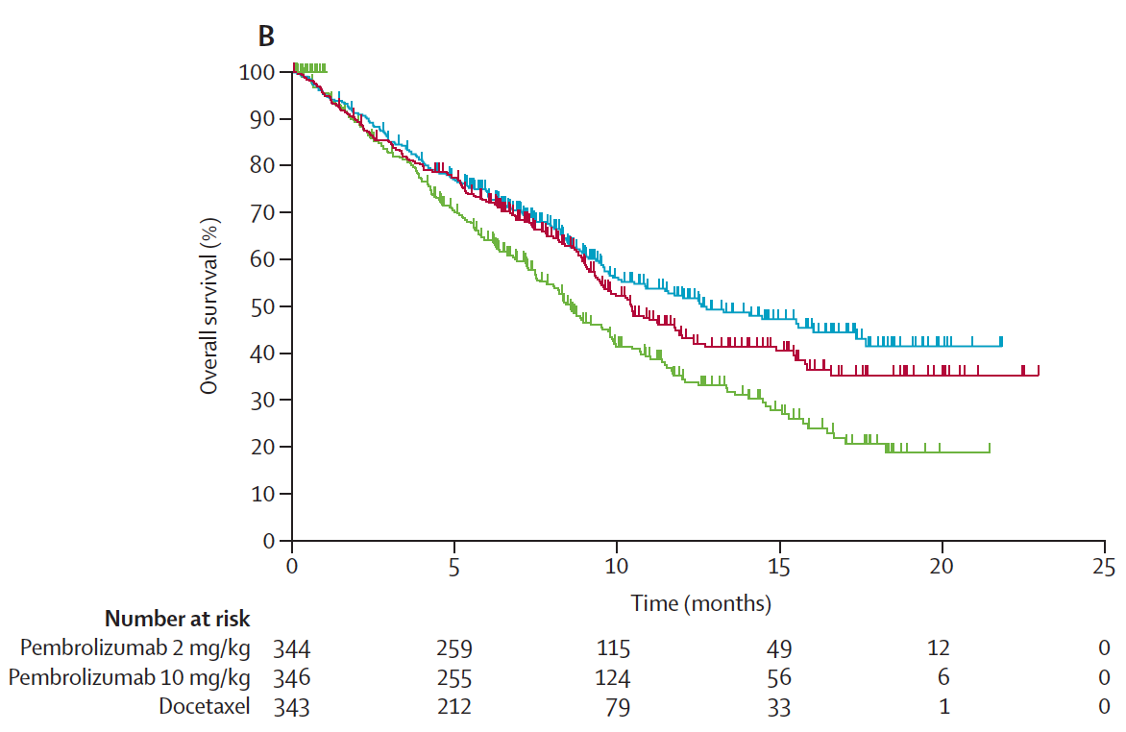
KEYNOTE-010: Pembro Vs. Docetaxel in NSCLC: OS in All Patients
Herbst et al, Lancet, 2015

Slide 39
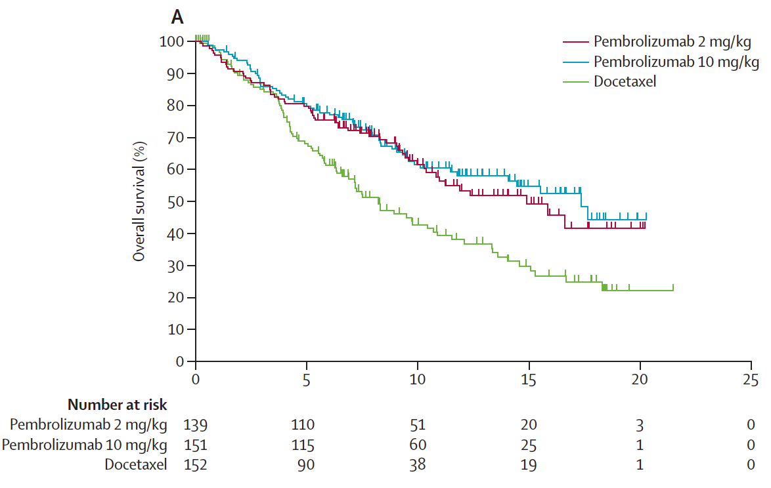
KEYNOTE-010: Pembro Vs. Docetaxel: OS in PD-L1 Positive Disease
Herbst et al, Lancet, 2015

Slide 40
Efficacy, Safety, and Predictive Biomarker Results from Phase II Atezolizumab (MPDL3280a) vs Docetaxel 2nd/3rd-line NSCLC POPLAR Study (Interim Analysis)
ITT Interim OS (n=287)
PD-L1 Expression Subgroups
TC 1/2/3 or IC 1/2/3 Interim OS (n=195)
Spira AI et al. Presented at: American Society of Clinical Oncology, 2015 Annual Meeting; (Abstract 8010).

Slide 41
MEDI4736 (Durvalumab) PD-L1 mAb
Segal NH et al. Presented at: American Society of Clinical Oncology, 2014 Annual Meeting; (Abstract 3002).
Brahmer J et al. Presented at: American Society of Clinical Oncology, 2015 Annual Meeting; (Abstract 8112).

Slide 42
Nivolumab 1rst Line NSCLung Gettinger ASCO 2014
1rst line lung monotherapy Nivolumab, n = 20
ORR 30% (50% PDL1+), Clinical Benefit SD+PR+CR = 65%
Grade 3-4 drug related AEs = 20%

Slide 43
Ipilimumab + Nivolumab 1rst Line Lung SJ Antonio, ASCO 2014
Phase IB, Front line lung cancer, n = 49
ORR 19% (PDL1+), 14% (PDL1-)
PFS 24 weeks 47% (PDL1+), 29% (PDL1-)
Drug related grade 3-4% AEs = 49%

Slide 44
Keynote-021 Cohort D: Phase I Pembrolizumab + Ipilimumab as 2nd-line NSCLC
Patnaik A et al. Presented at: American Society of Clinical Oncology, 2015 Annual Meeting; (Abstract 8011).

Slide 45
CheckMate 012 Study Design: Nivolumab Plus Ipilimumab in First-line NSCLC
Stage IIIB/IV NSCLC (any histology); no prior chemotherapy for advanced disease; ECOG PS 0 or 1
Nivo 1 mg/kg IV Q3W x 4
+
Ipi 1 mg/kg IV Q3W x 4
Nivo 1 mg/kg IV Q2W
+
Ipi 1 mg/kg IV Q6W
Nivo 3 mg/kg IV Q2W
+
Ipi 1 mg/kg IV Q12W
Nivo 3 mg/kg IV Q2W
+
Ipi 1 mg/kg IV Q6W
Nivo 3 mg/kg IV Q2W until disease progression or unacceptable toxicityª
Until disease progression or unacceptable toxicityª
Primary endpoint: safety and tolerability
Secondary endpoints: ORR (RECIST v 1.1) and PFS rate at 24 wks
Exploratory endpoints: OS; efficacy by PD-L1 expression
ªPatients tolerating study treatment permitted to continue treatment beyond RECIST v1.1-defined progression if considered to be deriving clinical benefit
Rizvi et al, WCLC 2015
Notes:
Baseline tumor PD-L1 expression measured in archival or fresh tissue biopsies using the BMS/Dako immunohistochemistry assay. Expression levels (≥1% and <1%) were defined by tumor cell membrane staining (any intensity) in a section containing at least 100 evaluable tumor cells
Arms were not randomized

Slide 46
Summary of Efficacy
 | Nivo 1 + Ipi 1 Q3W (n = 31) | Nivo 1 Q2W + Ipi 1 Q6W (n = 40) | Nivo 3 Q2W + Ipi 1 Q12W (n = 38) | Nivo 3 Q2W + Ipi 1 Q6W (n = 39) | Nivo 3 Q2Wª (n = 52)
Confirmed ORR, % (95% CI) | 13 (4, 30) | 25 (13, 41) | 39 (24, 57) | 31 (17, 48) | 23 (13, 37)
Confirmed DCR, % (95% CI) | 55 (36, 73) | 58 (41, 73) | 74 (57, 87) | 51 (35, 68) | 50 (36, 64)
Best overall response, %
Complete response Partial response Unconfirmed partial response | 0 13 3 | 0 25 3 | 0 39 5 | 0 31 8 | 8 15 0
Stable disease Progressive disease Unable to determine | 42 35 6 | 33 30 10 | 34 13 8 | 21 26 15 | 27 38 12
PFS rate at 24 wks, % (95% CI) | 55 (36, 71) | NC | 63 (44, 76) | NC | 41 (27, 54)
Median PFS, mos (95% CI) | 10.6 (2.1, 16.3) | 4.9 (2.8, ) | 8.0 (4.2, ) | 8.3 (2.6, ) | 3.6 (2.3, 6.6)
Median OS, mos (95% CI) | NR (11.5, ) | NR (8.9, ) | NR | NR (8.7, ) | 22.6 (14.9, )
Median length of follow-up, mos (range) | 16.6 (1.8–24.5) | 6.2 (0.4–13.1) | 8.4 (0.9–12.3) | 7.7 (1.1–12.2) | 14.3 (0.2–30.1)
Median DOR was not reached in any arm
Unconventional immune-related responses were observed in arms Nivo 3 Q2W + Ipi 1 Q12W (n = 2), Nivo 3 Q2W + Ipi 1 Q6W (n = 1) and Nivo 3 Q2W (n = 3)
NR: the time point at which the percent of survivors drops below 50% has not been reached due to insufficient number of events and/or follow up. ªResults for Nivo 3 Q2W are reported based on a March 2015 DBL
Rizvi et al, WCLC 2015
Notes:
Relative median length of follow-up is short across arms N1 Q2W + I1 Q6W, N3 Q2W + I1 Q12W and N3 Q2W + I1 Q6W, so PFS and OS data are preliminary with a high degree of censoring

Slide 47
Efficacy by Tumor PD-L1 Expression
 | ≥1% PD-L1 expression |  |  |  | <1% PD-L1 expression
 | Nivo 1 + Ipi 1 Q3W (n = 12) | Nivo 1 Q2W + Ipi 1 Q6W (n = 21) | Nivo 3 Q2W + Ipi 1 Q12W (n = 21) | Nivo 3 Q2W + Ipi 1 Q6W (n = 23) | Nivo 1 + Ipi 1 Q3W (n = 13) | Nivo 1 Q2W + Ipi 1 Q6W (n = 7) | Nivo 3 Q2W + Ipi 1 Q12W (n = 9) | Nivo 3 Q2W + Ipi 1 Q6W (n = 7)
ORR, % | 8 | 24 | 48 | 48 | 15 | 14 | 22 | 0
mPFS, wks (95% CI) | 11.5 (7.1, ) | 21.1 (11.4, ) | 34.6 (15.9, 35.3) | NR (15.4, ) | 34.0 (8.9, ) | NR (10.1, ) | 23.1 (4.0, ) | 10.3 (7.4, 12.7)
PFS rate at 24 wks, % (95% CI) | 42 (15, 67) | 40 (18, 61) | 74 (48, 88) | 65 (42, 81) | 57 (25, 80) | NC | 39 (9, 69) | 0
PD-L1 expression was measured using the Dako/BMS automated IHC assay^{1,16}
Fully validated with analytical performance having met all predetermined acceptance criteria for sensitivity, specificity, precision, and robustness
All patients had available pretreatment tumor samples; 76% (113/148) had samples evaluable for PD-L1 expression
Median DOR was not reached in any arm, regardless of PD-L1 expression
NR: the time point at which the percent of survivors drops below 50% has not been reached due to insufficient number of events and/or follow up
Rizvi et al, WCLC 2015

Slide 48
Mutational Landscape Determines Sensitivity to PD-1 Blockade in NSCLC
Background: PD-1 and PD-L1 best responses appear in melanoma and lung cancer (which have high carcinogen exposure)
34 lung patients on Pembro study had cancer exome gene sequence
>300 “nonsynonymous mutations” (meaning alter protein sequence) associated with:
Improved ORR, durable clinical benefit, and PFS
“Molecular smoking signature” (C-to A transversions)
Higher neo-antigen burden
DNA repair enzyme pathway mutations (“hypermutated tumors”)
Concluded: genomic landscape (mutational burden “mutanome”) enables response to PD-1 therapy
Rizvi NA et al. Science. 2015;348:124-128.

Slide 49
PD-L1 as a Predictive Immune Biomarker: Assays, Sample Collection, and Analyses in NSCLC Studies
Pembrolizumab Merck
Prototype or clinical trial IHC assay (22C3 Ab)¹
Surface expression of PD-L1 on tumor specimen*
Ph I: Fresh tissue Ph II/III: Archival or fresh tissue²
IHC Staining: Strong vs weak expression² PD-L1 expression required for NSCLC for enrollment² Note that one arm of KEYNOTE 001 trial requires PD-L1⁻ tumors¹ Tumor PD-L1 expression:¹ ≥50% PD-L1⁺ cut-off: 32% (41/129) 1-49% PD-L1⁺ cut-off: 36% (46/129)
Nivolumab Bristol-Myers Squibb
Dako automated IHC assay (28-8 Ab)^{3,4}
Surface expression of PD-L1 on tumor cells*
Archival⁴ or fresh tissue
IHC Staining: Strong vs weak expression^{3,4} Patients not restricted in PD-L1 status in 2nd- & 3rd-line⁴ Ph III 1st-line trial in PD-L1+³ Tumor PD-L1 expression:⁴ 5% PD-L1⁺ cut-off: 49% (33/68)⁴
MPDL3280A Roche/Genentech
Ventana automated IHC assay
Surface expression of PD-L1 on TILs⁵
Archival or fresh tissue
IHC Staining intensity (0, 1, 2, 3): IHC 3 (≥10% PD-L1⁺): Ph III trial⁵ IHC 2,3 (≥5% PD-L1⁺)⁵ IHC 1,2,3 (≥1% PD-L1⁺)⁵ IHC 1, 0, or unknown PD-L1 expression required for NSCLC for enrollment x TIL PD-L1 expression:^{5,6} IHC 3 (≥10% PD-L1⁺): 11% (6/53) PD-L1 low (IHC 1, 0): 75% (40/53)
MEDI4736 AstraZeneca
1st generation or Ventana automated IHC (BenchMark ULTRA) assay (Ventana PD-L1 (SP263) clone)^{7,8}
Surface expression of PD-L1 on TILs
PhI: Fresh tissue
IHC Staining intensity: Not presented to date^{7,8,9} TIL PD-L1 expression: Not presented to date^{7,8,9}
PD-L1 Assay
Sample Source and Collection
Definition of Positivity†
Notes:
*Tumor cells are stained, but not TILs and other tissue areas.
†Definition of PD-L1 positivity differs between assay methodologies.
IHC = immunohistochemistry; NSCLC = non-small cell lung cancer; PD-L1 = programmed cell death-ligand 1; TILs = tumor-infiltrating lymphocytes.
References
1. Garon EB, et al. Presented at ESMO 2014 (abstr. LBA43); 2. Rizvi NA, et al. Presented at ASCO 2014 (abstr. 8007); 3. Gettinger S et al. Poster p38 presented at ASCO 2014 (abstr. 8024); 4. Brahmer JR et al. Poster 293 presented at ASCO 2014 (abstr. 8112); 5. Rizvi NA et al. Poster presented at ASCO 2014 (abstr. TPS 8123); 6. Soria J-C, et al. ESMO 2014 (abstr. 1322P); 7. Brahmer JR, et al. Poster presented at ASCO 2014 (abstr. 8021); 8. Segal NH, et al. Presented at ASCO 2014 (abstr. 3002); 9. Segal NH, et al. ESMO 2014 (abstr. 1058PD).

Slide 50
Renal Cancer

Slide 51
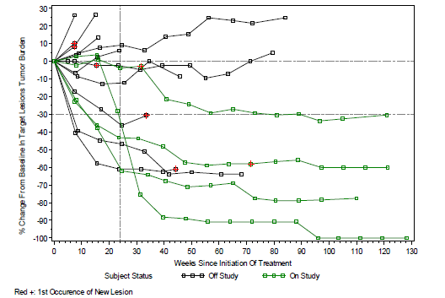
Renal Cell Cancer anti-PD1 mAb 10mg/kg cohort

Slide 52
Solid Tumors

Slide 53
MEDI4736 PDL1 mAb Segal ASCO 2014

Slide 54
MEDI4736 PDL1 mAb Segal ASCO 2014

Slide 55
MEDI4736 PDL1 mAb Segal ASCO 2014

Slide 56
Correlates & BioMarkers
Presence of Tumor Infiltrating Lymphocytes
Auto-immunity
PDL1 expression: On tumor & immune cells
Mutation load (Mutanome)
Carcinogen exposure
Smoking status
Hypermutators (BRCA, Lynch Syndrome)
Viral mediated tumors

Slide 57
PDL1 Tumor Expression
Distinct mechanisms of PDL1 expression:
Interferon gamma induced dynamic upregulation in the inflammatory tumor microenvironment (“adaptive resistance”)
Oncogenic driver mutations that constitutively express PDL1
Epithelial to Mesenchymal transformation (EMT) of the carcinoma phenotype

Slide 58
Biomarkers and Associations With the Clinical Activity of PD-L1 Blockade in a MPDL3280A Study
Powderly J¹, Koeppen H², Hodi FS³, Sosman J⁴, Gettinger S⁵, Desai R², Tabernero J⁶, Soria JC⁷, Hamid O⁸, Fine G², Xiao Y², Mokatrin A², Wu J², Anderson M², Irving B², Chen DS², Kowanetz M²
Full manuscript published in Nature, Herbst et al, Nov 2014

Slide 59
PD-L1 Expression by IHC is Associated With Anti-tumor Response to MPDL3280A
Investigator-Assessed Overall Response Rate (ORR*); % (n/n)
 | PD-L1 Positive | PD-L1 Negative | All†
Overall population (N = 140) | 36% (13/36) | 13% (9/67) | 21% (29/140)
Best Response
Complete response
Partial response
Patients, %
Stable disease
Study described in ASCO 2013 Abstract #3000 (Herbst et al.)
PD-L1 positive defined as tumors with infiltrating immune cells that stain for PD-L1 Dx IHC
Further assessment of PD-L1 Dx ongoing
* ORR includes investigator-assessed unconfirmed and confirmed PR/CR by RECIST 1.1
† All patients include PD-L1–positive, PD-L1–negative and patients with unknown tumor PD-L1 status. Patients first dosed at 1-20 mg/kg prior to Aug 1, 2012; data cutoff Feb 1, 2013.
Notes:
Next, this PDL1 diagnostic IHC assay was performed on 103 patients whom had evaluable archived tumor blocks while enrolled in the Phase I study.
PD-L1 positive patients, here identified as baseline samples positive for PD-L1 in tumor infiltrating immune cells, responded at a much higher rate than PD-L1 negative patients (36% vrs 13%). Additionally, stable disease, as best response was also much higher for PD-L1 positive vs negative patients.
This suggests that baseline PDL1+ immune cells in the tumor microenvironment were important for clinical regression to occur via PDL1 blockade by MPDL treatment.
Further assessment of the association between PD-L1 staining and efficacy related to MPDL monotherapy is on-going.

Slide 60
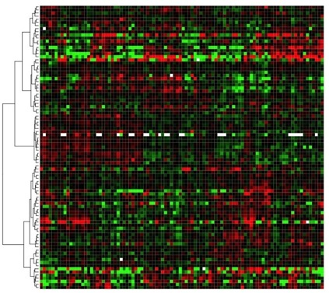
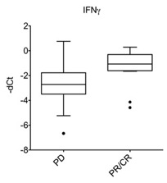
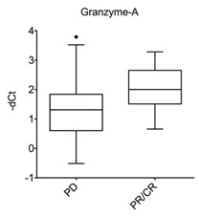
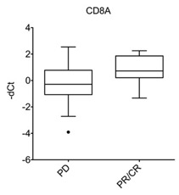
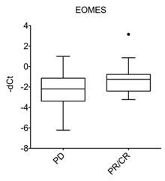
Anti-tumor Response to MPDL3280A is Associated With Th1-type T-cell Markers
Hierarchical clustering of Ph1 samples
P=0.003
P=0.028
Gene
Up-
regulation
Patient
Baseline tumor samples, n = 96 (MPDL3280A, Phase 1a). Data for samples available as of Dec 1, 2012. Patients first dosed at 1-20 mg/kg prior to Aug 1, 2012; data cutoff Feb 1, 2013. Includes investigator-assessed unconfirmed and confirmed PR/CR by RECIST 1.1
P=0.003
P=0.023
Down-
regulation
t-test (nominal) p-values
Higher expression of cytotoxic Th1 T-cell markers in tumor tissue is associated with MPDL3280A activity
Notes:
This immunochip gene expression assay showed that, among the 96 baseline tumor samples, patients with higher expression of Th1 genes at baseline were more likely to respond to MPDL treatment.
IFNg, Granzyme A, CD8A and EOMES (a transcription factor for Granzyme B) are representative of these Th1 associated genes. . T cells that express Th1 genes represent the population of T cells responsible for killing “foreign” cells, such as tumors. This suggested that baseline intra-tumoral “immune competency” by this Th1 “inflammatory signature” was important for the clinical benefit of MPDL treatment.

Slide 61
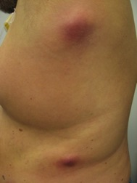
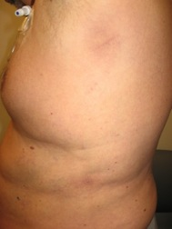
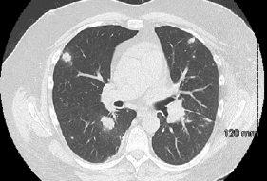
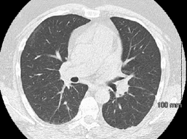
Serial Biopsy in a PD-L1–Positive RCC Patient With a Rapid Response to MPDL3280A
1 week tumor
Flare
After 4 weeks
Baseline
After 6 weeks
Surgical resection of responding mass, 0.75 x 0.75 cm at time of resection
51-year-old male with Sarcomatoid RCC s/p L nephrectomy, sunitinib, XRT T9, temsirolimus, PD-L1 positive
Carolina BioOncology Institute (Powderly).
MPDL3280A Phase Ia
Notes:
This patient of mine was a 51yo male with high grade sarcomatoid renal cell carcinoma. His tumor progressed through multiple regimens including sunitinib, radiation to vertebral bone mets, , and temsirolimus.
After his first dose of MPDL, his tumor became more inflammed, and then rapidly regressed by the 4rth week. By his 6th week, restaging scans showed that his 40 lung metastasis, multiple bone mets and skin mets had all disappeared, and he remains, today, in a durable complete remission 17 months later. His only side effect was a mild, transient skin rash and low grade fever.
At his 4rth week of treatment on MPDL, we resected his regressing flank nodule, and observed the immune infiltrate on next slide.

Slide 62
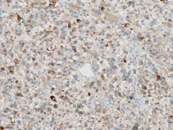
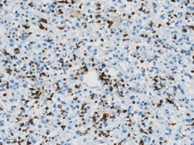
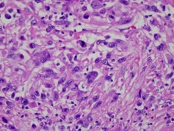
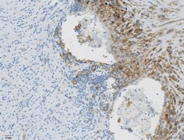
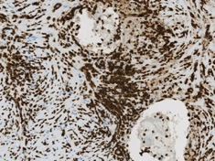
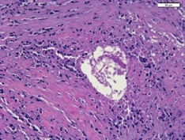
Serial Biopsy in a PD-L1–Positive RCC Patient With a Rapid Response to MPDL3280A
Baseline
Baseline H&E
PD-L1
PD-L1
CD8
Biomarkers at baseline:
PD-L1 positive
CD8+ T cells present
Lymphocytic infiltrate
Degenerating tumor cells (“ghost cells”)
On-Tx
On-Tx H&E
Necrotic tissue
PD-L1
CD8
Biomarkers at week 4 post C1D1:
PD-L1 positive
Increased CD8+ T-cell infiltrate
On-treatment H&E:
dense lymphocytic infiltrate and no viable tumor cells seen
Carolina BioOncology Institute (Powderly).
MPDL3280A Phase Ia
Notes:
His baseline tumor was high grade with multiple mitotic figures, and the IHC showed PDL1 positivity scattered on the tumor, and a few scattered CD8+ lymphocytes that were also PDL1+. This indicated he had at least some underlying immune competency with some immune cells present, but not enough to control his tumor.
Once PDL1 blockade was on-board, his 4 week biopsy showed massive upregulation of PDL1 in the tumor micro-environment, with a dense CD8 TIL cell infiltrate, and no viable tumor left behind, only degenerating ghost cells and necrotic tissue remained.
This rapidly induced immune regression suggested he had the baseline ABILITY to mount an immune response, but it was probably DAMPENED by PDL1… until PDL1 was blockaded by MPDL, which then unleashed his pre-existing TIL cells to attack and proliferate.

Slide 63
Melanoma Anti-PDL1 mAb
March 26, 2012
May 7, 2012
Notes:
R flank mass was excised for path review on April 30, 2012.

Slide 64
Melanoma
April 9, 2012 (cycle 1, week 1) Mild pruritic rash, then diffuse vitiligo

Slide 65
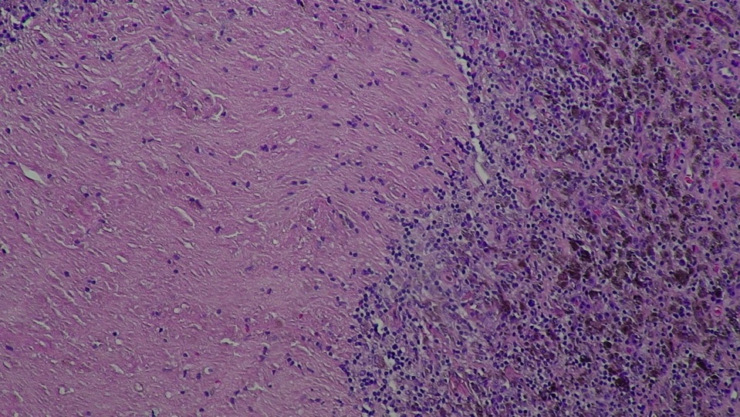
Path Excised R flank Regressing Melanoma April 30, 2012
Notes:
Excisional skin specimen from R flank cut through full thickness of epidermis and dermis to underlying fibrofatty tissue. Underlying dermis shows a sparse focal lymphohistiocytic inflammatory infiltrate.
Within the deep subcutaneous fibroadipose tissue there is a tumor nodule composed of markedly atypical cells forming solid collections with central tumor necrosis (comedo necrosis). Tumor cells demonstrate spindle cell morphology with hyperchromatic pleomorphic nuclei and occasioinal prominent nucleoli. Brown pigment deposition c/w melanin within tumor. The pigment is also present adjacent areas of fibrosis surrounding the tumor. There are dense collections of lyphohistiocytic cells surrounding the tumor; however the presence of remnants of a lymph node are not definitively identified.
IHC stains: S100 and HMB45 show strong positivity supporting Dx of metastatic melanoma. A CD20 stain showed marked postivity with scattered cells surrounding the tumor (but remnants of a lymph node not identified).

Slide 66
New Immunotherapies

Slide 67
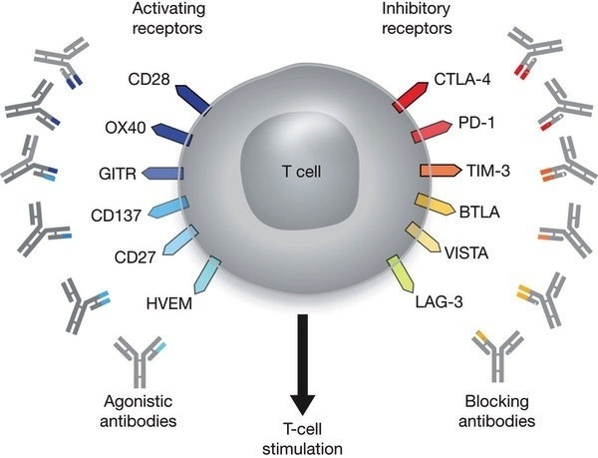
Immune Modulatory Receptors
Turning up The Activating
Blocking the Inhibiting
Activating
Inhibiting
Mellman et al. Nature, 2011

Slide 68
Other Check Point Immunotherapy: IDO Inhibitors
Indoleamine 2,3-dioxygenase (IDO) is a natural endogenous mechanism of immune suppression (involved in pregnancy and mucosal tolerance)
Tumor microenvironment may increase IDO to create peripheral tolerance
High IDO expression in tumors correlates with poor outcome
IDO inhibitors have shown preclinical anti-tumor benefit:
1-methyl D tryptophan (D-1MT, NSC-721782)
Indoximod
NLG919
INCB23843 (Epacadostat) (phase I)
GDC0919 (phase I)

Slide 69
Other Check Point Immunotherapy: A2A & CD73 Inhibitors
Adenosine is a signaling molecule in the inflammatory micro-environment used limit inflammation. Tumors exploit this adenosine axis to suppress immune response.
Adenosine Receptor (A2A, A2B) expressed on tumor cells (and cardiac cells), induces intracellular cAMP.
CPI-444 oral inhibitor of A2A (phase 1)
Tumor produce & sustain adenosine by expressing high levels of enzyme on tumor surface CD73 (ecto-5’-nucleotidase, converts AMP to adenosine). CD73 also used in lymphocyte differentiation.
mAb in development to block CD73 on tumors

