Slide 1
NIH Grant Application Strategies
Lillian Kuo, Ph.D.
Program Director, Division of Cancer Biology, NCI
Email: Lillian.Kuo@nih.gov; Twitter: @NCICancerBio

Slide 2
NIH Grant Application Strategies
Elements of Your R01 Application​
ESI Specific Considerations and Opportunities
Contact your Program Officer Anytime!
Warning: This information is generalized and not comprehensive. Please contact your Program Officer for individual-level guidance.

Slide 3
Elements of Your R01 Application​
Draft Your Specific Aims Page
Build Your Team
Research Strategy Components
Notes:
Generalized guidance for investigator-initiated R01s, different tweaks for other mechanisms

Slide 4
Draft Your Specific Aims Page
Make a good first impression, the Specific Aims page is read first
A central hypothesis will anchor your Specific Aims to a common scientific question or objective
Better to have depth over breadth
Specific Aims should be complementary and not inter-dependent
Share your draft Specific Aims page with mentors, colleagues, co-investigators, collaborators, and your Program Officer
Notes:
Depth vs. breadth: better to have 2 solid, thoroughly developed aims than 3 weak/superficial

Slide 5
Draft Your Specific Aims Page
Know your audience, the scientific peer-review panel:
Would they review the proposed project as tackling an important problem in a significant field?
Would they view the Specific Aims as capable of opening up new discoveries in the field?
Would the reviewers regard the work as new and unique?
Would they view the Specific Aims as likely to exert a significant influence on the research field(s) involved?
Are the Specific Aims written clearly and are they easy to understand?
Notes:
Depth vs. breadth: better to have 2 solid, thoroughly developed aims than 3 weak/superficial

Slide 6
Build Your Team
Contact PI vs. multi-PI (MPI) vs. Co-Investigator are different
For a multi-PI (MPI) application, each MPI should have complementary expertise
Strong letters of support demonstrating intellectual buy-in for the project
Engage your Biostatistician and/or Bioinformatician from the initiation of your experimental design through the interpretation of the data and alternate approaches sections
Notes:
Not just letters of support, Co-Is must demonstrate engagement in the entire study

Slide 7
Research Strategy Components
Structure: Significance, Innovation, or Approach
Significance: How will my research move the field forward
Innovation: Both conceptual and technical
Approach:
Your experimental design should tie back to your overarching hypothesis and specific aims
Avoid writing a list of experiments, instead provide a roadmap to how you will test your hypothesis and specific aims
As you write the approach, continue to reevaluate your hypothesis, aims, and title to ensure cohesion and reflect the scientific goals

Slide 8
Early Stage Investigator (ESI) Status
Early Stage Investigator (ESI) and New Investigator (NI) are different
Different NIH Institutes (ICs) have different policies on ESI vs. NI
You can request an extension (e.g., COVID lab shutdowns) to your ESI eligibility period through eRA Commons via an ESI Extension request button in the Education section of your Personal Profile.
Detailed info available at NOT-OD-19-125: https://grants.nih.gov/grants/guide/notice-files/NOT-OD-19-125.html

Slide 9
Cancer Moonshot Scholars
RFA-CA-22-050 (R01 Clinical Trial Optional), https://grants.nih.gov/grants/guide/rfa-files/RFA-CA-22-050.html
ESI R01 applicants from diverse backgrounds, including those from groups identified as underrepresented (NOT-OD-20-031) in the biomedical, clinical, behavioral, and social sciences research workforce
Applications must include an Institutional Eligibility Letter describing the PI's contribution to the program goals to be responsive to this FOA.
Submission dates are November 8, 2022, June 6, 2023, and February 6, 2024
Questions? Email Leeann.Bailey@nih.gov or Tiffany.Wallace@nih.gov

Slide 10
Katz ESI R01 PARs
Stephen I. Katz Early Stage Investigator Research Project Grant PARs:
PAR-21-038: R01 Clinical Trial Not Allowed
PAR-21-039: R01 Basic Experimental Studies with Humans Required
New research direction
Level of departure from previous efforts will be field-dependent
Should not be incremental advancement/expansion/extension of previous research
No preliminary data allowed
Unpublished data not allowed
Only published (or preprint) data with unambiguous Digital Object Identifier (DOI)
Non-AIDS application Due Dates: January 26, 2023; May 26, 2023; September 26, 2023
Questions? Email Scott Rogers, rogerssc@mail.nih.gov

Slide 11
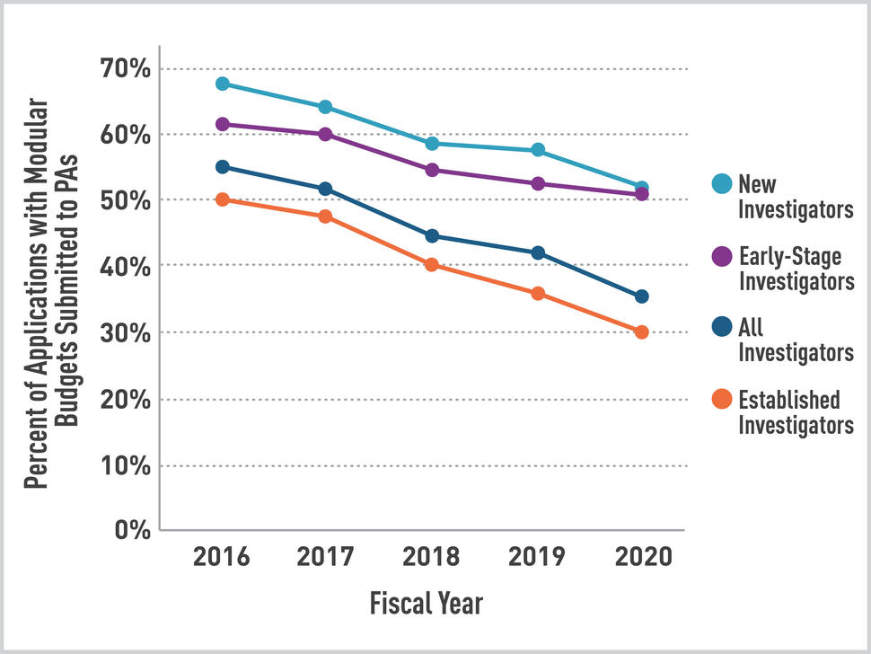
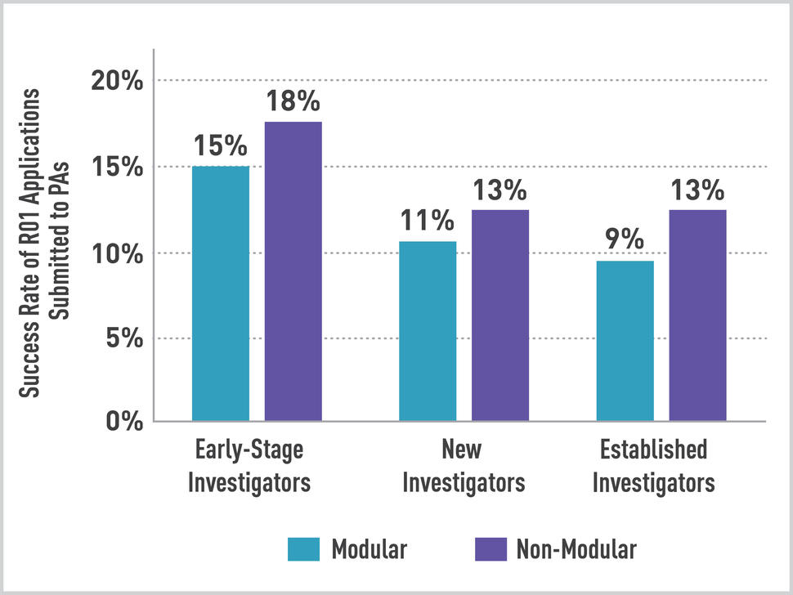
NCI R01 ESI Modular vs. Non-Modular Budget
Budget must be appropriate and scientifically justified for the research scope proposed
There is no disadvantage to submitting a non-modular budget, with justifications
https://www.cancer.gov/grants-training/nci-bottom-line-blog/2022/modular-versus-non-modular-budgets
Notes:
Caveats:
1. The analysis of NCI R01 applications submitted in response to NIH PAs excludes: 1) requests for applications (RFAs), and 2) applications to PAs with special receipt dates and special referral and/or review considerations (known as PARs). Also, the analysis included only new (Type 1) R01 applications to PAs that were reviewed and when a resubmission application was submitted in the same FY as the original application, the two applications were counted as one. Established investigator, new investigator, and early-stage investigator status was determined based on the characteristics of the application.
2. The conclusions are based on NCI application and award data only, and these conclusions should not be applied to applications submitted to other NIH institutes.

Slide 12
CSR Early Career Reviewer (ECR)
Unique, first-hand experience with CSR peer review to improve your own grant writing skills by getting an insider’s view of how grant applications are evaluated
Apply here: https://www.csr.nih.gov/EAVS/login
Questions? Email CSRearlyCareerReviewer@mail.nih.gov
Eligibility:
Have not served on an NIH study section in any capacity aside from as a mail reviewer
Have not held an R01 or R01-equivalent (R35, R37, RF1, R23, R29, DP1, DP2, DP5, U01, RL1) grant in the PD/PI role
Must have submitted a grant proposal, in the PI/PD role, to the NIH and received the associated summary statement

Slide 13
Contact Your Program Officer/Director
Your Program Officer will help you:
To identify the right type of grant program and/or funding opportunity for you and your research​
To review, develop and draft Specific Aims page
To discuss the summary statement and outcome of review
To strategize resubmission (A1) options and timing
To talk about progress or scientific and administrative issues that arise with the grant after award

Slide 14
Contact Your Program Officer/Director
https://reporter.nih.gov/matchmaker
Enter Text

Slide 15
Questions Welcome! Email: Lillian.Kuo@nih.gov Twitter: @NCICancerBio

Slide 17
Training and Career Development Awards

Slide 18
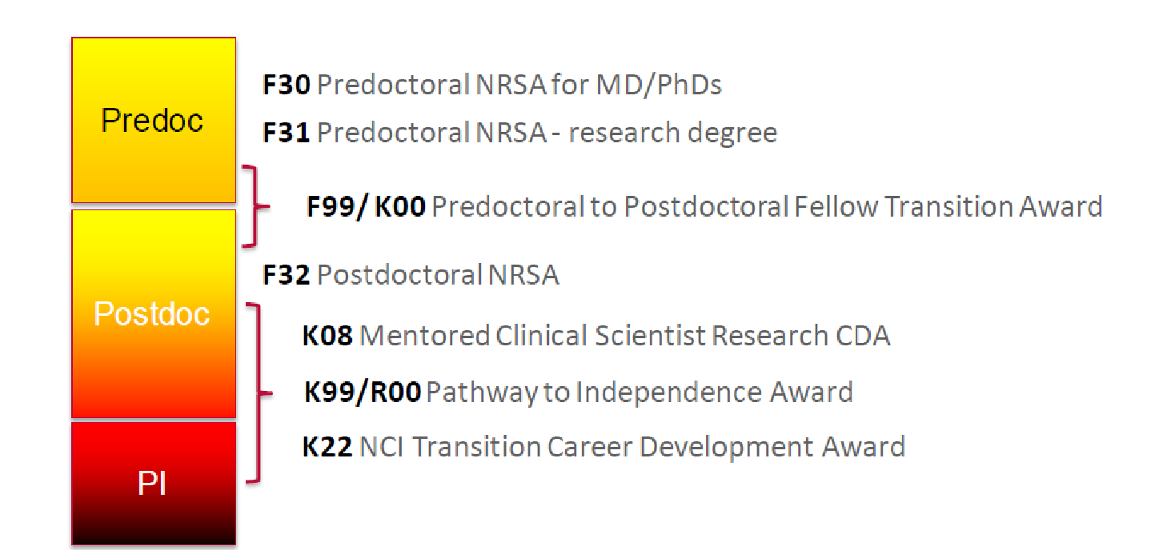
Training and Career Development Opportunities
https://www.cancer.gov/grants-training/training/funding
Michael Schmidt, Ph.D., mschmidt@mail.nih.gov

Slide 19
Types of NCI Career Development (K) Awards
Different types of K awards for different career stages and trajectories
K08: provide "protected time" (3-5 years) to support didactic study and/or mentored research for individuals with clinical doctoral degrees
K22 and K99/R00: help outstanding mentored, non-independent investigators in transitioning to research independence

Slide 20
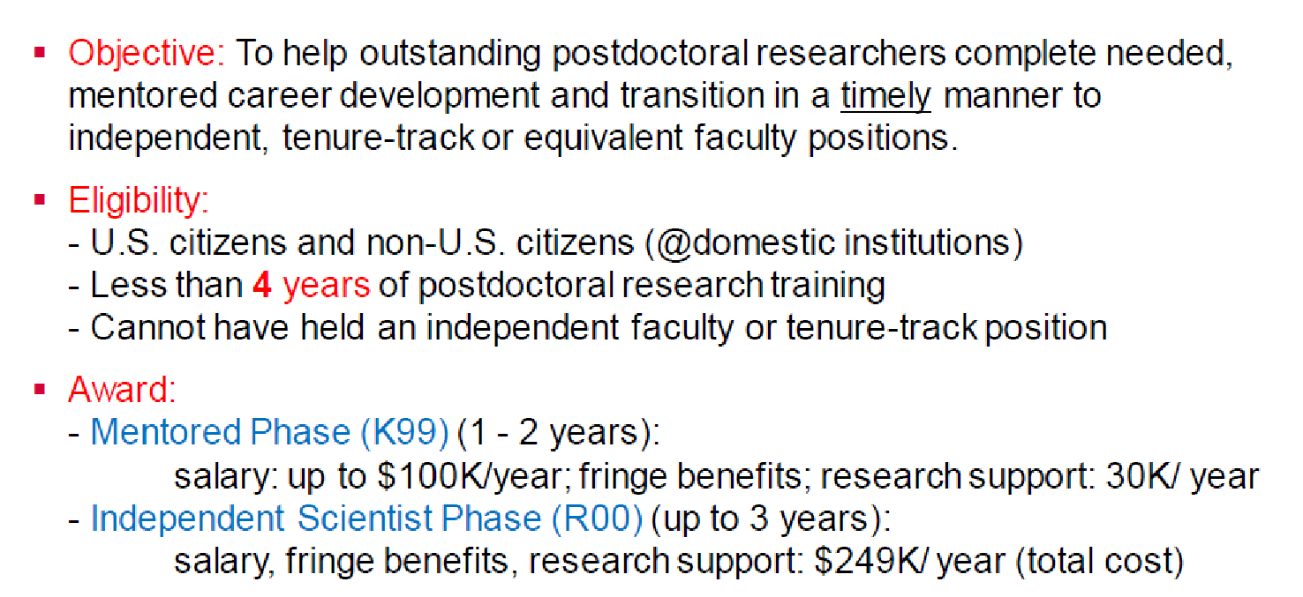
K99/R00: Pathway to Independence Award

Slide 21
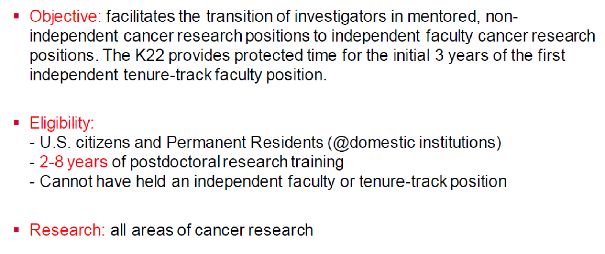
NCI Transition Career Development Award (K22)

Slide 22
Critical Elements for K Applications
Candidate: motivated, well-trained, productive
Mentor(s): strong mentoring and funding track record, highly qualified, committed to support the candidate
Career Development/Training Plan: meaningful training in research and professional development
Research Strategy: innovative, good training platform/ vehicle for transition to independence (high feasibility/ high impact; niche for applicant’s own lab)

Slide 23
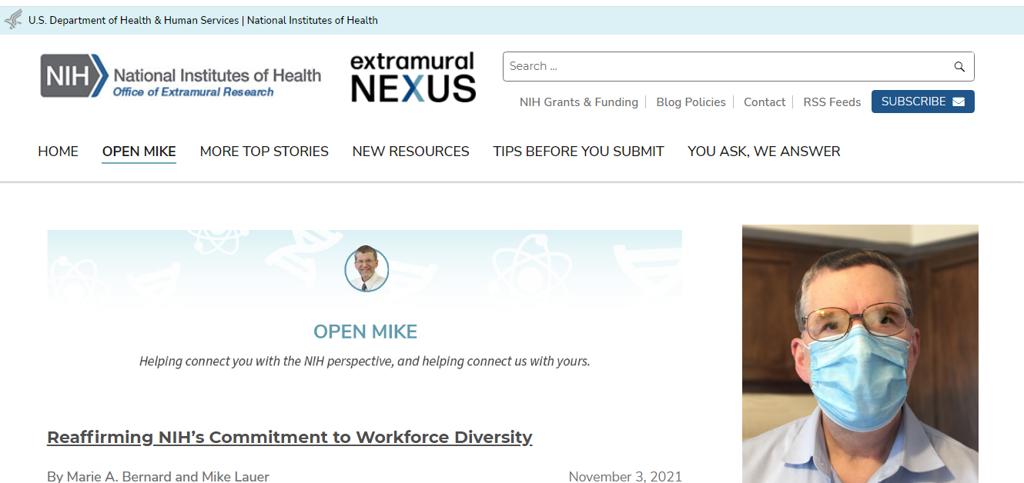
Subscribe to Email Alerts
https://nexus.od.nih.gov/all/
CLICK HERE

Slide 24
Search for Funding Opportunities
https://grants.nih.gov/funding/index.htm
Enter Keywords

