Slide 1
Combination Immunotherapy
Bambi Grilley, RPh, CCRP, CCRC, CIP, RAC
grilley@bcm.edu
Director, Clinical Protocol Research and Early Product Development
Associate Professor, Pediatrics
Center for Cell and Gene Therapy
Baylor College of Medicine

Slide 2
Disclosures
I own QBRegulatory Consulting, LLC which has agreements with:
March Bio
Tessa Therapeutics
Proxima

Slide 3
Why Do We Want to Combine Immunotherapy?
Convert non-responders to responders
overcome primary resistance
Rescue patients who progress on immunotherapy
overcome secondary resistance
Deepen responses that do occur
increase survival benefit
Harness tumor biology to support immunotherapy
monoclonal antibodies
small molecule inhibitors
Integrate with historical treatment modalities
chemotherapy
radiation

Slide 4
The Cancer Immunity Cycle
“Cold”
tumors
“Hot”
tumors
Chen DS, Mellman I, Cancer Immunity 2014

Slide 5
Harnessing the Cancer Immunity Cycle for Therapeutic Benefit
Chen DS, Mellman I, Cancer Immunity 2014

Slide 6
Optimizing the Development of Immunotherapy Combinations
traditional development path is basic discovery to preclinical modeling to testing patients
modern development path interrogates human tumors, both at baseline and after exposure to drugs of interest, to rank the combinations of most interest to test--one drug may have limited activity in itself, but may sensitize tumors to a second agent – then test both preclinically and in humans
carefully set the bar for activity of a combination immunotherapy relative to the activity or either single agent in the context of the tumor type in which it is being tested
evaluate pharmacodynamic changes with systems biology technologies (agnostic and high throughput)
consider the impact of context and drug sequence (also drug dose)
Mellman I et al. Cancer Immunol Res 2016;4:279-288

Slide 7
Combining Immunotherapy with Other Treatment Modalities may result in a Combination Product
Combination Products are products that combine biologics and/or drugs or devices. A more complete definition is provided in 21CFR3.2
Review of such products can cross the lines of separation between the FDA's medical product centers:
Center for Biologics Evaluation and Research (CBER)
Center for Drug Evaluation and Research (CDER)
Center for Devices and Radiological Health (CDRH)
This results in differences (generally more challenging) in the regulatory pathway for such products

Slide 8
Case Study: Somatic Cell Therapy
HER2 CAR T-cells

Slide 9
HER2: an immunotherapeutic target for CART
Notes:
**NOTE: mention that HER2 is found on normal cells in the body
Human epidermal growth factor 2 or HER2 is differentially expressed in a number of solid tumors including many sarcomas and a proportion of brain tumors in children and adults. While its surface expressed at too low levels for Mab antibodies to be effective, degree of HER2 expression has been described to be associated with poorer outcomes even in some cancers that lack gene amplification. Using various pre-clinical models, Nabil has previously shown that low HER2 expressing tumors can be effectively targeted using CAR T cells. This led to the HER2 CAR T cell program at our center which is based on a FRP5-scFv derived, CD28-containing 2nd generation CAR.
Herceptin binds to the juxtamembrane region of HER2 on the C-terminal portion of subdomain IV.

Slide 10
Initial IND Targeting (Osteo)Sarcoma
May 2009: IND Submitted
June 2009: IND placed on clinical hold
Somewhat simultaneously with IND submission, there was a patient death at another site who had been treated with similar (but not identical) CAR T cells at a higher dose and inclusive of lymphodepletion.

Slide 11
HEROS IND –Targeting Osteosarcoma
Dose levels in initial submission
DL1 1x10⁷/m²
DL2 1x10⁸/m²
DL3 1x10⁹/m²
Study allowed to proceed in January 2010 with the following dose levels:
Dose Level 1: 1x10⁴cells/m²
Dose Level 2:3x10⁴cells/m²
Dose Level 3: 1x10⁵cells/m²
Dose Level 4: 3x10⁵cells/m²
Dose Level 5: 1x10⁶cells/m²
Dose Level 6: 3x10⁶cells/m²
Dose Level 7: 1x10⁷cells/m²
Dose Level 8:3x10⁷cells/m²
Dose Level 9: 1x10⁸cells/m²

Slide 12
Next Steps: March 2010
We had a number of HER2 CART cells protocols with slightly different products being used in different diagnoses
We requested that following advice from the NIH RAC the safety data from these studies be allowed to be reviewed in aggregate
Not approved however, the FDA stated that if we had data on a suitable number of patients (in the future) we could approach them with a plan to start new studies at a higher dose level

Slide 13
Getting started
August 2010: First patient was treated
May 2011: Accrual 5 patients on this study 3 patients on other HER2 CART cell studies
Dose range for these patients: 1X10⁴ – 1X10⁶.
Number of doses (Additional doses provided following FDA approval on a case by case basis): 1 patient received a total of 2 doses 1 patient received a total of 3 doses Results: Although there was some persistence of the T cells there was no in vivo expansion, no changes in the plasma cytokine levels and no clinical responses.

Slide 14
July 2011: Request to skip DL3 and DL4
The request was approved in July 2011. The new dosing schedule:
Dose Level 1: 1 x 10⁴ cells/m²
Dose Level 2: 3 x 10⁴ cells/m²
Dose Level 3: 1 x 10⁵ cells/m²
Dose Level 4: 3 x 10⁵ cells/m²
Dose Level 5: 1 x 10⁶ cells/m²
Dose Level 6: 3 x 10⁶ cells/m²
Dose Level 7: 1 x 10⁷ cells/m²
Dose Level 8: 3 x 10⁷ cells/m²
Dose Level 9: 1 x 10⁸ cells/m²

Slide 15
Later in July 2011
With an increasing number of subjects requesting additional doses to consolidate or improve clinical responses, we discussed the addition of repeat doses to the protocol.
The FDA was supportive of this approach and a modified protocol inclusive of repeat dosing was submitted to the FDA in October 2011 and allowed to proceed.

Slide 16
HEROS: HER2 CAR T cells for OSteosarcoma
Notes:
We have previously shown the safety of intravenous administration of this second generation HER2 CAR T cells in patients with advanced sarcomas. This dose escalation study consisted of 8 dose levels with 1x10e8 cells/m2 being the highest dose infused with no DLTs.
Infused T cells homed to the tumor site as confirmed by CD3 expression and qPCR for transgene detection in the tumor biopsies.
Major limitations were the lack of expansion and poor persistence of infused CAR T cells.

Slide 17
The addition of Lymphodepletion (HEROS 2.0)
September 2014: Based on preliminary internal data and the data that has been recently presented on CAR studies across the US showing that lymphodepleting chemotherapy has been helpful with improving the expansion & persistence of CAR T cells and thereby increasing the potential for anti-tumor efficacy.
Dose Level 1: 1x10⁴cells/m²
Dose Level 2:3x10⁴cells/m²
Dose Level 3: 1x10⁵cells/m²
Dose Level 4:3x10⁵cells/m²
Dose Level 5: 1x10⁶cells/m²
Dose Level 6: 3x10⁶cells/m²
Dose Level 7: 1x10⁷cells/m²
Dose Level 8:3x10⁷cells/m²
Dose Level 9: 1x10⁸cells/m²
Dose Level 9A: Flu followed by 1x10⁸cells/m²
Dose Level 9B: Flu/CTX followed by 1x10⁸cells/m²

Slide 18
April 2019 (DL9C)
The highest dose level of cells to be 1X10⁸/m² CAR positive cells rather than the total T cell dose.
This final change was made to improve consistency in dosing when previously variable transduction efficiencies (ranging from 61.9% to 98.3%) may have led to slight inconsistencies.

Slide 19
Patients treated (HEROS 2.0)
Notes:
Table here summarizes the characteristics of all patients treated. In summary, total 13 patients were treated in 14 enrollments.
12 patients were younger than 18 years of age at the time of T cell infusion, with the median age of 14 years for the study cohort.
Majority of the patients had osteosarcoma, followed by rhabdomyosarcoma.
All patients had metastatic disease at initial diagnosis or at recurrence and had disease progression after 2 or more lines of treatment.

Slide 20
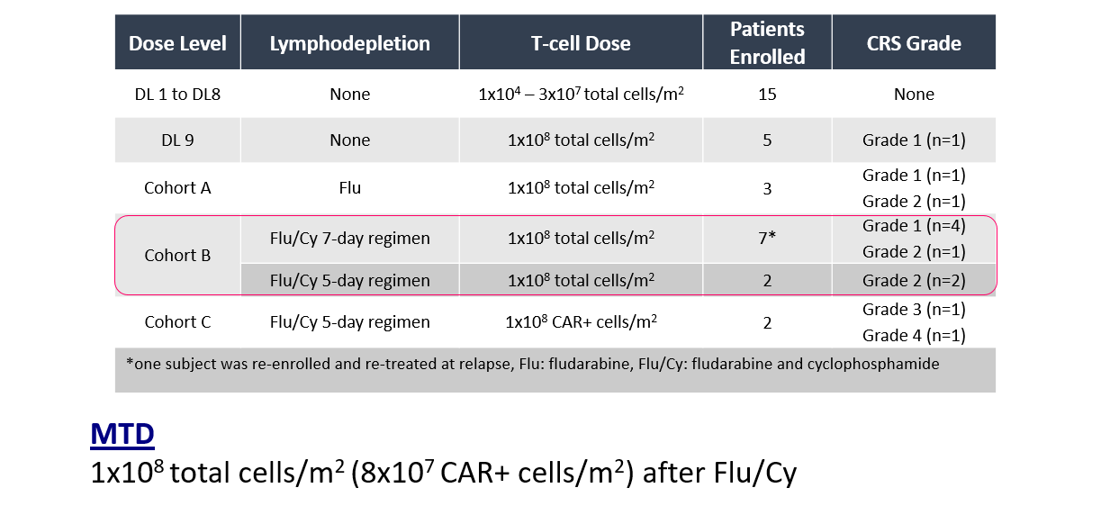
CRS-like syndrome after HER2 CART (HEROS and HEROS 2.0)
Notes:
The Table here summarizes the CRS grade by dose level including the historical controls infused with CAR T cells only. In the current cohort, 5 patients developed grade 1 CRS and 4 patients had CRS grade 2. Two patients who received CAR+ cell dose in cohort C experienced grade 3 and 4 CRS with respiratory adverse event which were considered dose limiting toxicities. All patients recovered completely from CRS. Based on the study criteria, 1x10e8 total cells/m2 infused after Flu/Cy in cohort B was determined to be the MTD.

Slide 21
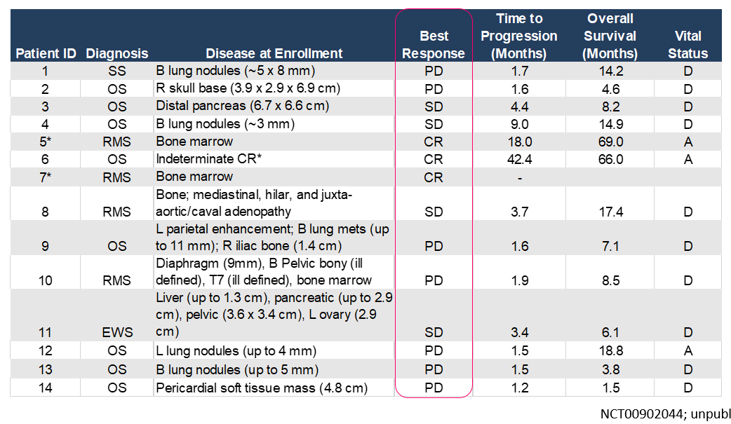
Clinical Responses (HEROS 2.0)
Notes:
All patients were evaluable for response. The table here summarizes the disease burden at the time of T cell infusion and the best response at 6 weeks post-infusion.

Slide 22
Survival outcomes
Notes:
In summary, of the 14 enrollments, 4 had stable disease lasting from 3.4 to 9 months, 3 had complete response and 7 had progressive disease at 6-week evaluation. At the time of last follow up, 3 patients are alive, and one patient remains without disease. At the maximum tolerated dose infused in cohort C, 66% of the patients had clinical benefit and the median overall survival was 16 months.

Slide 23
Subject 6 (HEROS 2.0): CR, HER2 loss, Relapse
16-year-old female with 4th recurrence (2013-2015)
5 lines of therapy
H/o b/l lung metastatectomy (x3)
S/p resection of a 10 cm pleural based right pulmonary mass with positive surgical margin
*FDA allowed her enrollment without active disease due to the high likelihood of recurrence of her aggressive tumor. She received cells in May 2016, 8 wks after the surgery. She remained without disease progression and CAR transgene was detected at low levels in the peripheral blood (qPCR). A persistent lung nodule was resected 13 mths after the T cells and showed chronic inflammatory cells and sclerosis; no tumor was identified.
CR for 42 months after CART
Notes:
This 16-year-old girl was initially diagnosed with osteosarcoma in 2010, later had 4 recurrences in the span of 2 years, involving bilateral lungs that failed to respond to multiple lines of therapies. She was infused with HER2 CAR T cells 8 weeks after resection of a 10 cm pleural based pulmonary metastasis which on histopathology had positive surgical margins.
A persistent left lung nodule (~0.5 cm) was resected 13 months post-infusion and showed no tumor.
She remained without disease progression or recurrence for 3.5 years. The recurrent tumor in the right lung was HER2 negative. Vimentin staining was used to assess for potential antigen loss during tumor processing and was positive.

Slide 24
Case Study: Patient SN
At 42 months post CAR T cell infusion, SN experienced relapse in the right lung adjacent to the prior surgical site. The recurrent tumor was HER2 negative. Therefore, Ms. SN was considered ineligible to receive additional HER2 CAR T cell infusions and the tumor was treated with radiation therapy followed by surgical resection.
SN experienced a new recurrence in March 2022 with a large right paraspinal/pararenal mass adjacent to the site of prior recurrence. Biopsy was performed and histopathology confirmed the diagnosis of metastatic osteosarcoma. The tumor was found to be HER2 positive. SN received radiation therapy and tumor resection. The patient, her family and her oncologist contacted us for a 2nd infusion of HER2 CART cells. We discussed this plan with the IRB and FDA and this retreatment occurred at the end of August 2022 (almost 6 years later).

Slide 25
New Protocol (iCAR); Same IND
In May 2015 we submitted a study that utilized the same product however in this case it was to be infused intra-cranially to patients with HER2-positive Glioblastoma. This protocol was allowed to proceed with no discussion. Patients are stratified into high risk (patients with tumors expressing high amounts of HER2) and standard risk. Dosing is as follows (without lymphodepletion):
Cell Dosing schedules
Cycle |  | Dosing Schedule 1 | Dosing Schedule 2 | Dosing Schedule 3
1 |  | A: 1x10⁷ | A: 1x10⁷ | A: 1x10⁷
2 |  | A: 1x10⁷ | B: 3x10⁷ | B: 3x10⁷
3 |  | A: 1x10⁷ | B: 3x10⁷ | C: 1x10⁸
Total Dose over 6 weeks |  | 3 x 10⁷ | 7 x 10⁷ | 14 x 10⁷
Restaging
Subsequent cycles* | ≤ 1x10⁷ |  | ≤ 3x10⁷ | ≤ 1x10⁸
*Additional cycles may be administered at ≤ the final cell dose reached in cycle 3, provided that the subject continues to meet eligibility criteria and does not have confirmed progressive disease.

Slide 26
New Protocol (iCAR); Same IND
The study has subsequently been amended to allow for enrollment of other brain tumors and HER2+ cancers metastatic to the brain
8 pts have been treated. 7 in standard risk, 6 of which are evaluable:
The High risk patient had SD
# of Subjects | Response
4 | Had PD
1 | Had SD
1 | Had cCR
Notes:
cCR = Continuing Complete Response

Slide 27
Multi-site study
In July 2021 we submitted a new multi site study being organized by a cooperative group
*16 sites were invited to participate
*The study targets ependymomas and utilizes IV HER2-CAR T cells in combination with lymphodepleting chemotherapy.
*In addition to being a safety/efficacy study this is also a feasibility study to access the ability to conduct this study across multiple sites across the USA.
*At the time of last data freeze (earlier in 2022) the protocol had not accrued any patients.

Slide 28
HEROS 3.0
More recently (October 2021) we submitted a new protocol which includes not only lymphodepletion but also a PD1 Inhibitor (pembrolizumab). Dosing is as follows
NOTE: The protocol does allow for treatment with Nivolumab for patients whose insurance doesn’t cover pembrolizumab.
No patients had been treated at the time of the last data freeze.
Dose Level | Lymphodepletion | HER2 CAR T Cells | PD-1 Antibody
 |  |  | Dosage | Timing
-1 | Fludarabine* plus Cyclophosphamide* | 5x10⁷ cells/m²** | Pembrolizumab 2 mg/kg/dose (max 200 mg/dose) every 3 weeks | Starting at least 7 days after T cell infusion or after all symptoms of CRS have resolved, whichever is later
1 | Fludarabine* plus Cyclophosphamide* | 1x10⁸ cells/m²** | Pembrolizumab 2 mg/kg/dose (max 200 mg/dose) every 3 weeks

Slide 29
Current Status of this IND
In addition to these clinical trials we also submitted 2 patient specific protocols for patients with HER2 positive disease not included in this IND.
Overall, at this time, the IND filing fills fifteen 3 inch binders (114 cm)
3 clinical trials remain active on this IND

Slide 30
VISTA
May 2020 we further expanded development of this product by submitting a new IND inclusive of a in a clinical trial that treats patients with advanced refractory HER2 positive solid tumors.
Patients will receive a novel oncolytic adenovirus (CAdVEC; expressing human IL-12p70, HSV-tk and anti-human PD-L1 blocking mini-antibody as intratumoral injection). With the first dose level to be given as a single agent, and subsequent dose levels given in combination with the HER2 CART cells previously discussed in this presentation.

Slide 31
VISTA
Since the study includes 2 investigational agents we developed a novel approach to dose escalation in which each of those two agents will be sequentially escalated at three different dose levels.
Dose Level | CAdVEC | HER2.CAR-AdVST
1 | 1.00E+10 | 0
2 | 1.00E+10 | 1.00E+06
3 | 1.00E+11 | 1.00E+06
4 | 1.00E+11 | 1.00E+07
5 | 1.00E+12 | 1.00E+07
6 | 1.00E+12 | 1.00E+08
The IND was placed on clinical hold during initial review for further data on the adenoviral product however the issues were addressed and the hold was removed in July 2020

Slide 32
Preliminary Results: VISTA
We have treated 9 subjects; 6 of whom were able to complete treatment and the initial follow-up specified in the protocol.
Of the 6:
# of Subjects | Response
1 | Had PD
1 | Had PR
1 | Had a CR
3 | Had SD

Slide 33
Summary of Data for HER2 Product at BCM
HER 2 can be safely targeted using CAR T cells
Lymphodepletion leads to improved expansion of HER2 CART cells with evidence of antitumor activity
Repeat infusions could overcome poor persistence
Identifying the mechanism(s) and determinants of toxicity is needed
Multi-institutional trials will determine feasibility and increase the speed of outcome data
Biological correlatives and pre-clinical models are need to pin town tumor adaptations
Rational development of CART platforms/combination therapies benefit research initiatives

Slide 34
Conclusions
Immunotherapy can transform the lives of cancer patients who respond
To date, a minority of cancer patients benefit from immunotherapy
Combination immunotherapies could improve the impact of immunotherapy
The development of combinations should consider the immunobiology of the patient’s tumor, the mechanism of each agent, and how they might interact when given together
Trial designs should:
take into account the activity of monotherapy in the tumor type of interest to properly identify proper combination products
incorporate baseline, on-treatment, and post-progression tumor biopsies
Incorporate an agnostic, systems-based biomarker evaluation strategy to elucidate mechanisms of response and resistance
Unexpected and/or synergistic toxicities may occur with combination immunotherapies

Slide 35
Acknowledgements for the HEROS IND/Protocol
The patients and families
The referring physicians
Nabil Ahmed
Meena Hegde
Shoba Navai
Sujith Joseph
Vita Salsman
Rebecca Brock
Ahmed Gad
Jessica Morris
Michelle Choe
Saad Malik
Alesandra Echeandia
Lea Godret
Khaled Sanber
Kristen Fousek
Kevin Bielamowicz
Daniel Landi
Zeid Nawas
Rose Mathew
Matthew Campbell
Dolores Mullikin
Cynthia Chauvin
Tiara Byrd
Ankita Shree
Abraham Akerele
Nikita Aware
Malena M
Stephen Gottschalk
Winfried Wels
Chris DeRenzo
Catherine Robertson
Huimin Zhang
Birju Mehta
Olga Dakhova
John Hicks
Tao Wang
Jessie Wu
Natasha Lapteva
Adrian Gee
Susan Blaney
Will Parsons
Patty Baxter
David Poplack
Helen Heslop
Malcom Brenner
Pediatric Cancer Dream Team
Our collaborators
Patient advocates

Slide 36
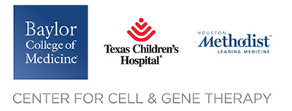
Suzuki Lab
Clinical PIs
Masataka Suzuki, Ph. D.
Amanda Rosewell Shaw, Ph.D.
Caroline Porter
Daisuke Morita, M.D., Ph.D.
Greyson Biegert
Daniel Wang, M.D.
Bora Lim, M.D.
Benjamin Musher, M.D.
Tao Wang, Ph.D.
Ya Xu, M.D.
GMP/GLP groups
CAGT PIs
Zhuyong Mei
Huimin Zhang
Birju Mehta
Sachin Thakkar
Malcolm K. Brenner, M.D., Ph.D.
Helen E. Heslop, M.D.
Clinical Research
Catherine Robertson
QA/QC
The patients and families
The referring physicians
Adrian Gee, Ph.D.
Natasha Lapteva, Ph.D.
Deborah Lyon
Aaron Orozco

