Slide 1
How to Handle Big Data and High Throughput Data
Single Cell Data Analysis Tools
Dinesh Kumar, Ph.D.
Director, Bioinformatics
SITC Winter School 2023

Slide 2
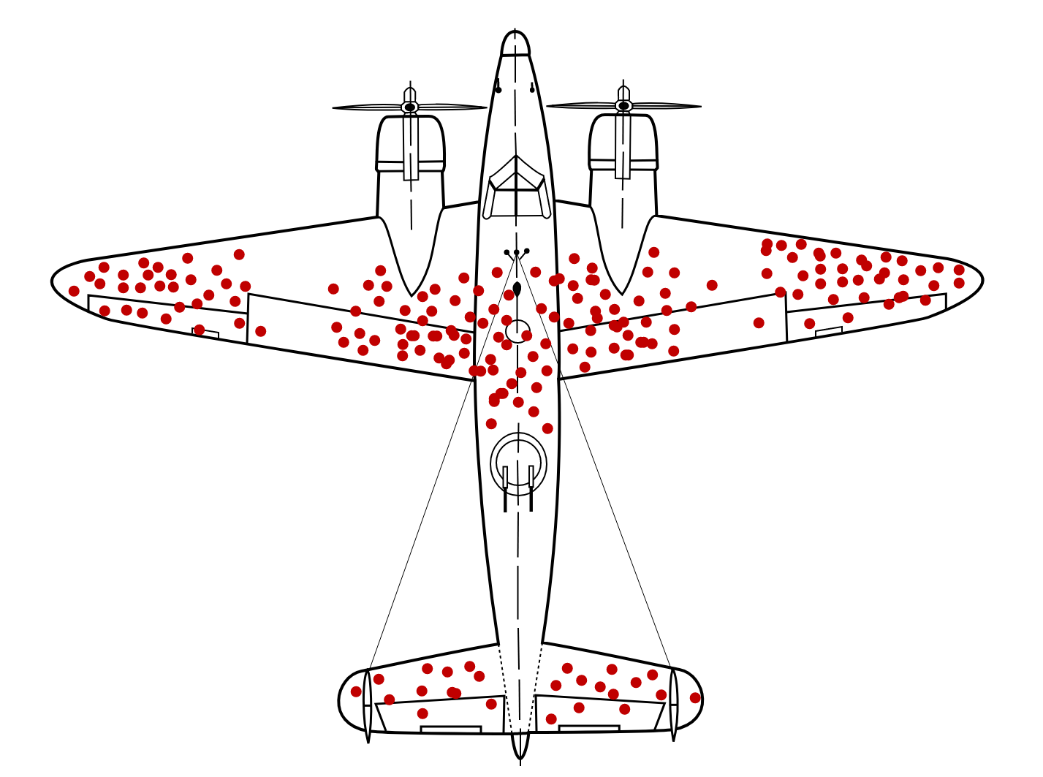

Slide 4
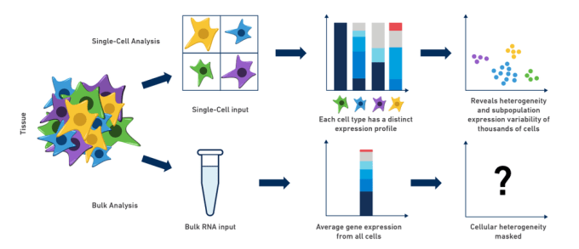
Why single cell genomics?

Slide 5
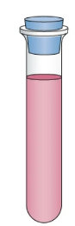
Central Workflow : Single Cell/Nuclei Sequencing
Oil
Cells/Nuclei
Gene x Cell Count Matrix
Barcode

Slide 6
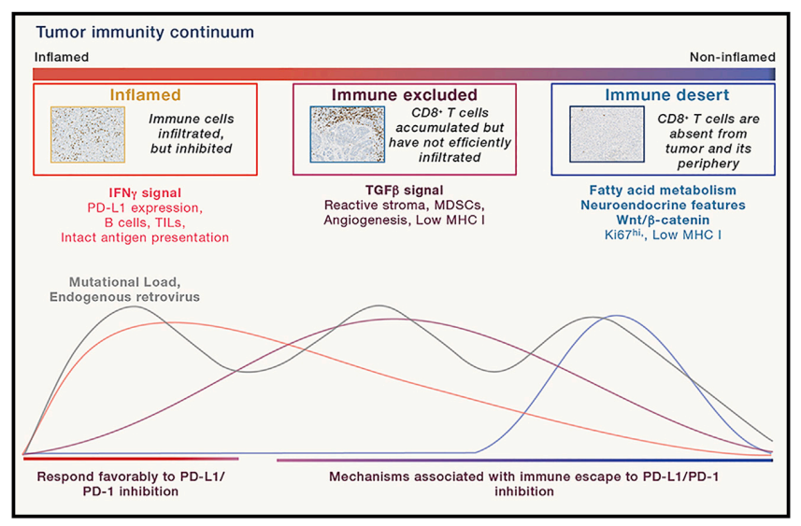
Challenge 1: Molecular Features of the TME on the Continuum Scale
Immunity, 2020 Jan 14;52(1):17-35. doi: 10.1016/j.immuni.2019.12.011
Notes:
Important to identify molecular features at the scale at individual cell type level

Slide 7
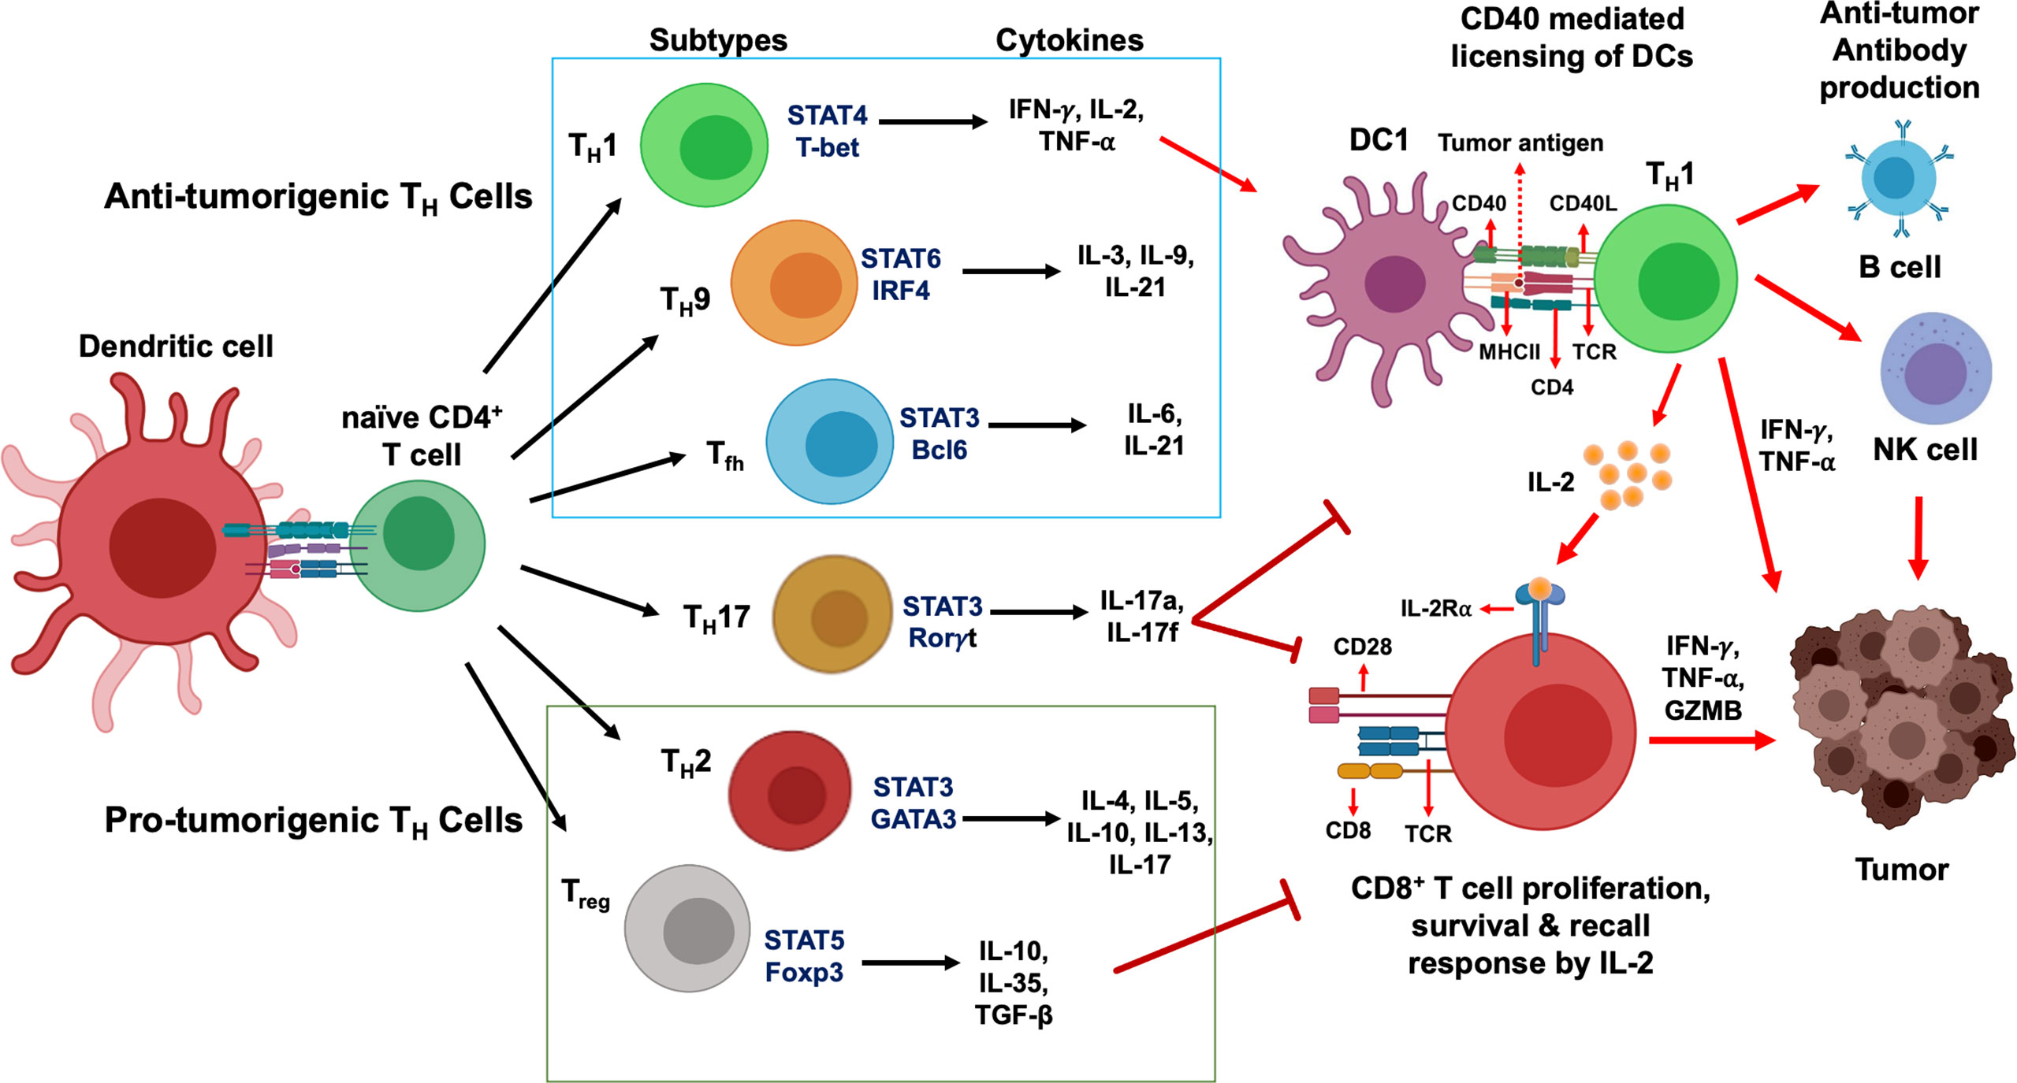
Challenge 2: Specific Cell Tuning
Sharma et. al., Cancer Discov. 2021
Jahchan et. al., Front. Immunol., 03 May 2021
Basu et.al., Front. Immunol., 25 July 2019
Notes:
Biomarkers of response and resistance to ICT. Tumor cell–specific and immune cell–specific biomarkers associated with response and resistance to ICT, and combinatorial biomarkers that may predict response to ICT. DC, dendritic cell; MSI, microsatellite instability; Teff, effector T cell; TLS, tertiary lymphoid structure; TMB, tumor mutational burden; Treg, regulatory T cell.

Slide 8
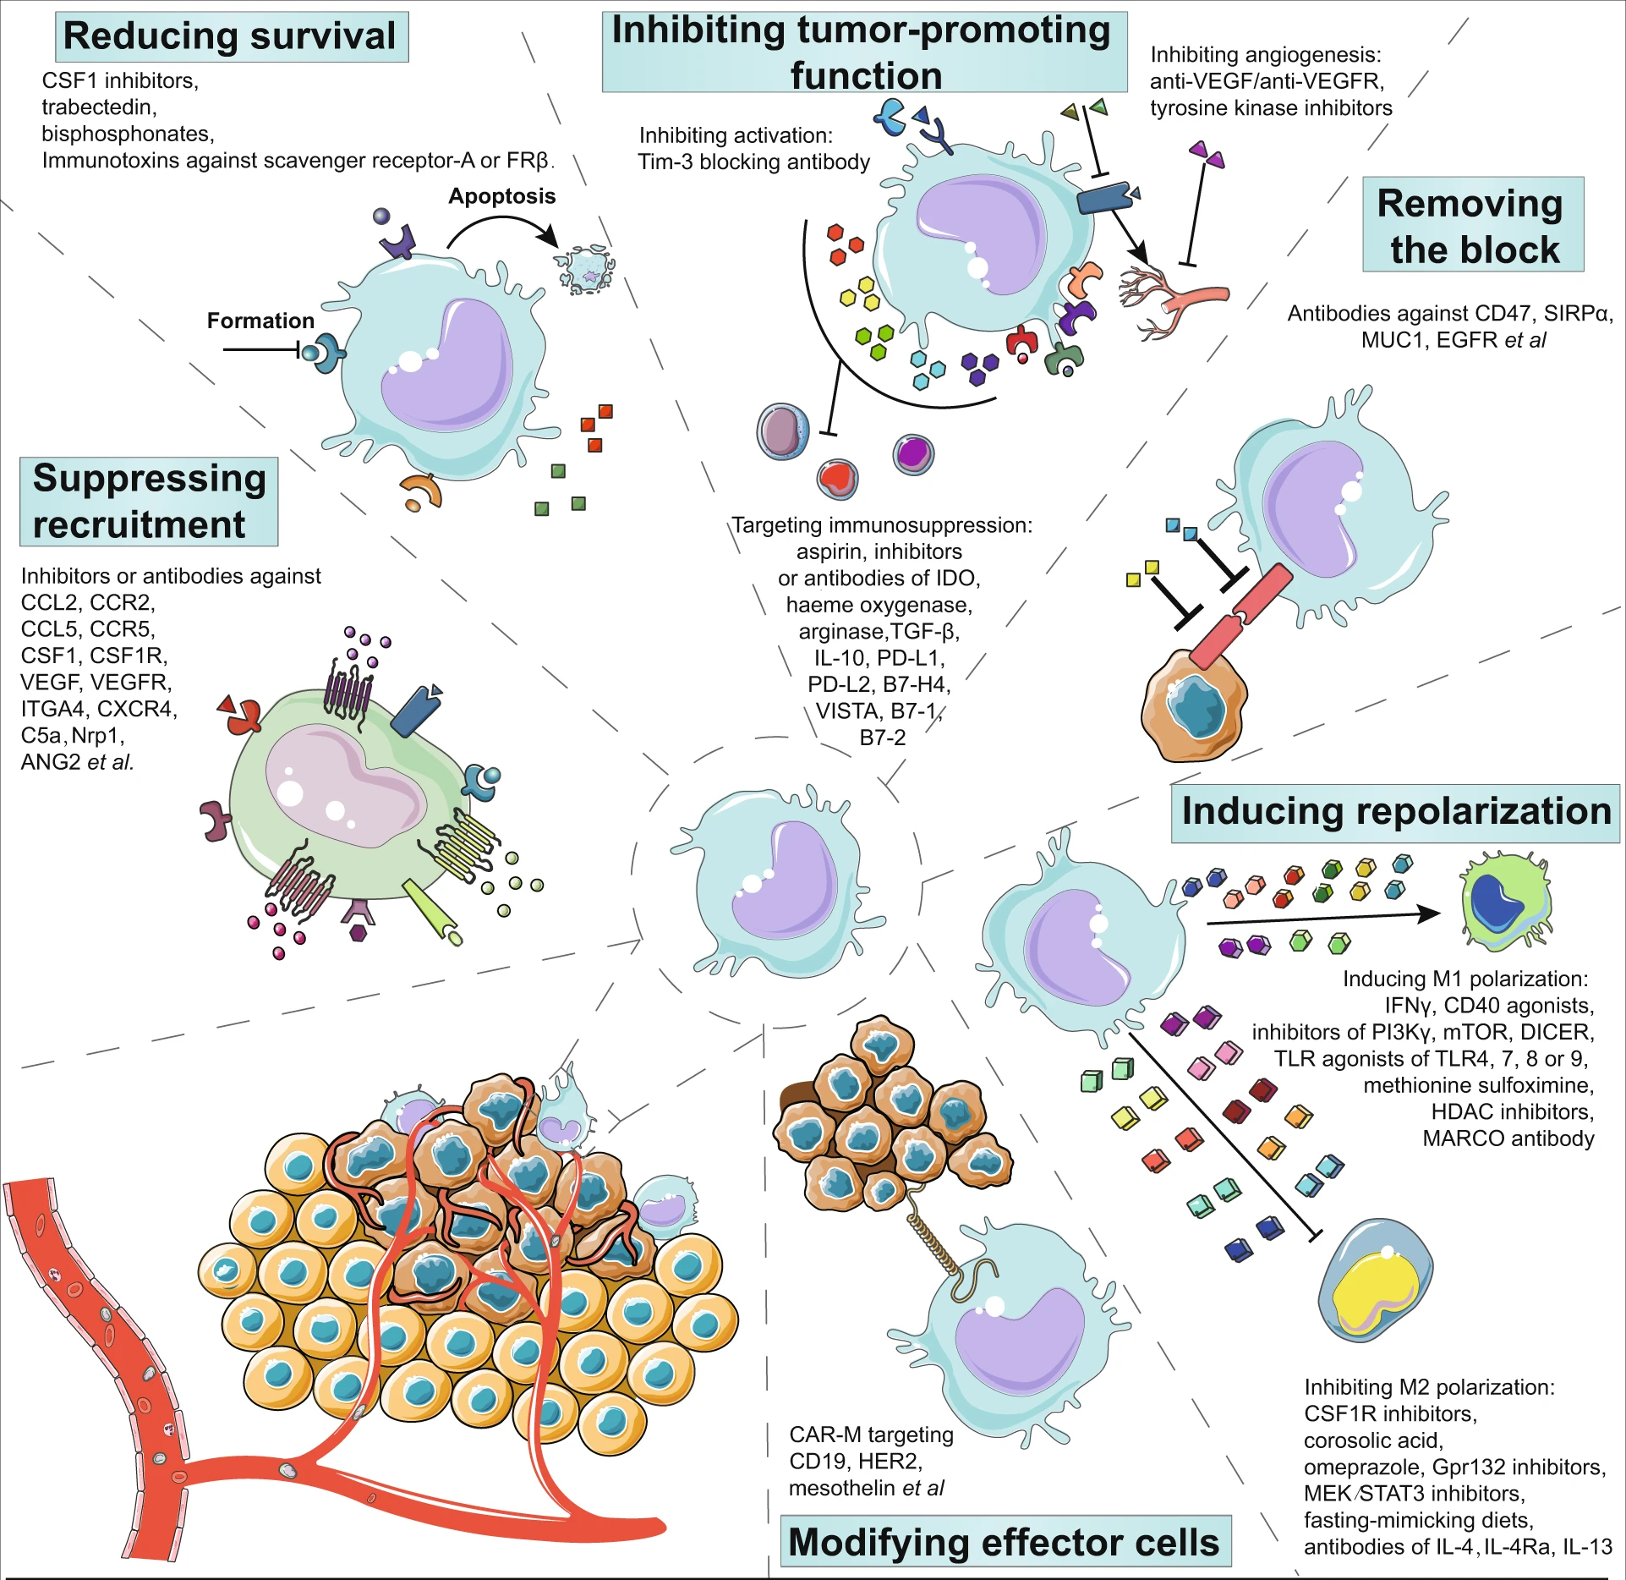
Challenge 2: Specific Cell Tuning
Targeting macrophages in cancer immunotherapy
Signal Transduction and Targeted Therapy volume 6, Article number: 127 (2021)

Slide 9
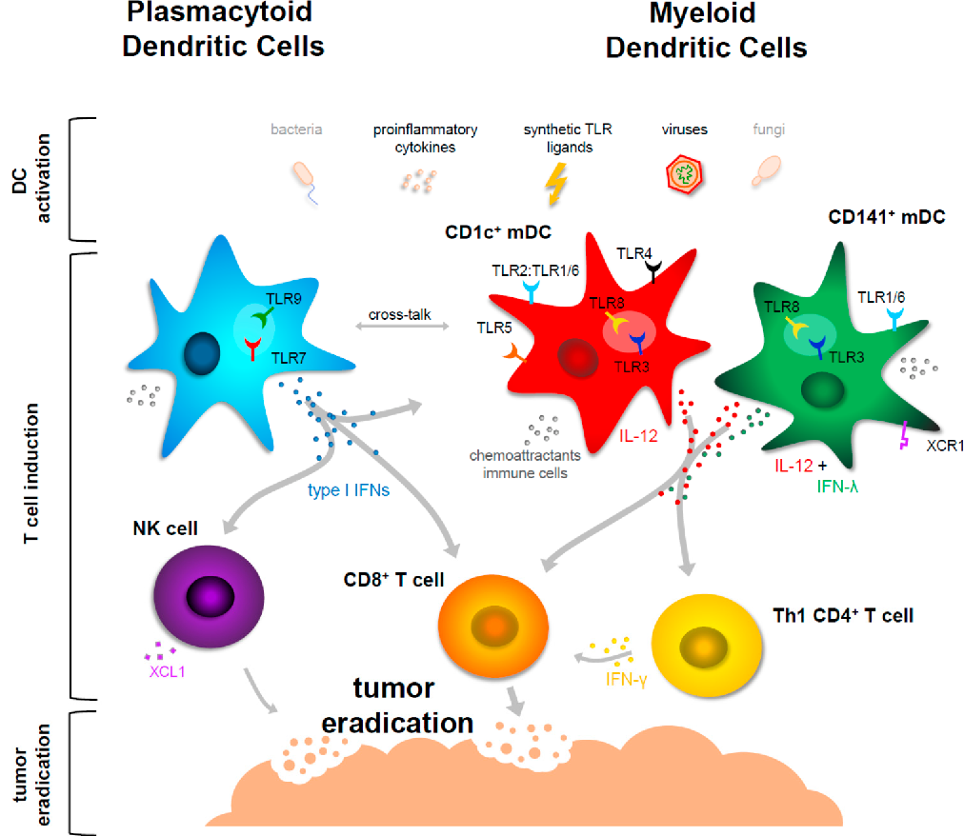
Challenge 2: Specific Cell Tuning
Tailoring the Immune Response by Dendritic
Cell Maturation
Biomedicines 2015, 3, 282-303; doi:10.3390/biomedicines3040282

Slide 10
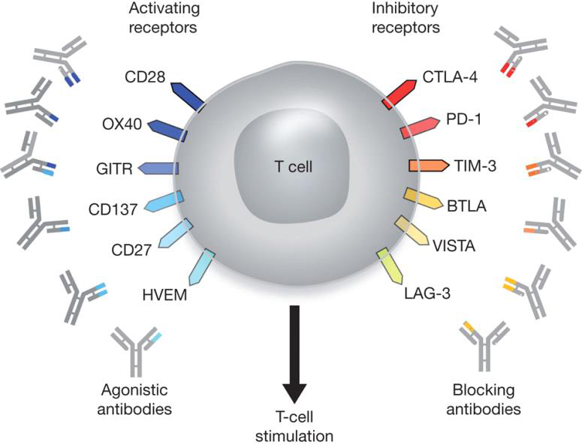
Challenge 3: Combination Strategy
Nature, 480, 2011
Notes:
Increasing and decreasing strength
Many of them…which cell type and when..
What combination we should target and how …

Slide 12
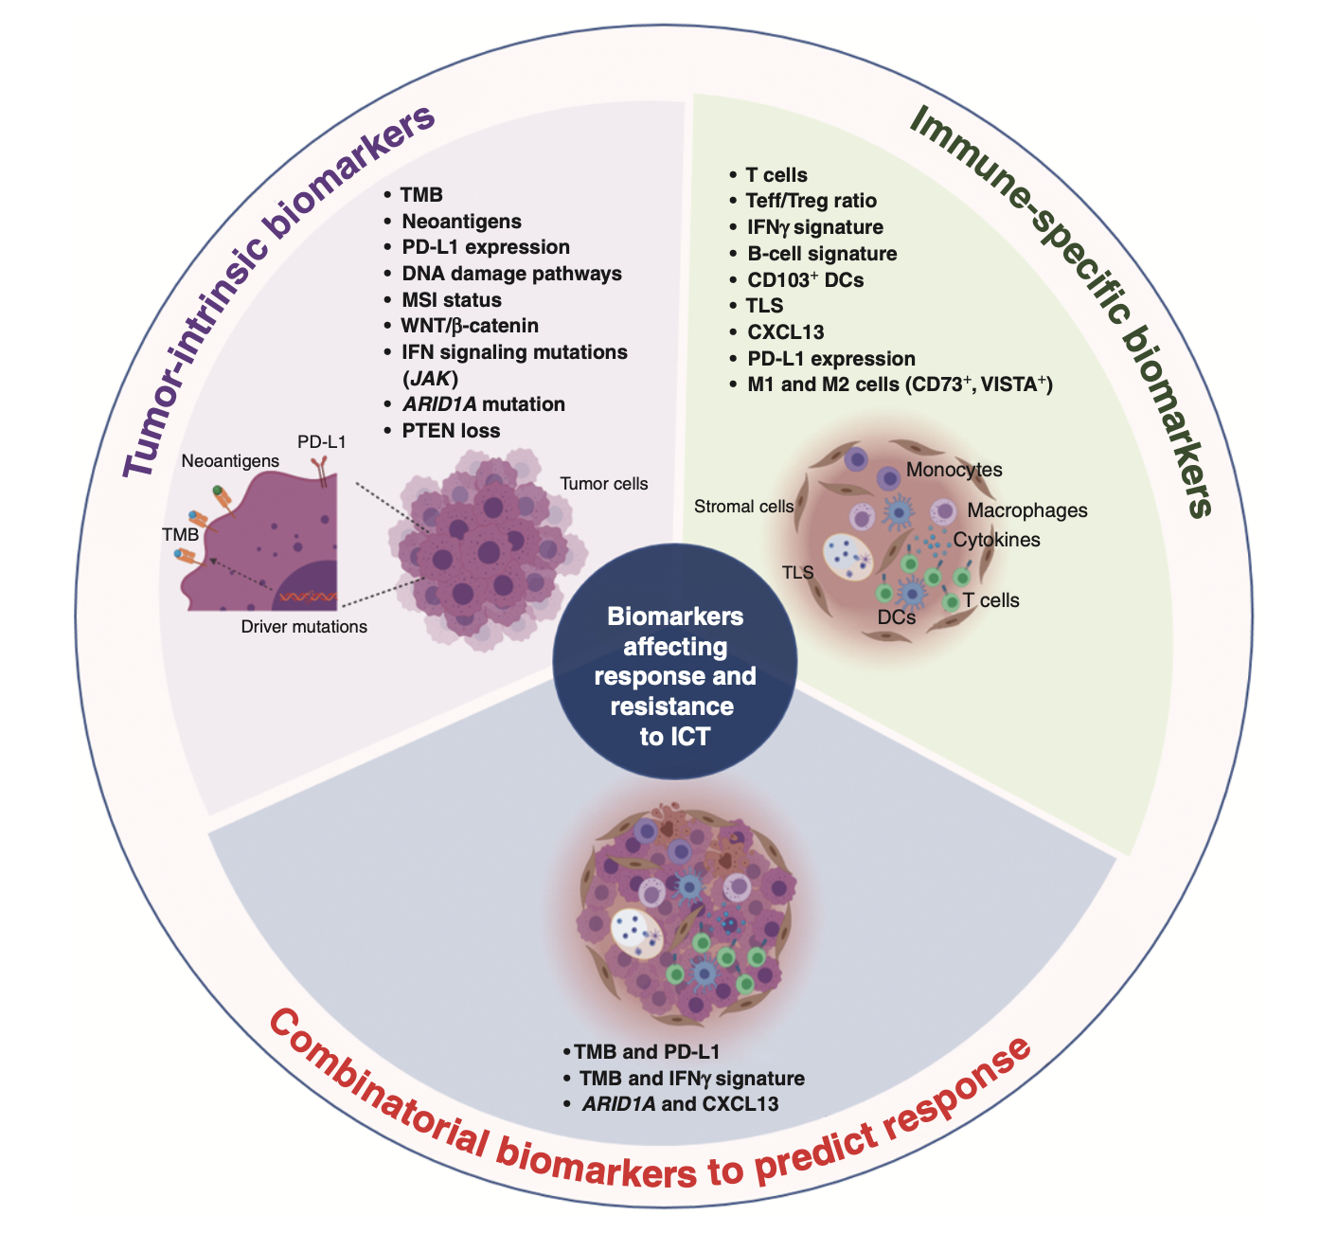
Challenge 3: Biomarkers of Response and Resistance to ICT
Sharma et. al., Cancer Discov. 2021
Jahchan et. al., Front. Immunol., 03 May 2021
Basu et.al., Front. Immunol., 25 July 2019
Notes:
Biomarkers of response and resistance to ICT. Tumor cell–specific and immune cell–specific biomarkers associated with response and resistance to ICT, and combinatorial biomarkers that may predict response to ICT. DC, dendritic cell; MSI, microsatellite instability; Teff, effector T cell; TLS, tertiary lymphoid structure; TMB, tumor mutational burden; Treg, regulatory T cell.

Slide 13
Several Immune Checkpoint Inhibitors are Approved or are in Drug Pipeline
Nature, 480, 2011

Slide 14
Central Workflow : Single Cell/Nuclei Sequencing
Oil
Cells/Nuclei
Gene x Cell Count Matrix
Barcode

Slide 15
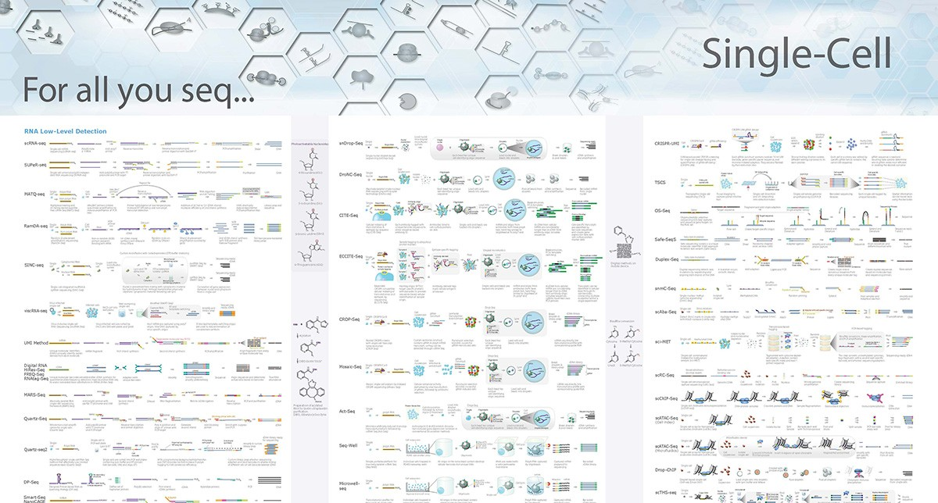
https://www.illumina.com/content/dam/illumina-marketing/documents/applications/ngs-library-prep/ForAllYouSeqMethods.pdf

Slide 16
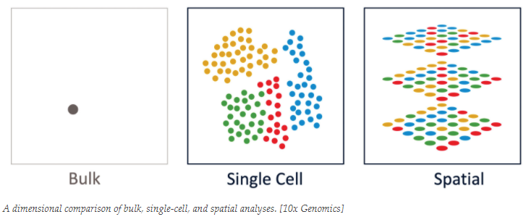
Single Cell Multi-Omics: The Big Data Integration and Analysis Challenge
Transcriptome
Methylome
Proteome
Chromatin (ATAC)

Slide 17
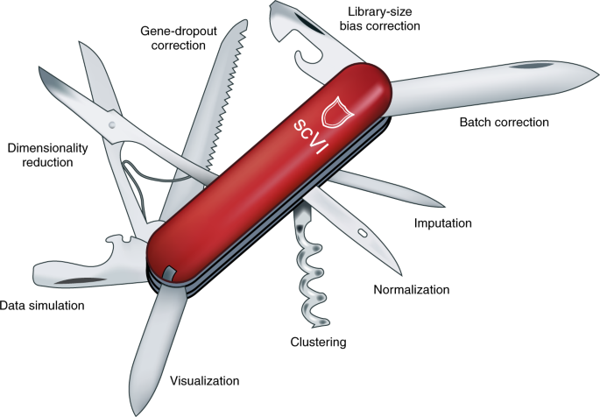
Tools for Single Cell/Nuclei Sequencing Data Analysis
Nature Methods volume 15, pages1009–1010 (2018)

Slide 18
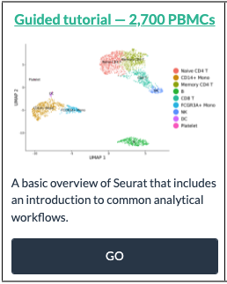
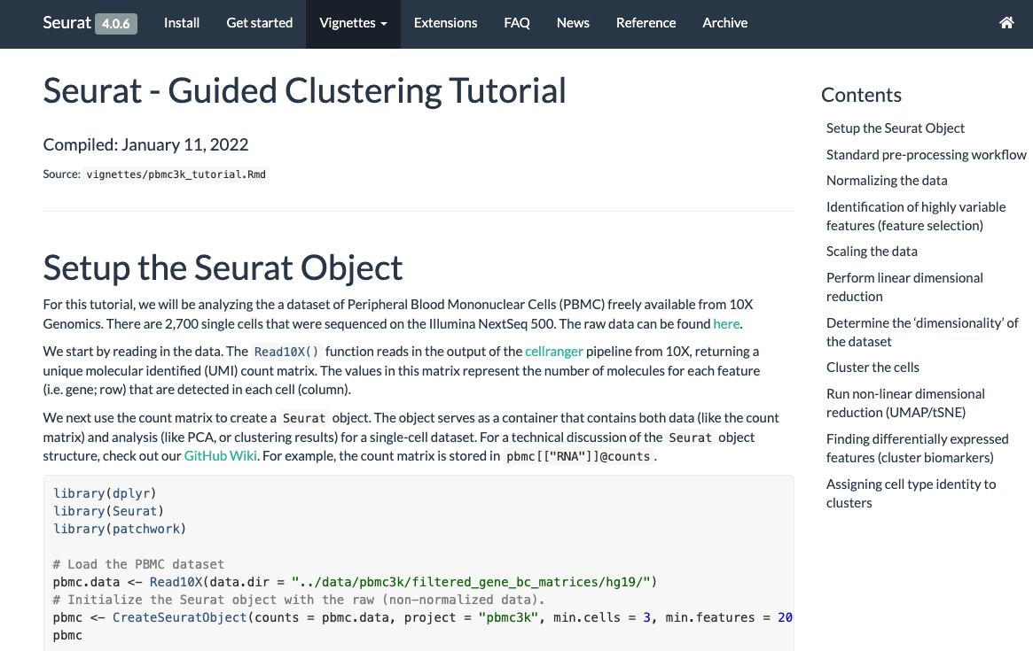
Seurat: Great Place to Start for Single Cell Analysis
https://satijalab.org/seurat/articles/pbmc3k_tutorial.html

Slide 20
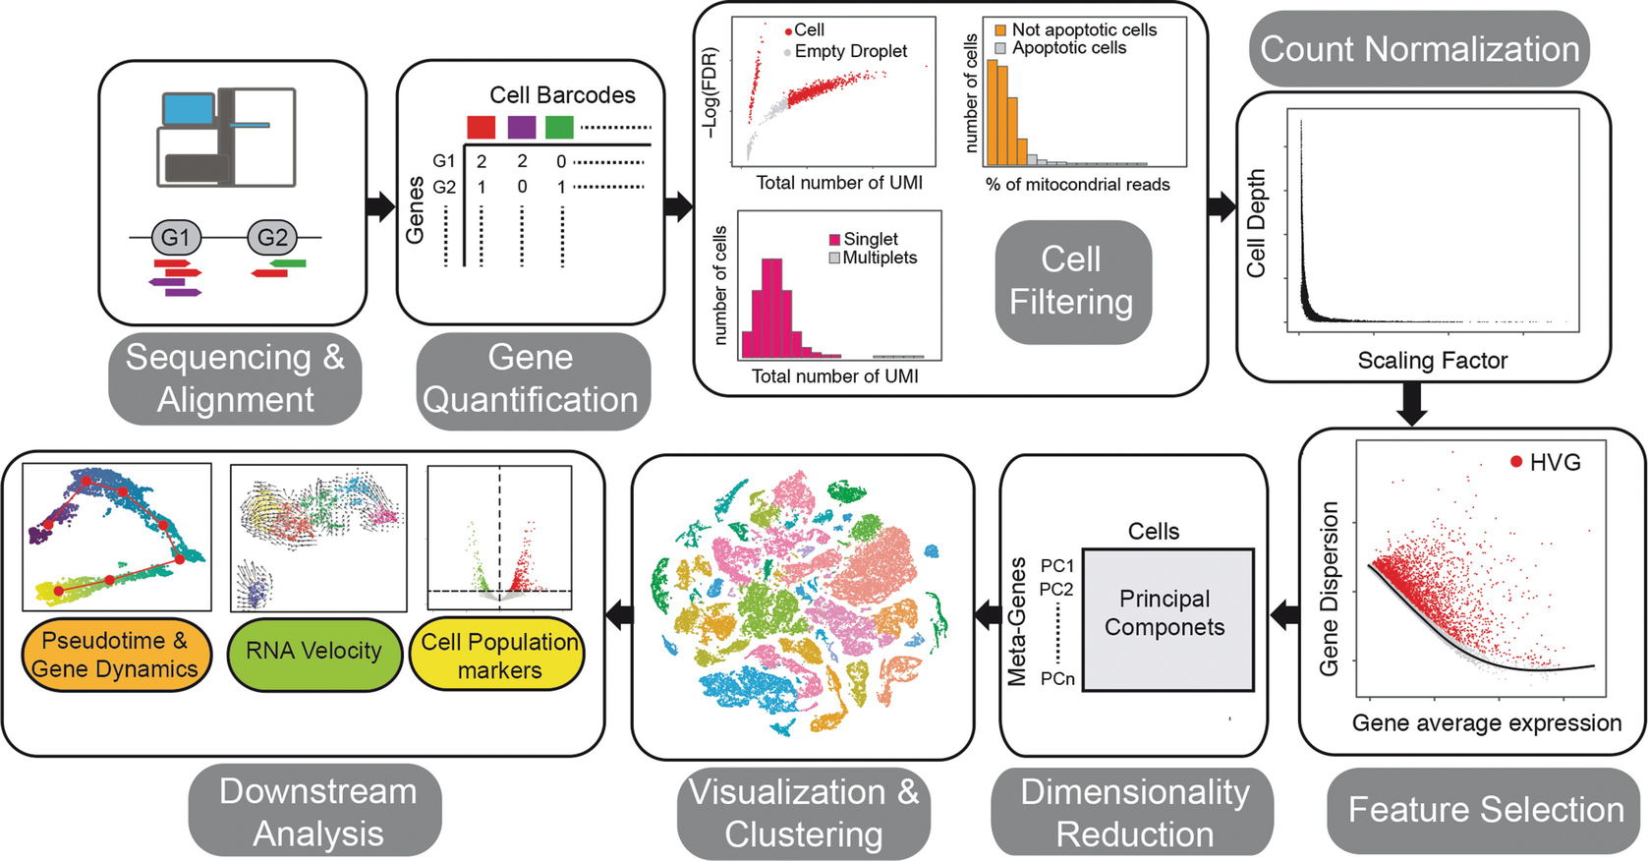
Analysis Overview
Slovin S. et al. (2021) Single-Cell RNA Sequencing Analysis: A Step-by-Step Overview. In: Picardi E. (eds) RNA Bioinformatics. Methods in Molecular Biology, vol 2284. Humana, New York, NY. https://doi.org/10.1007/978-1-0716-1307-8_19

Slide 21
Challenge I: Handling Sparsity in Single-Cell RNA Sequencing
scRNA-seq measurements typically suffer from large fractions of observed zeros, where a given gene in a given cell has no unique molecular identifiers or reads mapping to it.
Sparsity pervades all aspects of scRNA-seq data analysis.
The term “dropout” is often used to denote observed zero values in scRNA-seq data. But this term usually conflates two distinct types of zero values: those attributable to methodological noise, where a gene is expressed but not detected by the sequencing technology, and those attributable to biologically-true absence of expression.
In general, two broad approaches can be applied to tackle this problem of sparsity: (i) use statistical models that inherently model the sparsity, sampling variation, and noise modes of scRNA-seq data with an appropriate data generative model (i.e., quantifying uncertainty or (ii) attempt to “impute” values for observed zeros (ideally the technical zeros; sometimes also non-zero values) that better approximate the true gene expression levels.
Genome Biology volume 21, Article number: 31 (2020)

Slide 22
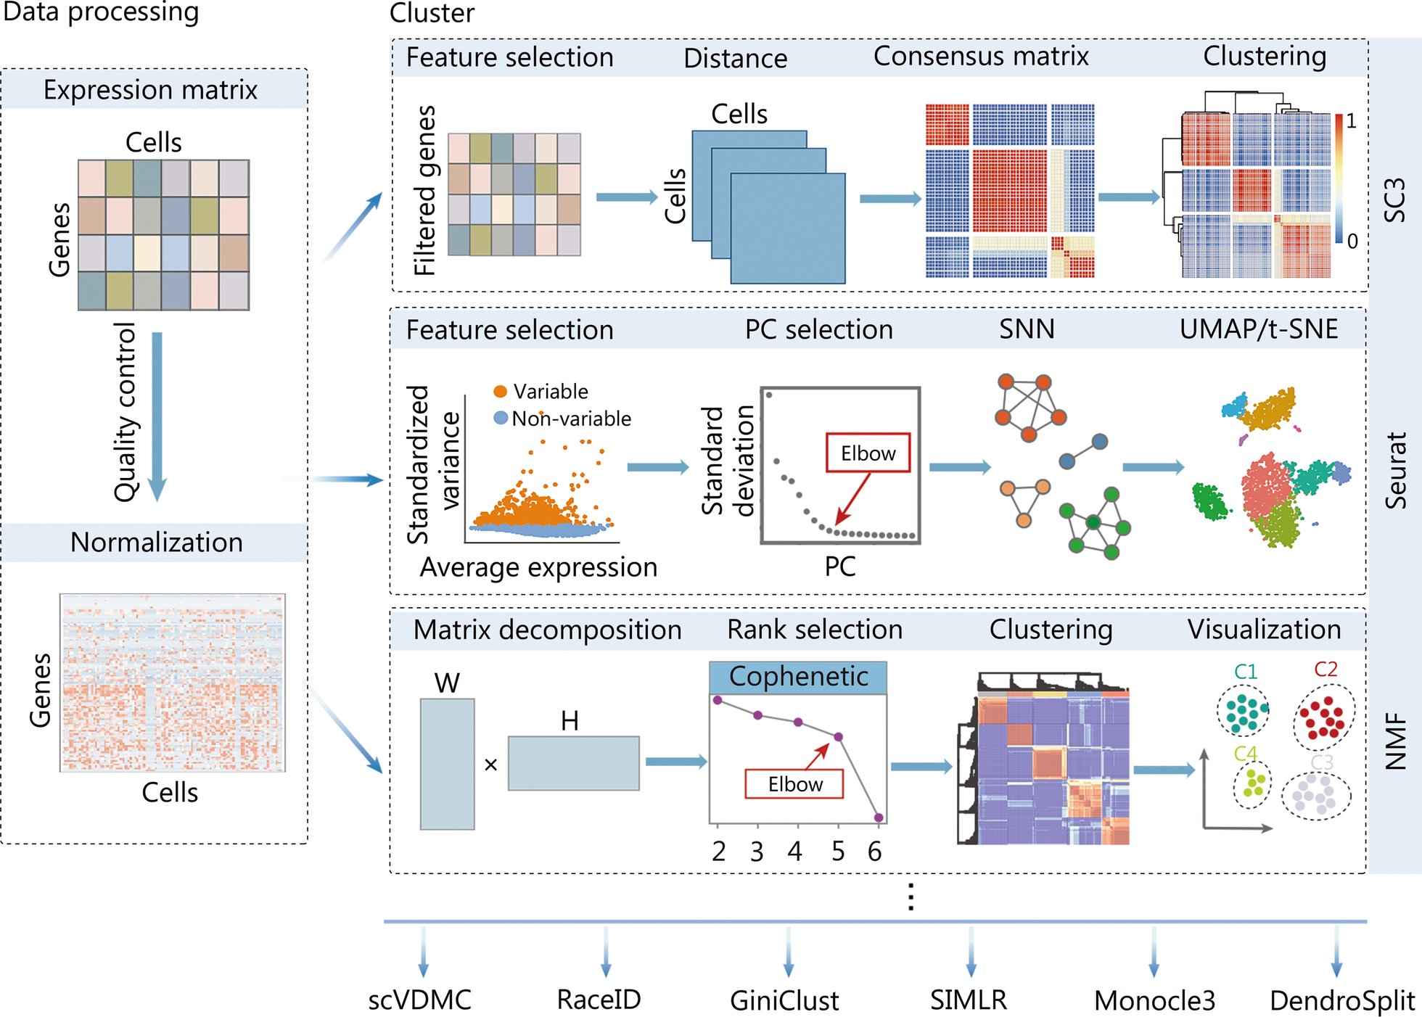
Computational Strategies and Methods for Clustering Cells using scRNA-seq Data
Notes:
Typical computational strategies and methods for clustering cells using scRNA-seq data. With the processed scRNA-seq data, the SC3
approach, the Seurat clustering implementation based on the community detection method, and the NMF method are popular choices. scRNA-seq
single-cell RNA sequencing, SC3 single-cell consensus clustering, NMF non-negative matrix factorization, PC principal component, SNN shared
nearest neighbor, scVDMC variance-driven multitask clustering of scRNA-seq data, SIMLR single-cell interpretation via multikernel learning, UMAP
uniform manifold approximation and projection, t-SNE t-distributed stochastic neighbor embedding

Slide 23
Challenge II: Defining Flexible Statistical Frameworks for Discovering Complex Differential Patterns in Gene Expression
Beyond simple changes in average gene expression between cell types (or across bulk-collected libraries), scRNA-seq enables a high granularity of changes in expression to be unraveled.
While some methods exist to identify more general patterns of gene expression changes (e.g., variability, distributions), these methods could be further improved by integrating with existing approaches that account for confounding effects such as cell cycle and complex batch effects.
Genome Biology volume 21, Article number: 31 (2020)

Slide 24
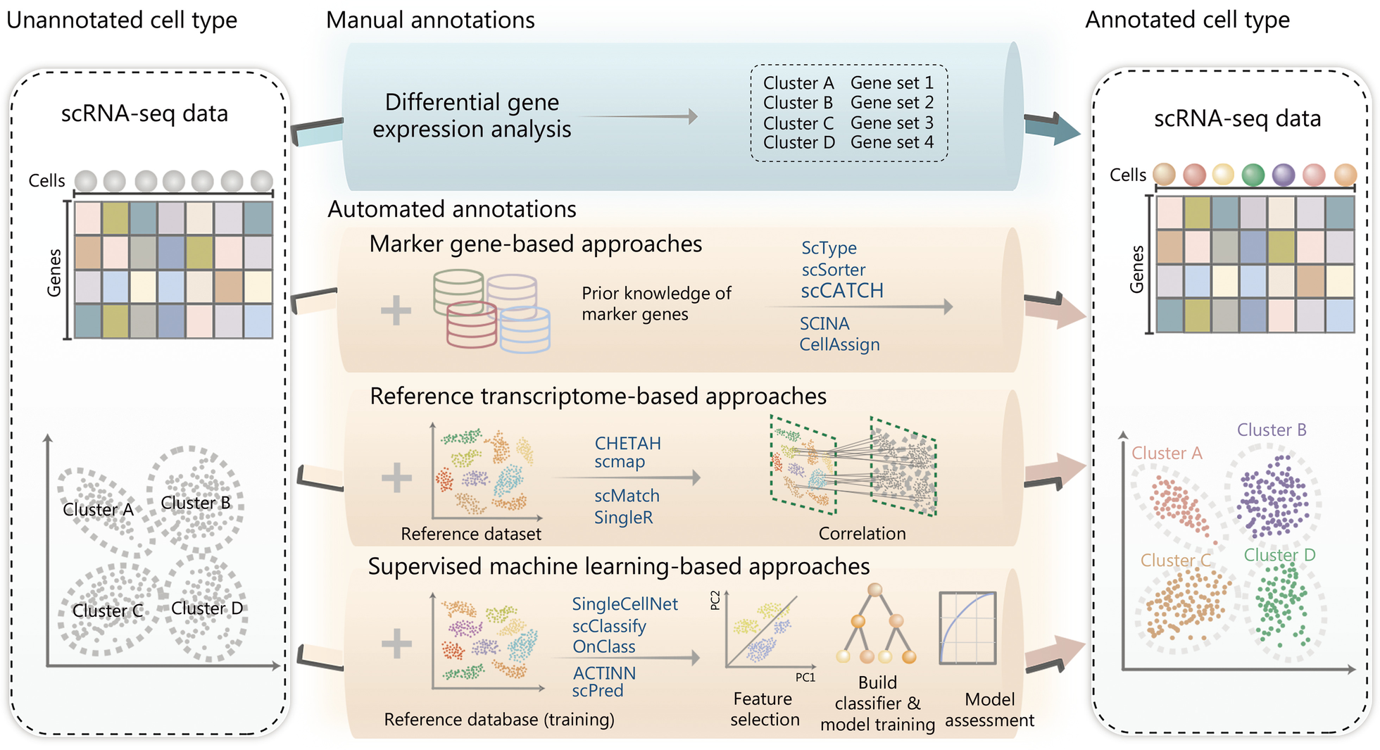
Strategies and Representative Methods for Annotating Cell Subpopulations Identified by scRNA-seq
Notes:
Typical strategies and representative methods for annotating cell subpopulations identified by scRNA-seq. In addition to manual annotation,
which is potentially time-consuming and subjective, automated cell type annotation can be mainly sorted into three categories: marker
gene-based, reference transcriptome-based, and supervised machine learning-based approaches. The example approach names are listed in
the plot. scRNA-seq single-cell RNA sequencing, scCATCH single-cell cluster-based automatic annotation toolkit for cellular heterogeneity, SCINA
semi-supervised category identification and assignment, CHETAH characterization of cell types aided by hierarchical classification, SingleR single
cell recognition, OnClass ontology-based single cell classification, ACTINN automated cell type identification using neural networks

Slide 25
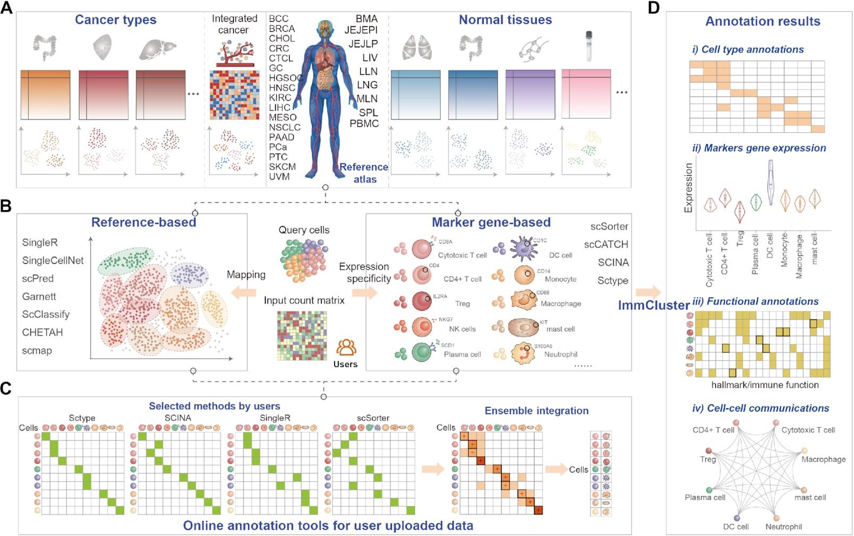
Schematic Diagram of the Overall Design of ImmCluster
Notes:
Figure 1. Schematic diagram of the overall design of ImmCluster. (A) Collection of reference transcriptomes from cancerous or normal tissues from published studies. (B) Computational methods for automatically annotating cell types. (C) Ensemble method is provided in ImmCluster. (D) Four main types of annotations are provided in ImmCluster.
Unless provided in the caption above, the following copyright applies to the content of this slide: © The Author(s) 2022. Published by Oxford University Press on behalf of Nucleic Acids Research.This is an Open Access article distributed under the terms of the Creative Commons Attribution-NonCommercial License (https://creativecommons.org/licenses/by-nc/4.0/), which permits non-commercial re-use, distribution, and reproduction in any medium, provided the original work is properly cited. For commercial re-use, please contact journals.permissions@oup.com

Slide 26
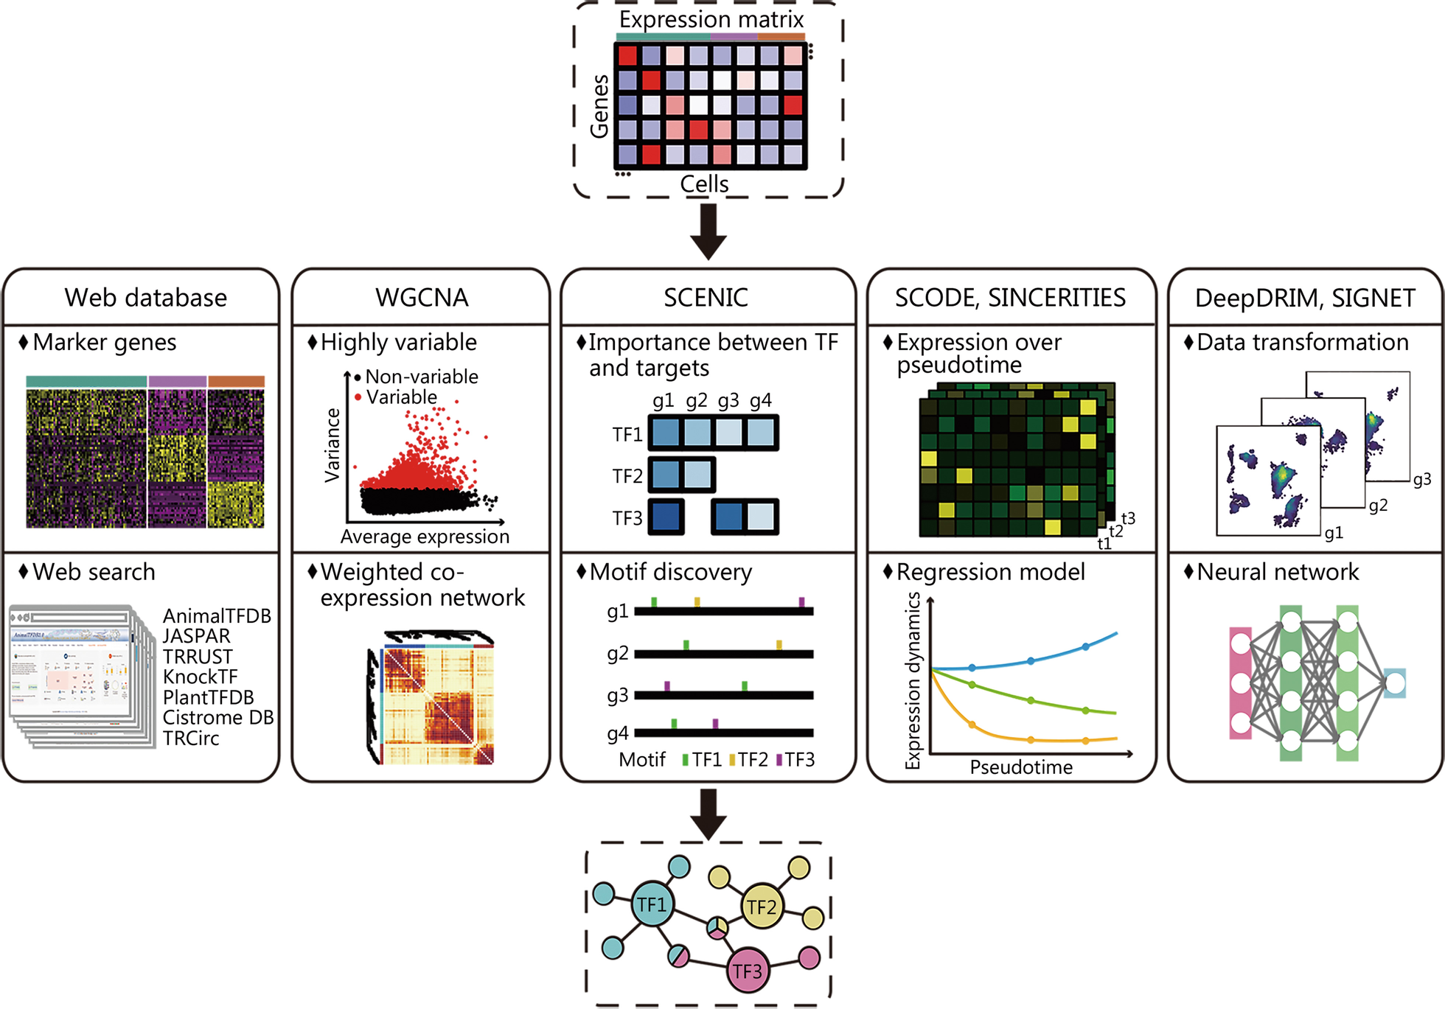
Different Strategies and Approaches Developed for Regulon Inference and TF Activity Prediction with scRNA-seq
Notes:
Different strategies and approaches developed for regulon inference and TF activity prediction with scRNA-seq. To achieve regulon and TF
activity prediction, the TF databases and TF-target databases are important resources, and the computational strategies include co-expression gene
module identification, dynamic and stochastic modeling of TF versus target expression changes, and application of machine learning approaches.
TF transcription factor, scRNA-seq single-cell RNA sequencing, AnimalTFDB Animal Transcription Factor DataBase, Cistrome DB Cistrome Data
Browser, WGCNA weighted gene co-expression network analysis, SCENIC single cell regulatory network information and clustering, TRRUST
transcriptional regulatory relationships unravelled by sentence-based text-mining

Slide 27
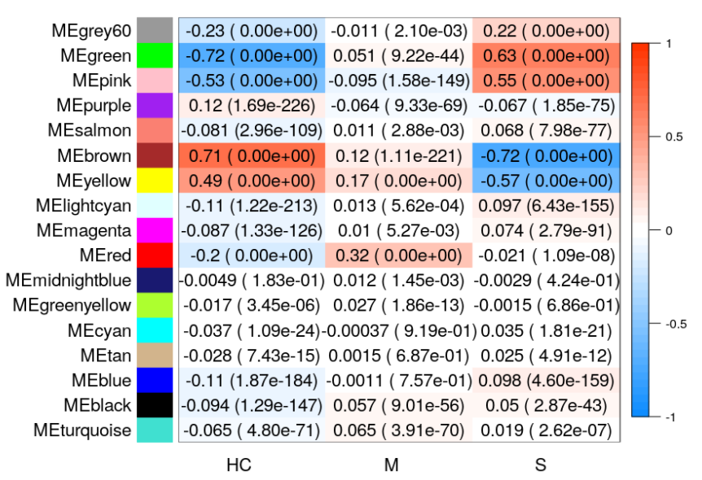
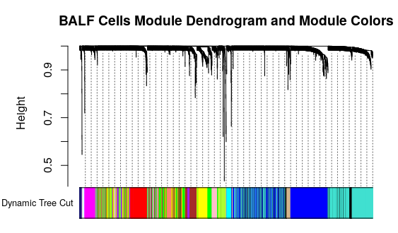
Bulk RNA-seq Based Biomarker using WGCNA
Finding Gene Modules Correlated with Response

Slide 28
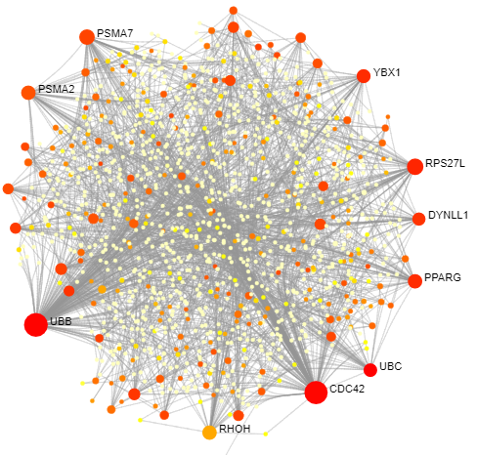
Common Module and Associated Pathways as Biomarker
The Common Gene Module

Slide 29
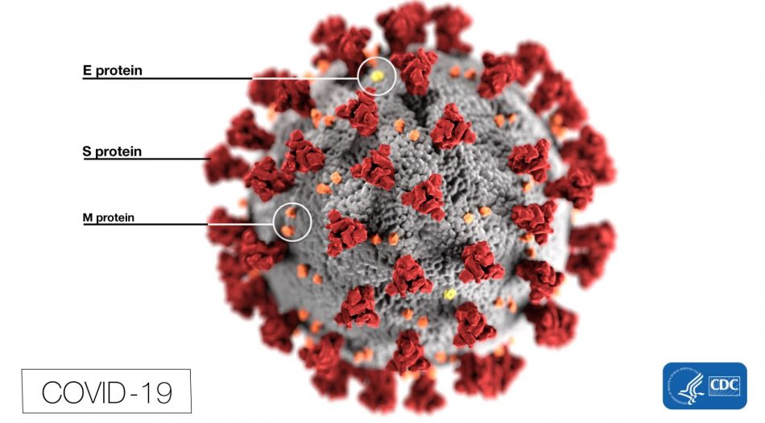
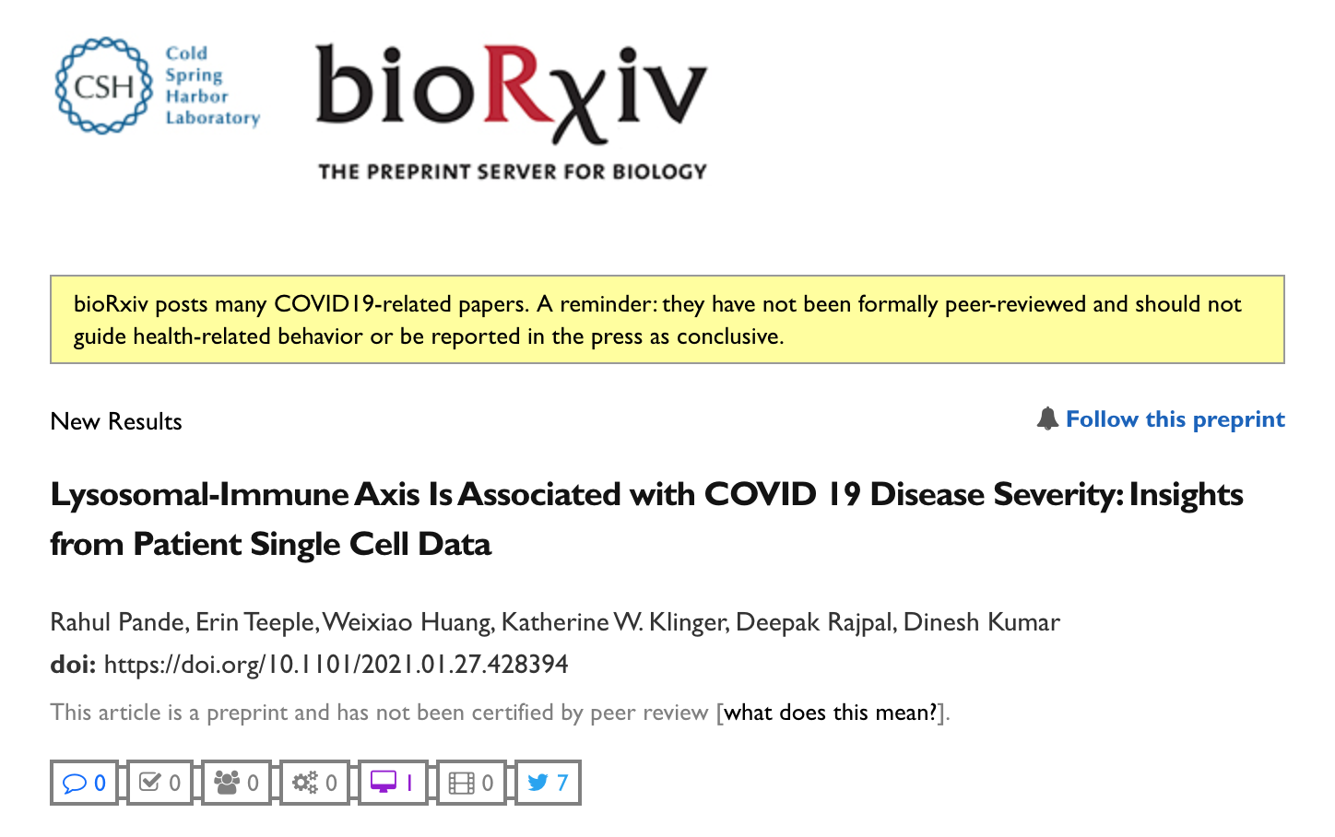

Slide 30
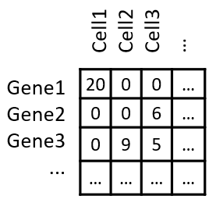
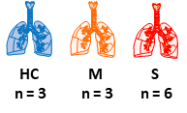
Finding Co-Expression Modules
From Healthy Controls; Mild and Severe COVID Patients
75,076 Cells

Slide 31
Finding Disease Stage Association for Modules
Green, Pink and Brown Modules were Chosen for Further Analysis

Slide 32
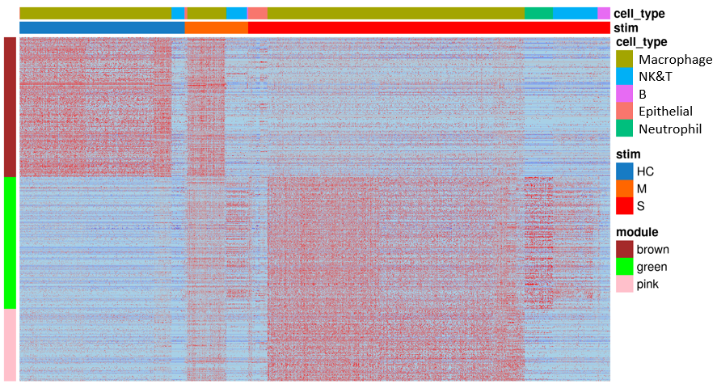
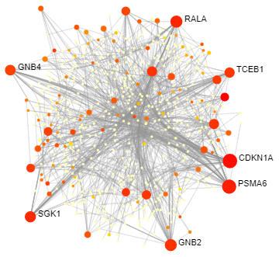
Identified 3 Disease Correlated Modules

Slide 33
Brown Module Expression is Down regulated in Severe Patients
Negatively Correlated with Disease Severity

Slide 34
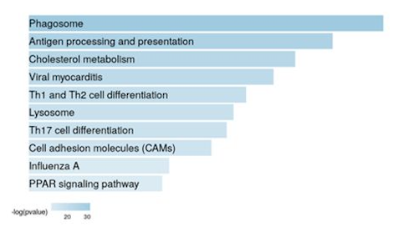
Brown Module Expression is Downregulated in Severe Patients
Negatively Correlated with Disease Severity

Slide 35
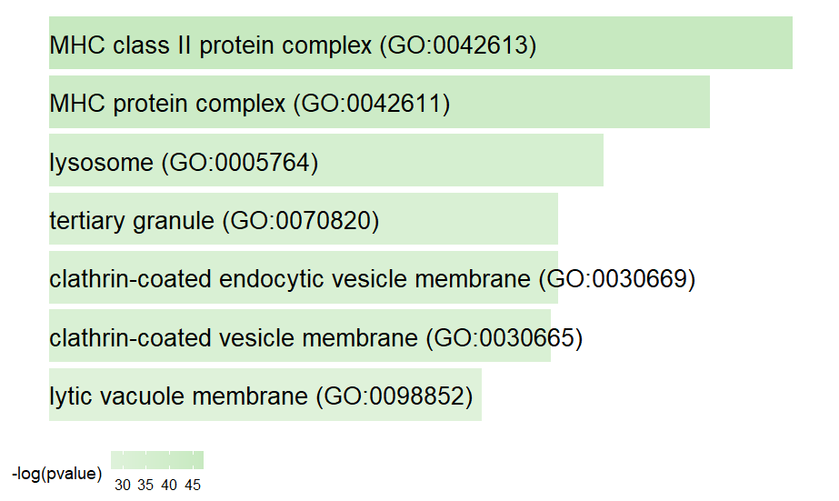
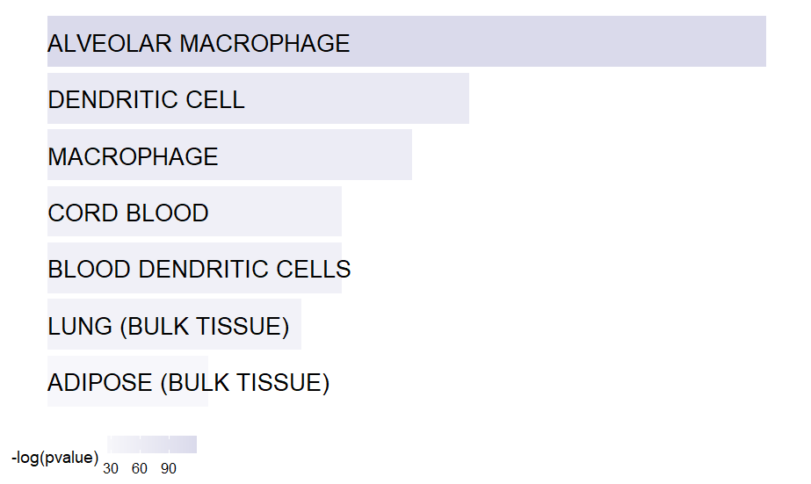
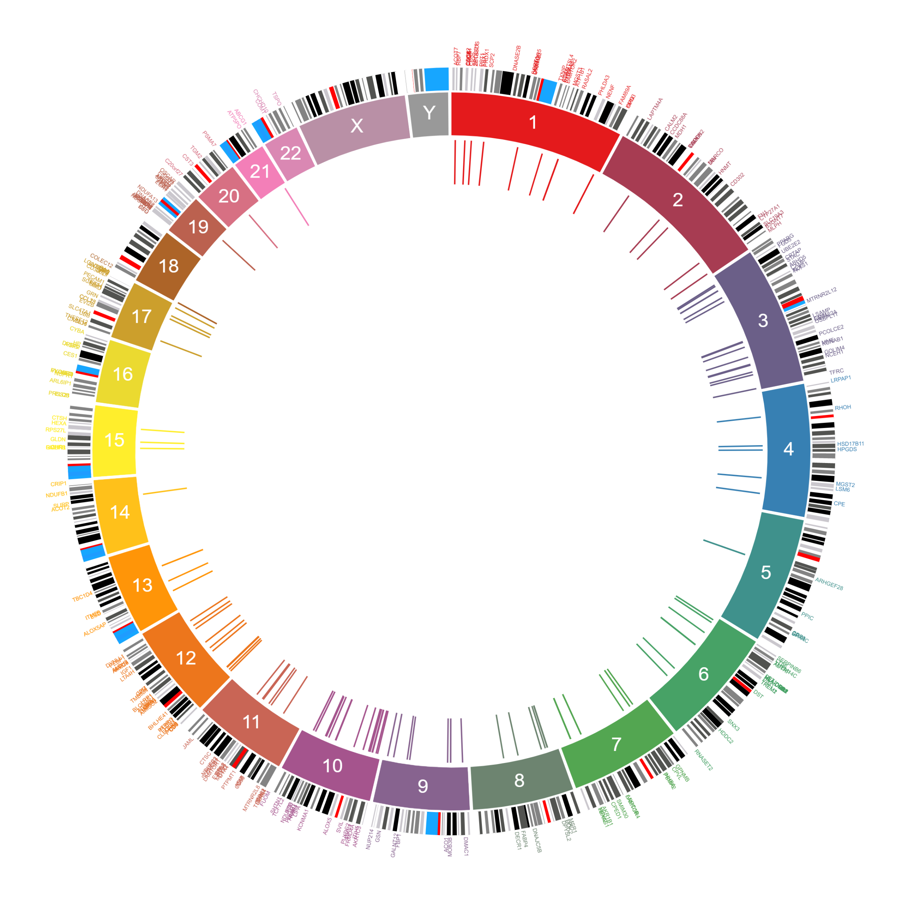
Brown Module Expression is Downregulated in Severe Patients
Negatively Correlated with Disease Severity
GO Cellular Component
ARCHS4 Tissues
MGI Mammalian Phenotype

Slide 36
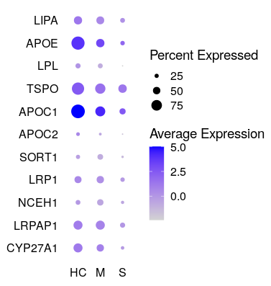
Cholesterol Genes Expression is Negatively Correlated with Disease Severity

Slide 37
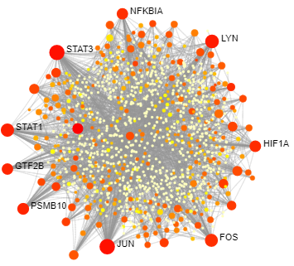
Green Module Expression Unregulated Severe Cases
Positively Correlated with Disease Severity

Slide 38
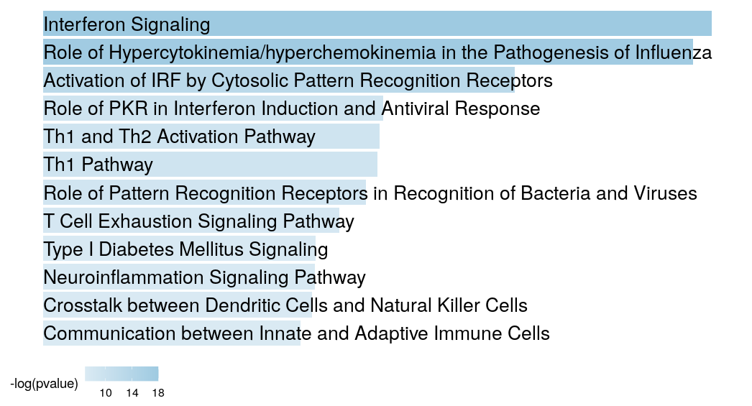
Green Module Expression Unregulated Severe Cases
Positively Correlated with Disease Severity

Slide 39
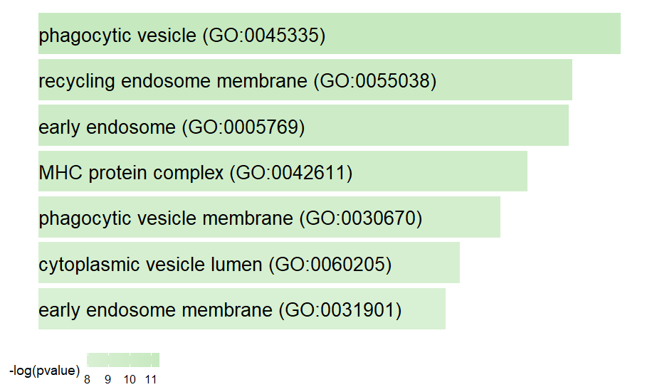
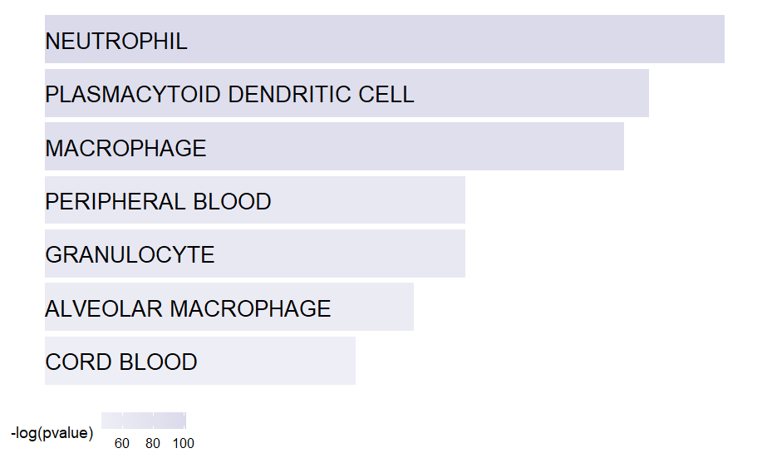
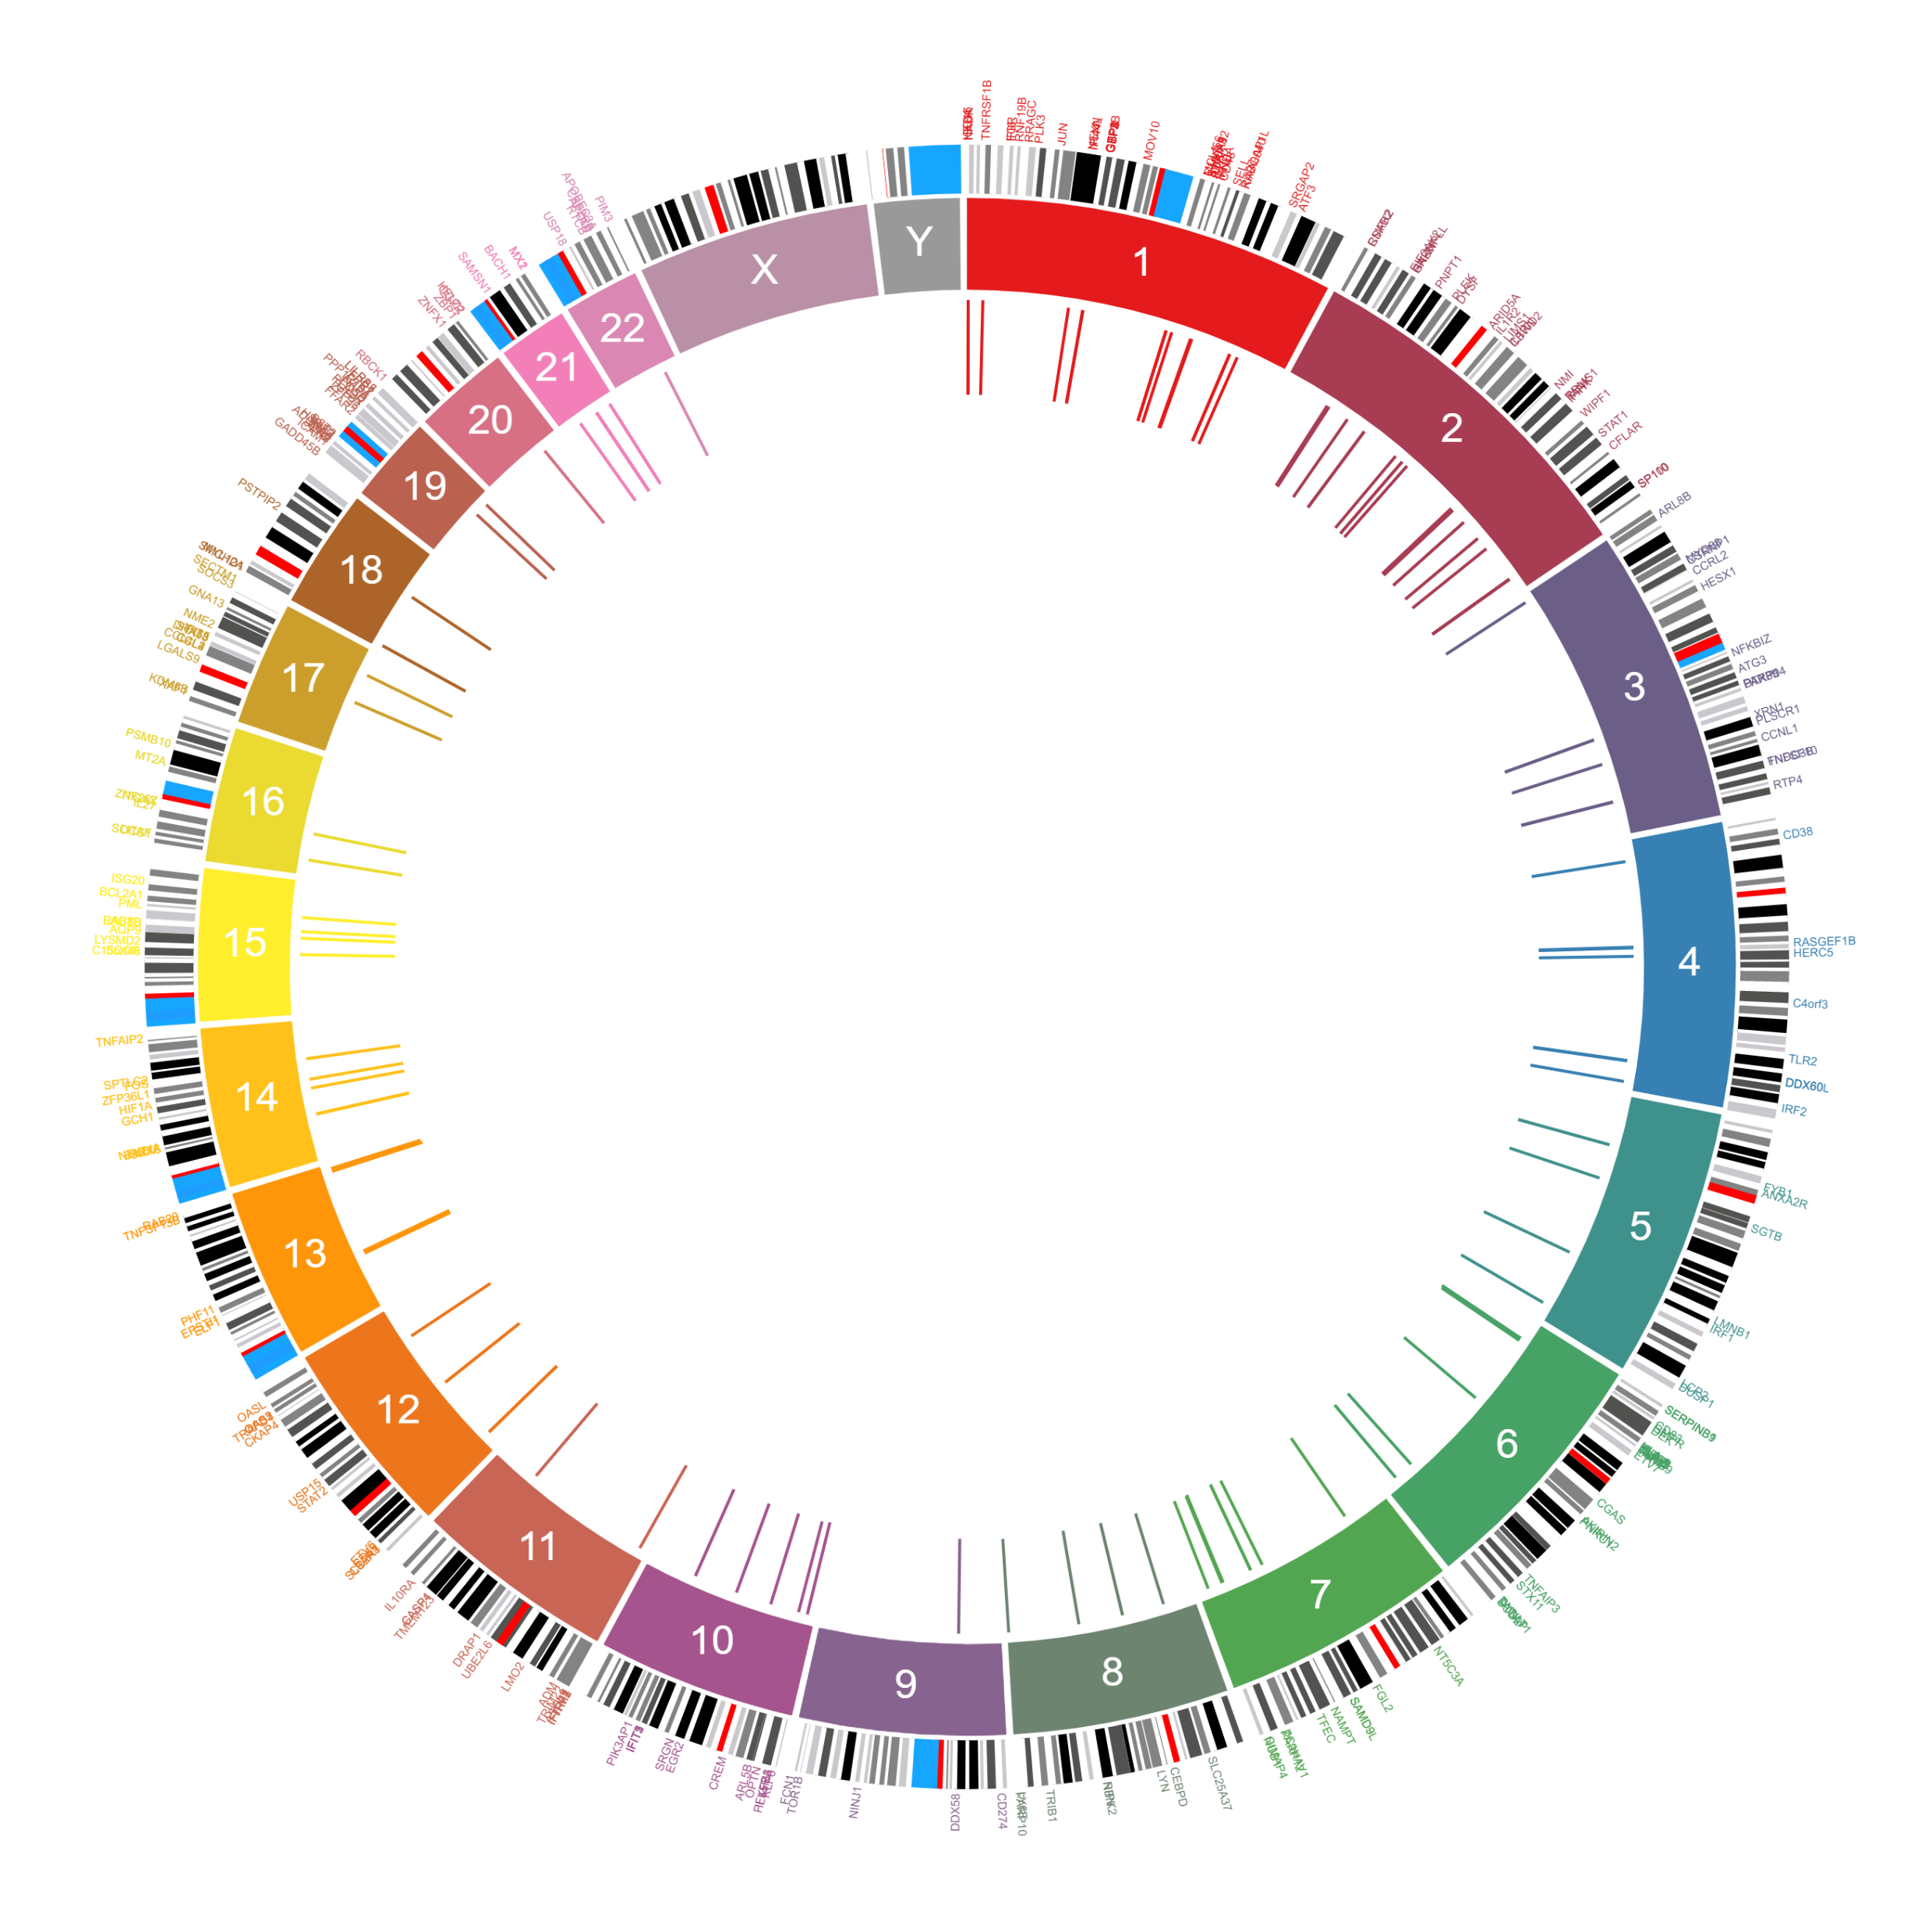
Green Module Expression Unregulated Severe Cases
Positively Correlated with Disease Severity
GO Cellular Component
ARCHS4 Tissues
MGI Mammalian Phenotype

Slide 40
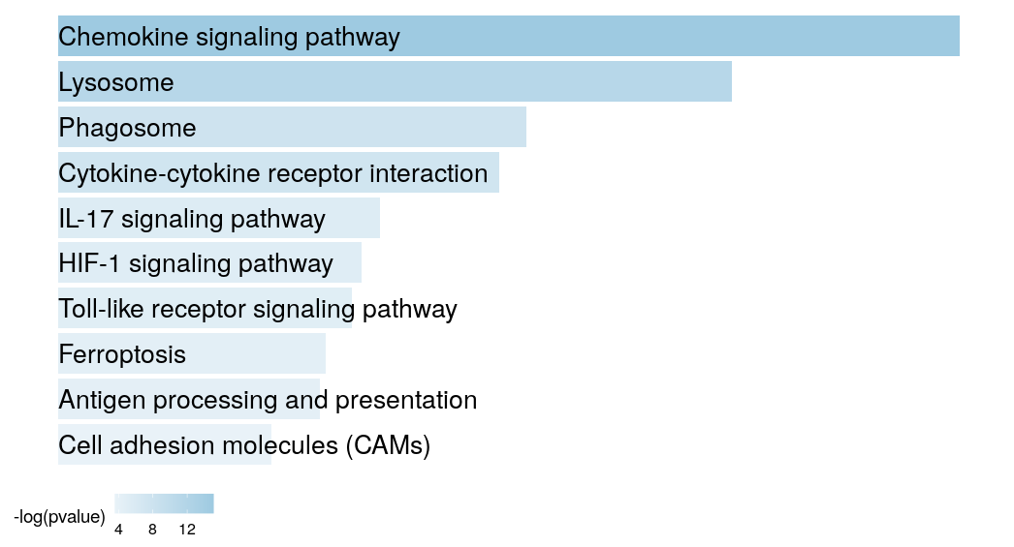
Pink Module is Upregulated in Macrophages
Positively Correlated with Disease Severity

Slide 41
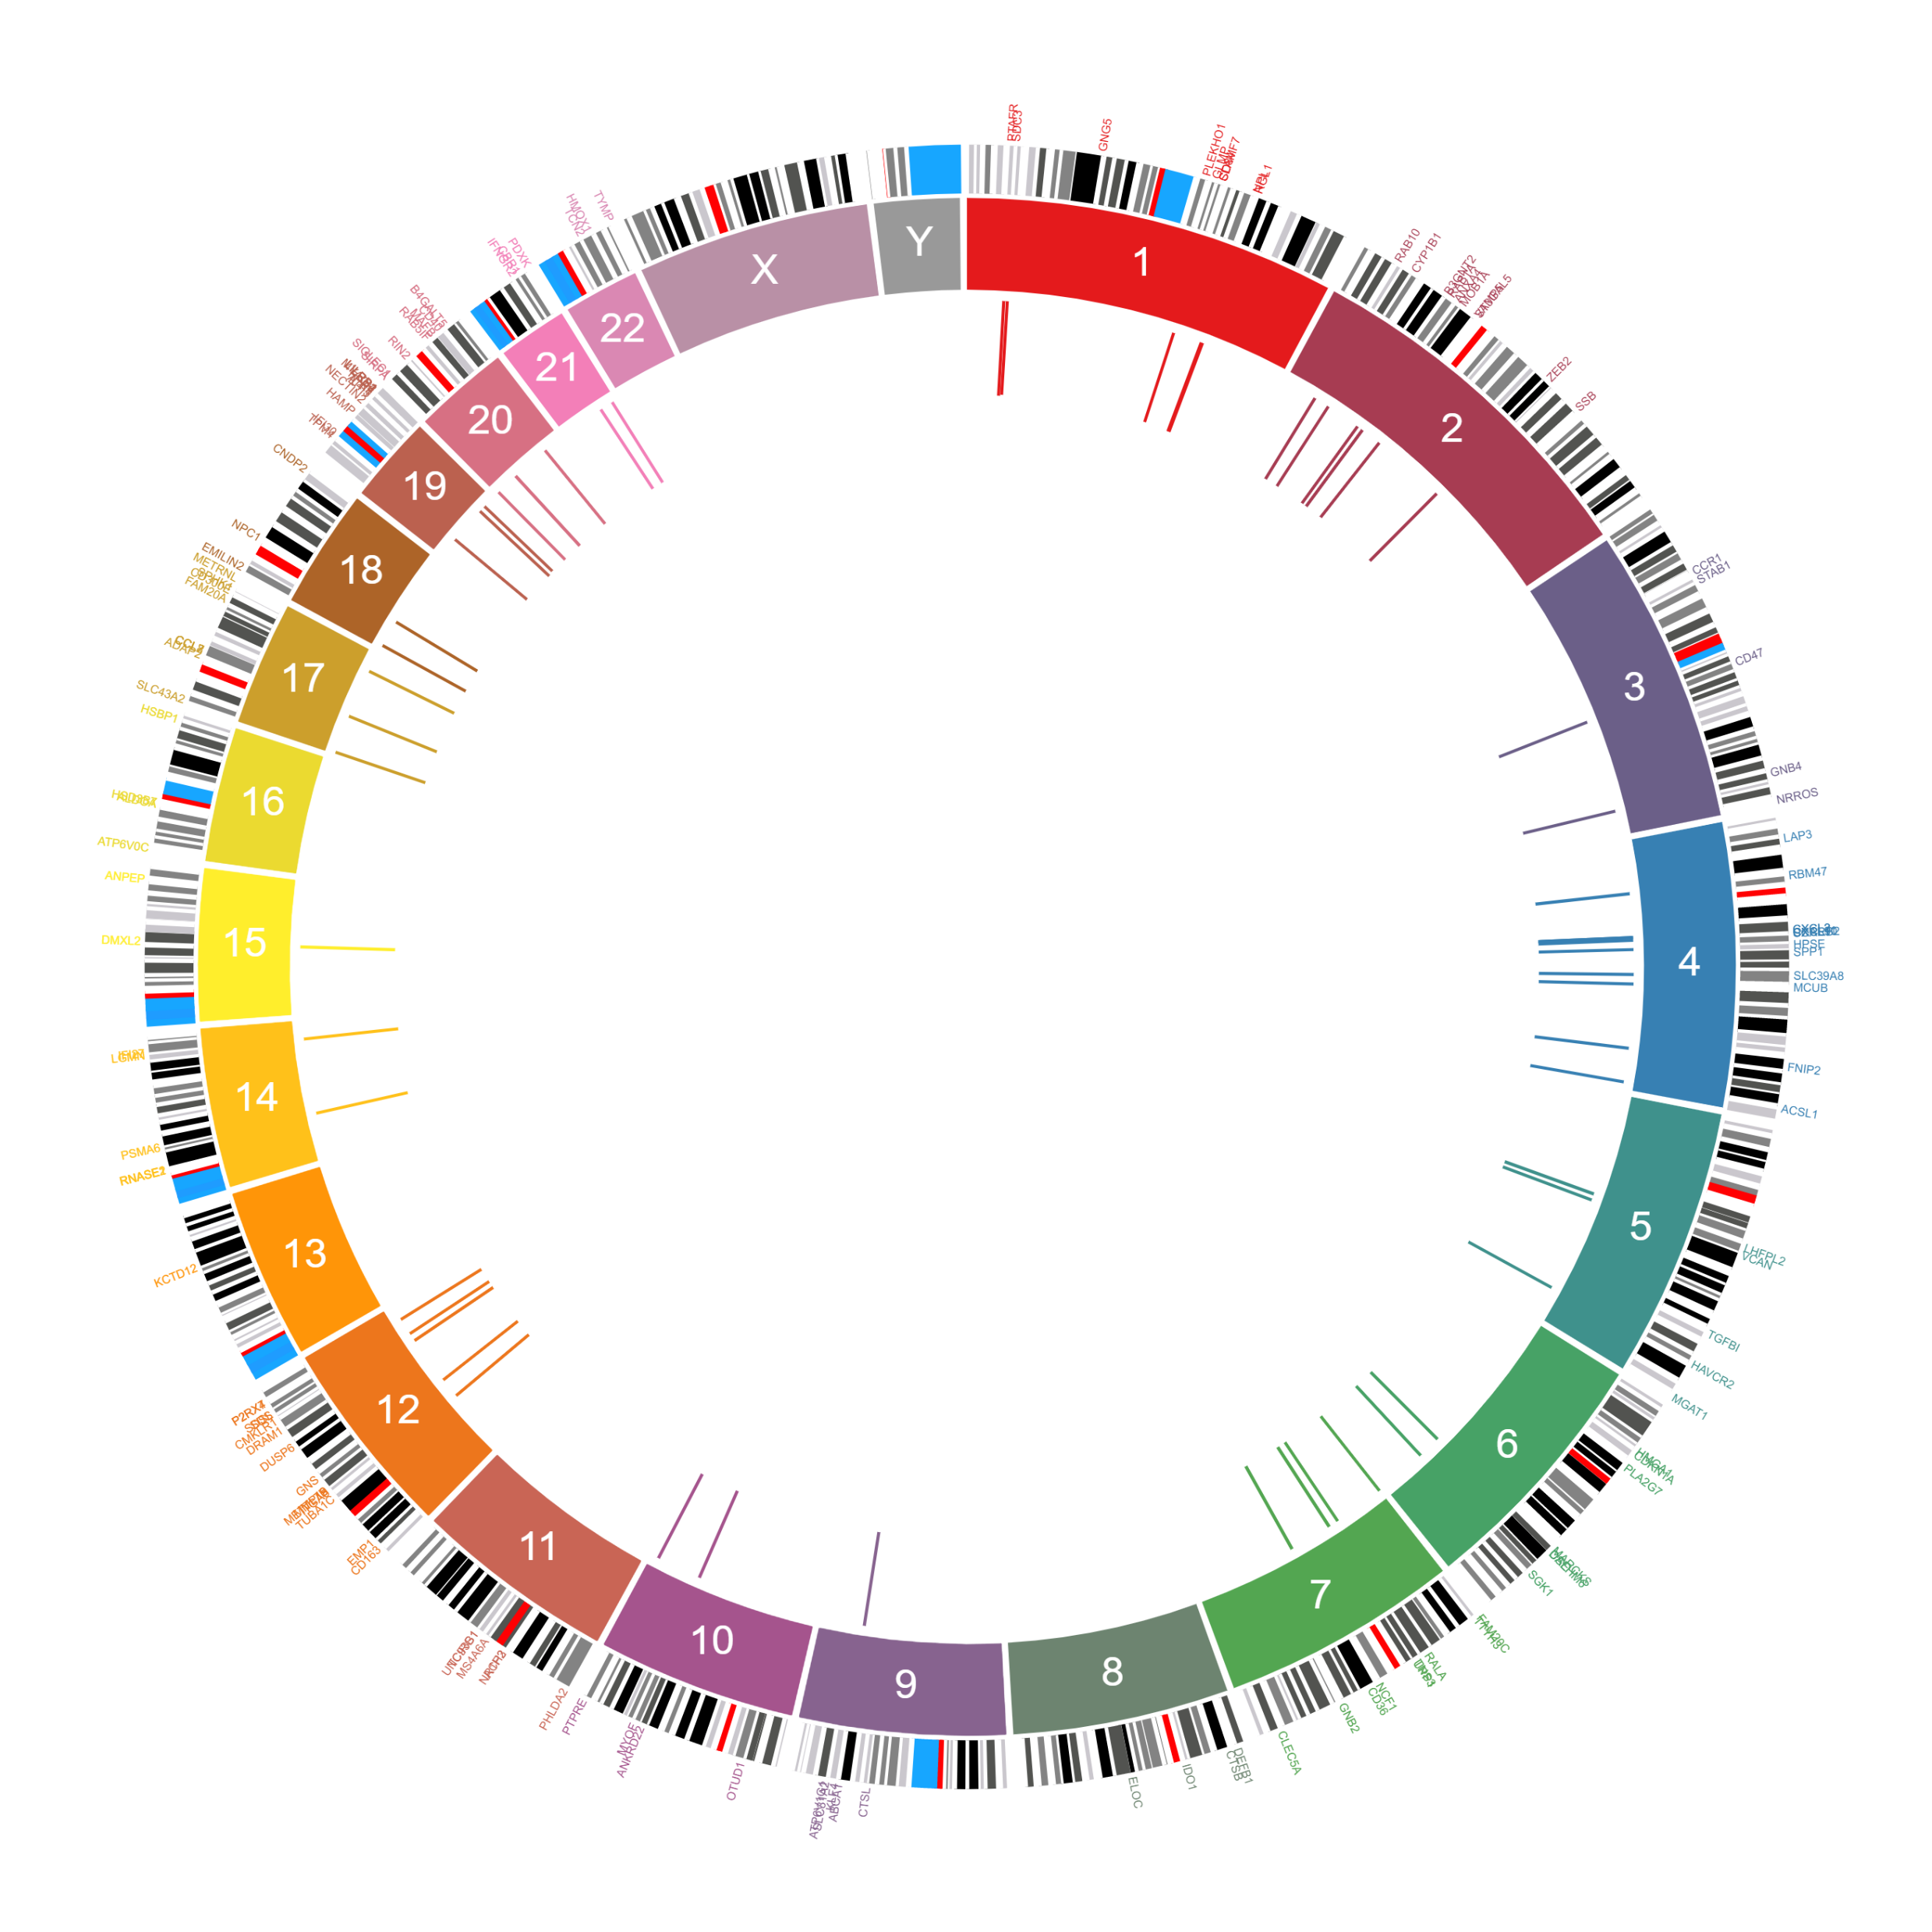
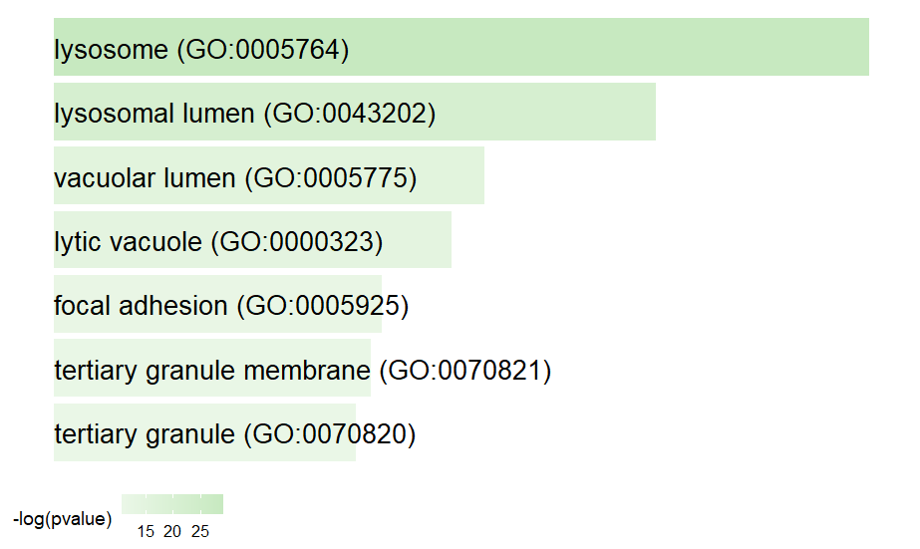
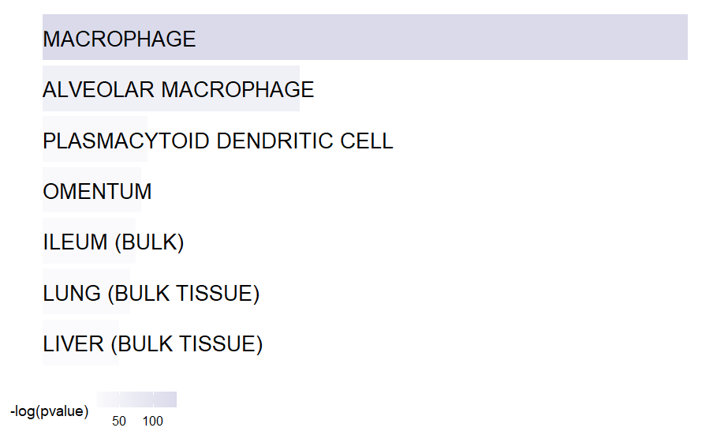
All the Modules are Enriched for Lyosomal location
GO Cellular Component
ARCHS4 Tissues

Slide 42
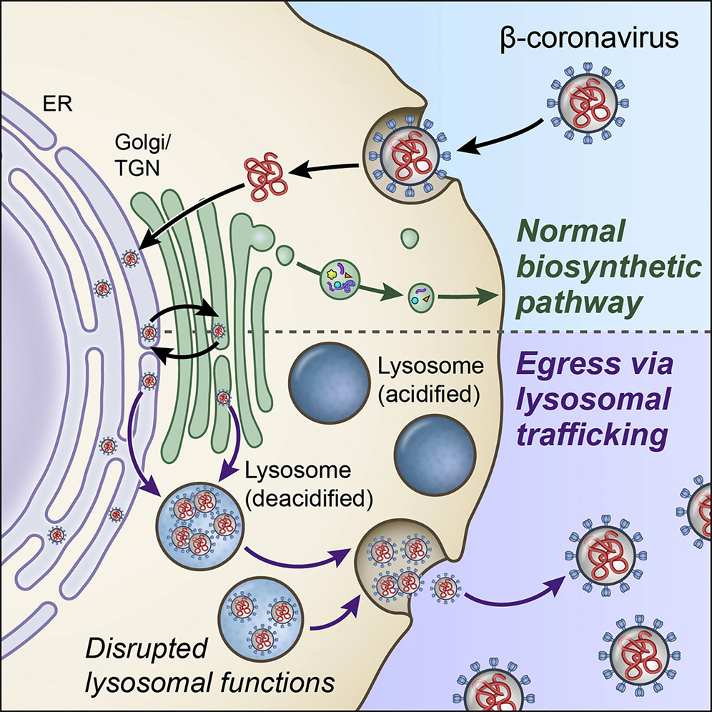
β-Coronaviruses do not use the biosynthetic secretory pathway to egress
Using Mouse MHV
β-Coronaviruses traffic to lysosomes and egress by Arl8b-dependent lysosomal exocytosis
•
Lysosomes are deacidified, and proteolytic enzymes are inactive in infected cells
•
Antigen processing and presentation are perturbed in β-coronavirus infection
Ghosh et. al., Cell 2020

Slide 44
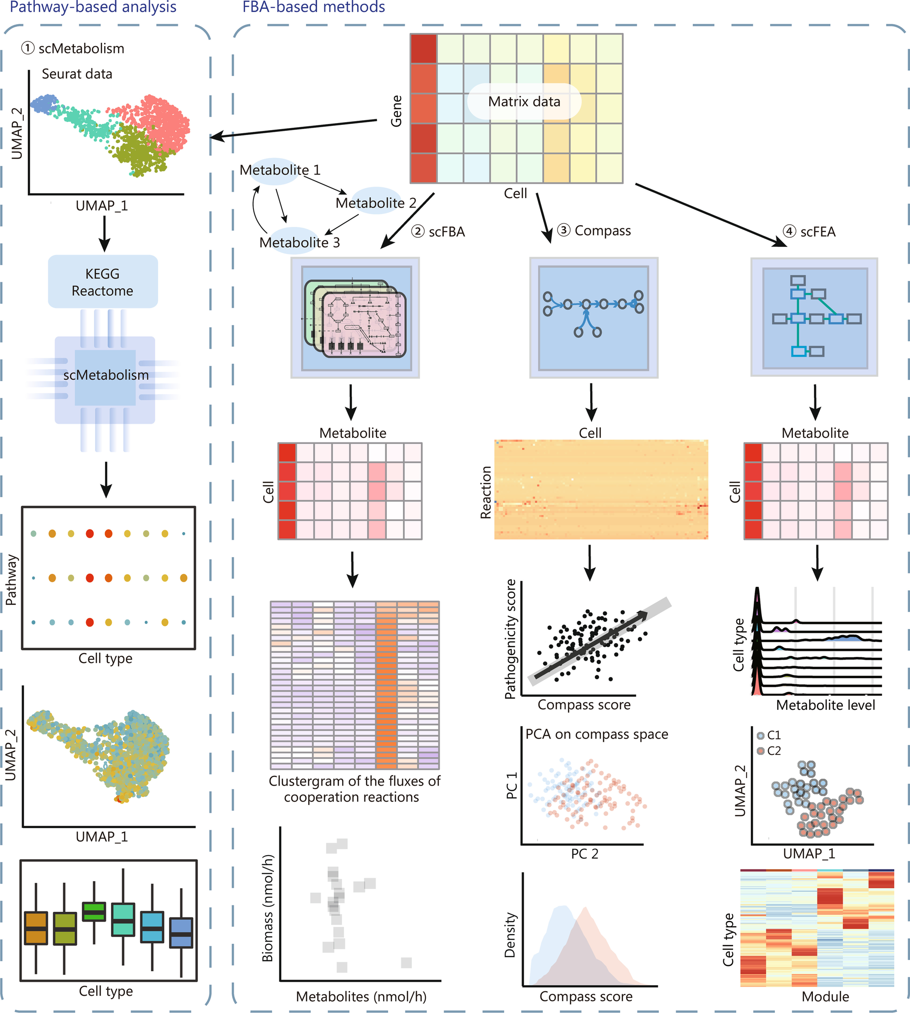
Metabolic analysis within scRNA-seq: pathway-based functional enrichment analysis and flux balance
analysis of metabolic flow
constraint-based mathematical
models
Notes:
Two main types of metabolic analysis within scRNA-seq: pathway-based functional enrichment analysis and flux balance analysis of
metabolic flow. While the former makes use of standard functional enrichment analysis, and the latter utilizes constraint-based mathematical
models to systematically simulate metabolism in metabolic networks. Methods including scFBA, Compass, and scFEA employed different
implementation strategies for flux balance analysis of metabolic flow. FBA flux balance analysis, KEGG Kyoto Encyclopedia of Genes and Genomes,
UMAP uniform manifold approximation and projection, scRNA-seq single-cell RNA sequencing, scFBA single-cell flux balance analysis, scFEA
single-cell flux estimation analysis, PCA principal component analysis

Slide 45
Differential Expression Analysis
Stewart et al. Nature reviews nephrology (2019)

Slide 46
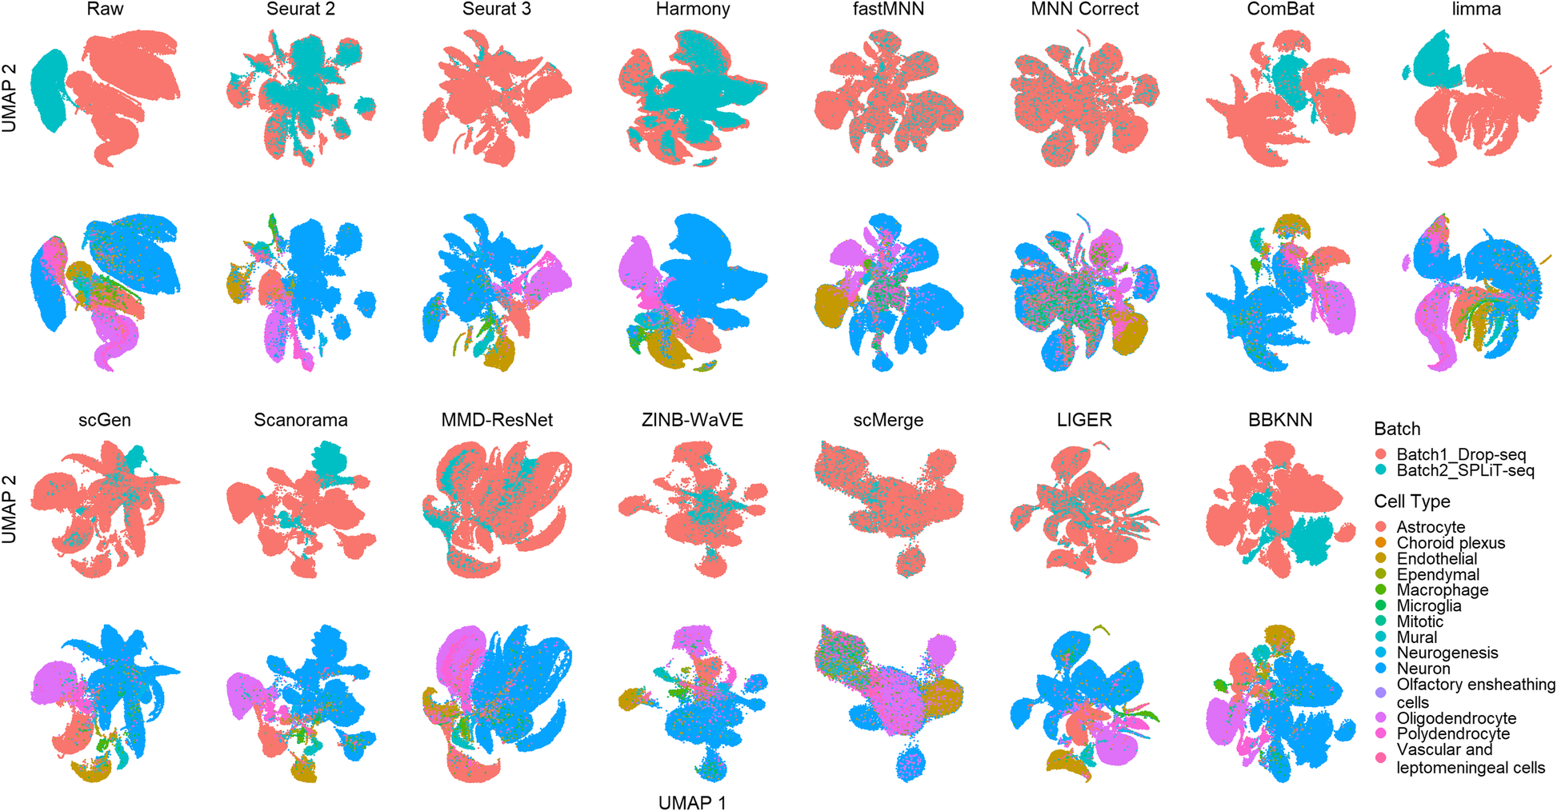
A benchmark of batch-effect correction methods for single-cell RNA sequencing data
Genome Biology volume 21, Article number: 12 (2020)

Slide 47
Challenge III: Mapping Single Cells to a Reference Atlas
Classifying cells into cell types or states is essential for many secondary analyses. As an example, consider studying and classifying how expression within a cell type varies across different biological conditions.
Genome Biology volume 21, Article number: 31 (2020)

Slide 48
Disease Associated Cell Types/ Cell States
Stewart et al. Nature reviews nephrology (2019)

Slide 49
Challenge IV: Generalizing Trajectory Inference
Several biological processes, such as differentiation, immune response, or cancer expansion, can be described and represented as continuous dynamic changes in cell type/state space using tree, graphical, or probabilistic models. A potential path that a cell can undergo in this continuous space is often referred to as a trajectory
Trajectory inference is in principle not limited to transcriptomics. Nevertheless, modeling of other measurements, such as proteomic, metabolomic, and epigenomic, or even integrating multiple types of data is still at its infancy.
We believe the study of complex trajectories integrating different data types, especially epigenetics and proteomics information in addition to transcriptomics data, will lead to a more systematic understanding of the processes determining cell fate.
Trajectory methods start from a count matrix where genes are rows and cells are columns. First, a feature selection or dimensionality reduction step is used to explore a subspace where distances between cells are more reliable. Next, clustering and minimum spanning trees, principal curve or graph fitting, or random walks and diffusion operations on graphs are used to infer pseudo time and/or branching trajectories.
Genome Biology volume 21, Article number: 31 (2020)
Notes:
Trajectory methods start from a count matrix where genes are rows and cells are columns. First, a feature selection or dimensionality reduction step is used to explore a subspace where distances between cells are more reliable. Next, clustering and minimum spanning trees [156, 158], principal curve or graph fitting [159–161], or random walks and diffusion operations on graphs ([162, 163] among others) are used to infer pseudotime and/or branching trajectories.

Slide 50
Trajectory: States differences in CD8 T cells in Responders Vs Non Responders
Liu S and Trapnell C F1000Research 2016, 5:182 (doi: 10.12688/f1000research.7223.1)

Slide 51
Challenge V: Finding patterns in spatially resolved measurements
Single-cell spatial transcriptomics or proteomics technologies can obtain transcript abundance measurements while retaining spatial coordinates of cells or even transcripts within a tissue. With such data, the question arises of how spatial information can best be leveraged to find patterns, infer cell types or functions, and classify cells in a given tissue.
The central problem is to consider gene or transcript expression and spatial coordinates of cells, and derive an assignment of cells to classes, functional groups, or cell types. Depending on the studied biological question, it can be useful to constrain assignments with expectations on the homogeneity of the tissue.
Genome Biology volume 21, Article number: 31 (2020)

Slide 52
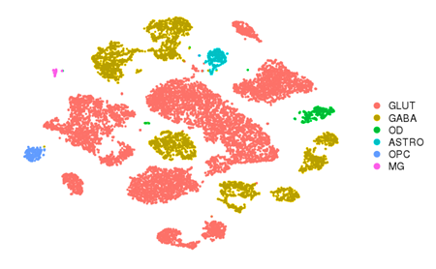
Single Cell Sequencing: Adding Spatial Component

Slide 53
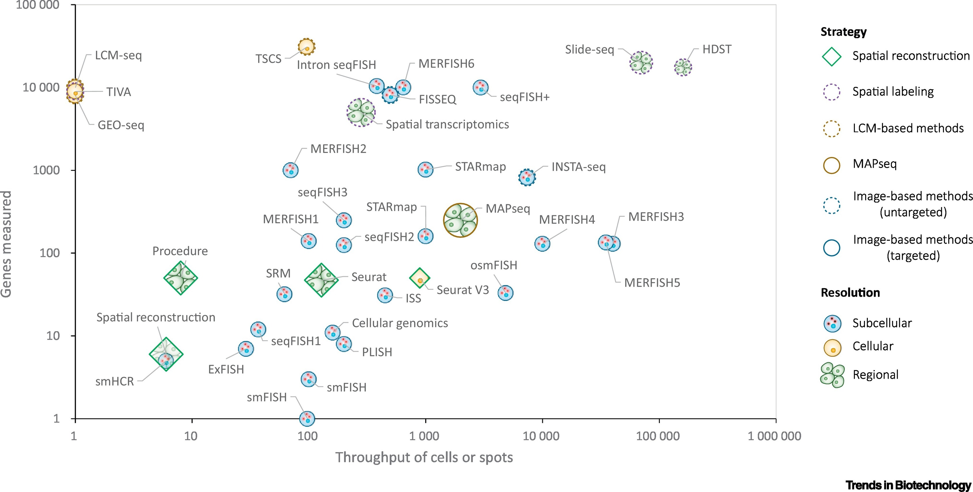
Emerging Spatial-seq Technologies
Trends in Biotechnology 2021 3943-58DOI: (10.1016/j.tibtech.2020.05.006)

Slide 54
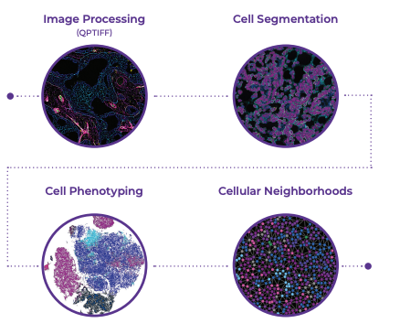
Main Steps in Image Analysis
https://www.akoyabio.com/phenocycler/
Cancer Cell 39, August 9, 2021 a 2021 Elsevier Inc.
Notes:
file:///Users/dkumar/Downloads/Highly_multiplexed_tissue_imaging_using_repeated_o.pdf

Slide 55
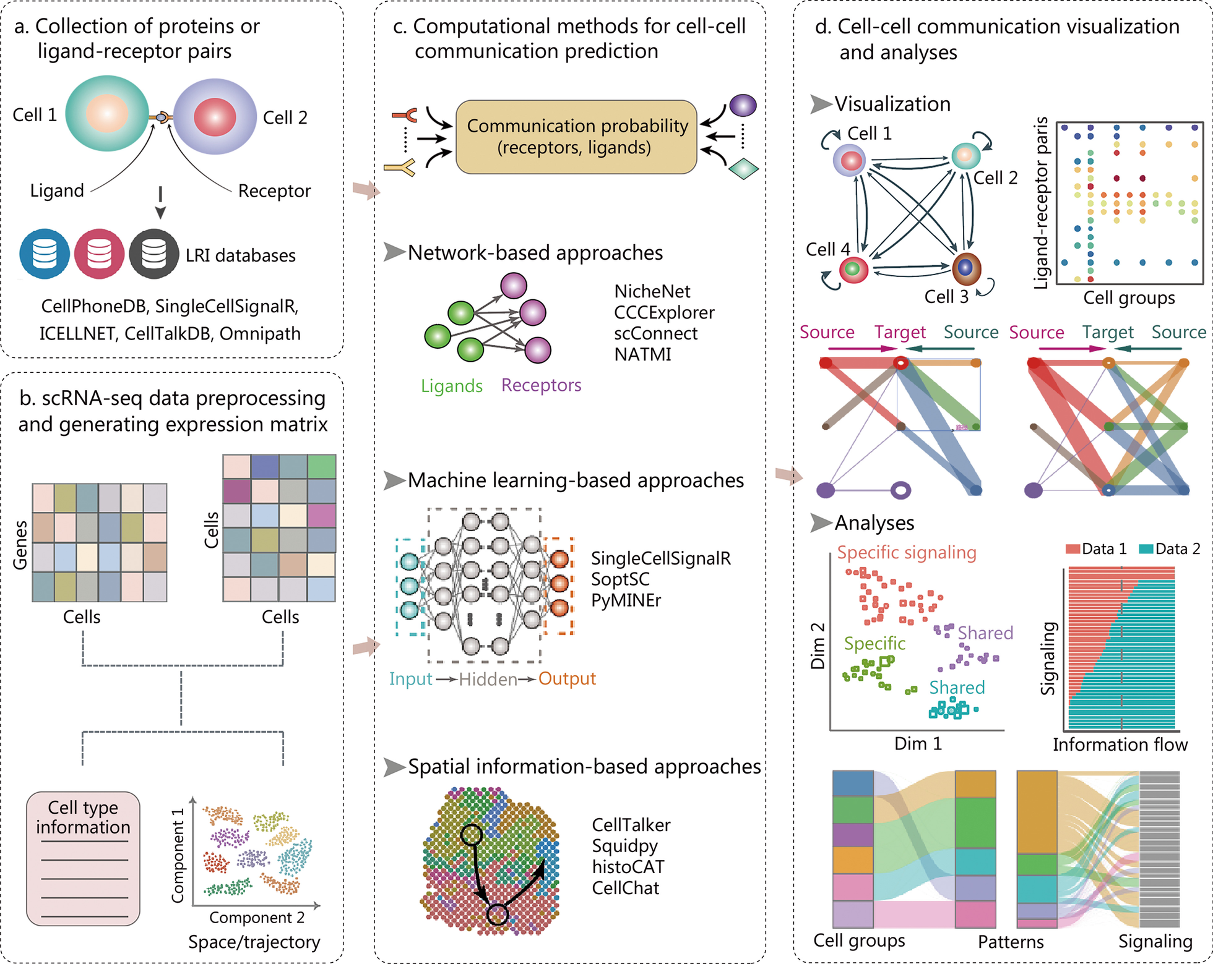
Data Resources, Computational Pipelines, and Visualization Methods used for Cell–Cell Communication (CCC)
Notes:
The data resources, computational pipelines, and visualization methods used for cell–cell communication (CCC) inference with scRNA-seq
data. Typical analysis steps include the collection of ligand-receptor pairs (a), cell clustering and annotation in scRNA-seq (b), computational
prediction of CCC (c), followed by results visualization and downstream analysis (d). The CCC inference tools can be categorized into three main
classes: network-based, machine learning-based and spatial information-based approaches. LRI ligand-receptor interaction, scRNA-seq single-cell
RNA sequencing, CCCExplorer cell–cell communication explorer, NATMI network analysis toolkit for multicellular interactions, histoCAT histology
topography cytometry analysis toolbox, SoptSC similarity matrix-based optimization for single-cell data analysis, PyMINEr Python maximal
information network exploration resource, Squidpy spatial quantification of molecular data in Python

Slide 56
Challenge VI: Integration of single-cell data across samples, experiments, and types of measurement
Biological processes are complex and dynamic, varying across cells and organisms. To comprehensively analyze such processes, different types of measurements from multiple experiments need to be obtained and integrated. Depending on the actual research question, such experiments can be different time points, tissues, or organisms. For their integration, we need flexible but rigorous statistical and computational frameworks.
Genome Biology volume 21, Article number: 31 (2020)

Slide 57
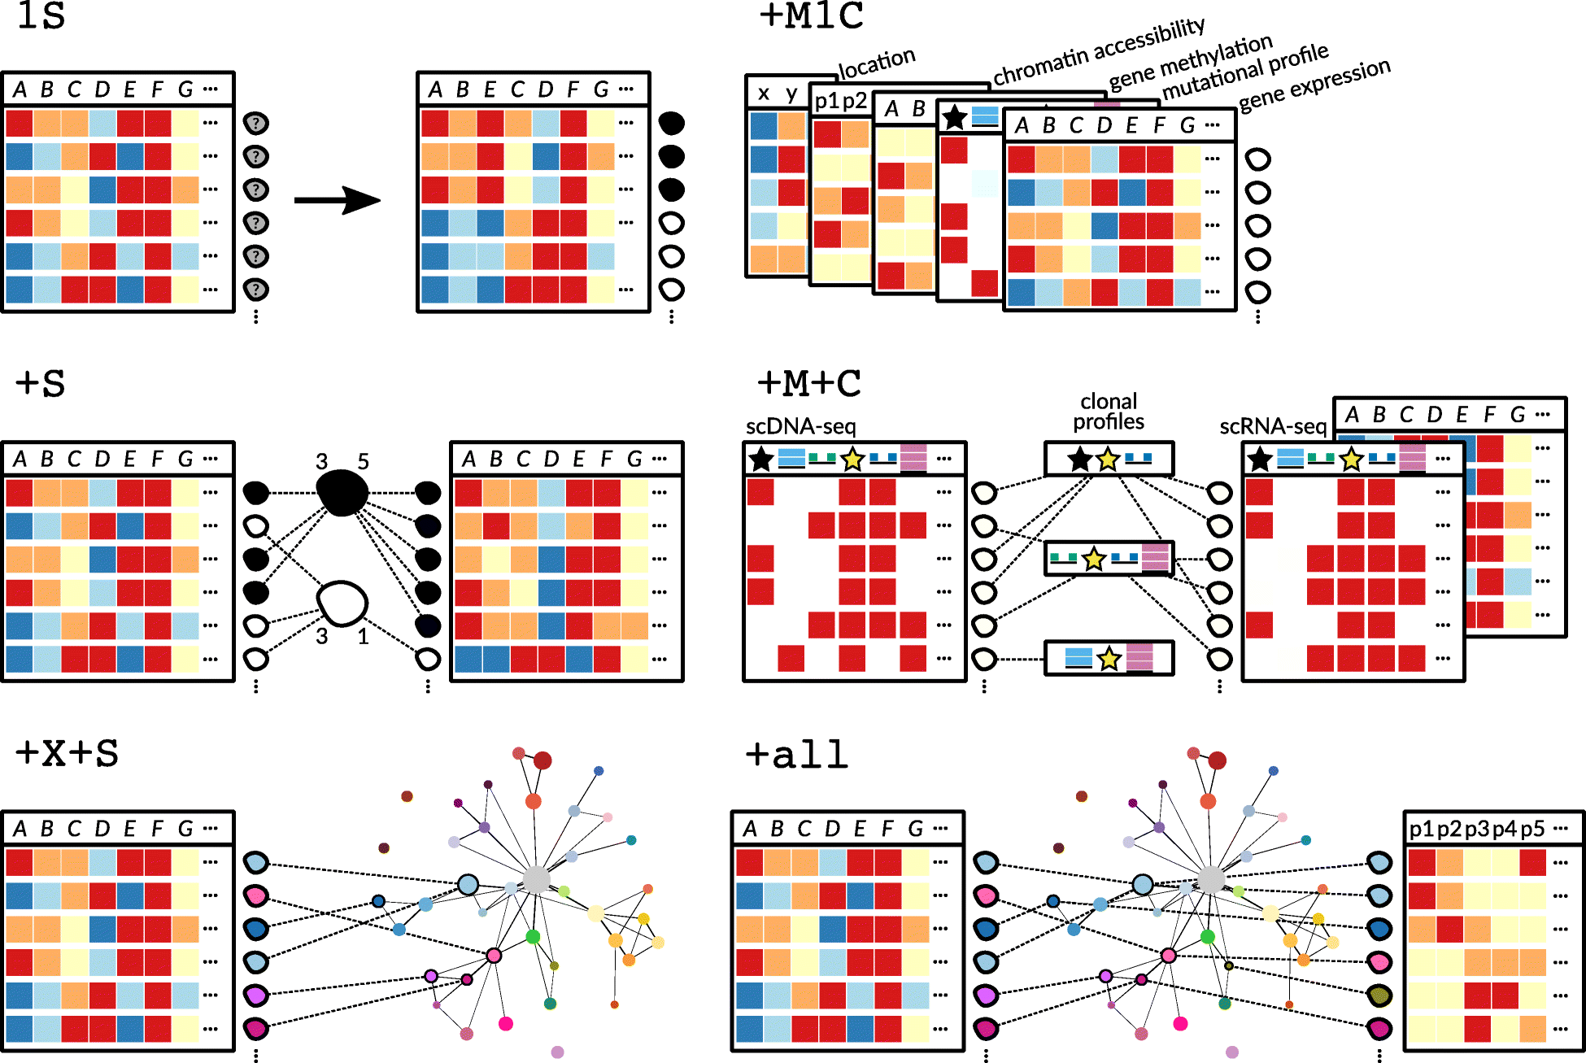
Abbreviations: “↓” same challenge also applies to all approaches below, AM analysis method, exp(s) experiment(s), HCA human cell atlas, MT measurement type, smps samples, TCGA The Cancer Genome Atlas
Genome Biology volume 21, Article number: 31 (2020)

Slide 58
Integration
DOI:
Trends in Biotechnology 2020 DOI: (https://doi.org/10.1016/j.tibtech.2020.02.013)
Notes:
(A) Machine learning-based methods of classification – such as logistic regression – can be used to learn the transcriptional features of different cell states and use these learned models to recognize these cell types in new tissues and under multiple conditions. (B) Multilayer neural networks can identify relationships between expression datasets (scRNA-seq) and transcriptional regulation (scATAC-seq) to predict regulatory circuits under different cellular conditions. (C) Generative adversarial networks can model single-cell data produced from animal models and evaluate how different perturbations (i.e., infection) may alter cellular states in the model under study or in other models. (D) Expression data from individual cells and whole tissues can be integrated using an autoencoder to map expression trajectories to tissue coordinates. Abbreviations: scRNA-seq, single-cell RNA deep sequencing; scATAC-seq: single-cell assay for transposase-accessible chromatin combined with deep sequencing.

Slide 60
A Benchmark of Batch-effect Correction Methods for Single-cell RNA Sequencing Data
Genome Biology volume 21, Article number: 12 (2020)

Slide 61
Guidelines to Choose an Integration Method
Nature Methods volume 19, pages41–50 (2022)

Slide 62
Challenge VII: Validating and Benchmarking Analysis Tools for Single-cell Measurements
With the advances in sc-seq and other single-cell technologies, more and more analysis tools become available for researchers, and even more are being developed and will be published in the near future.
Thus, the need for datasets and methods that support systematic benchmarking and evaluation of these tools is becoming increasingly pressing.
To be useful and reliable, algorithms and pipelines should be able to pass the following quality control tests: (i) They should produce the expected results (e.g., reconstruct phylogenies, estimate differential expressions, or cluster the data) of high quality and outperform existing methods, if such methods exist. (ii) They should be robust to high levels of sequencing noise and technological biases, including PCR bias, allele dropout, and chimeric signals. In addition, benchmarking should be conducted in a systematic way, following established recommendations.
Genome Biology volume 21, Article number: 31 (2020)

Slide 63
Single Cell RNA Tools
https://www.scrna-tools.org/
Genome Biology volume 22, Article number: 301 (2021)

Slide 64
Single Cell RNA Tools
https://www.scrna-tools.org/
Genome Biology volume 22, Article number: 301 (2021)

Slide 65
Challenge VIII: Visualization
GePac Symp Biocomput. 2019; 24: 350–361.
Notes:
Visualizing scRNA-seq data can help researchers effectively extract meaningful biological information and make new discoveries. While commonly used scRNA-seq visualization methods, such as t-SNE, are useful in detecting cell clusters, they often tear apart the intrinsic continuous structure in gene expression profiles. Topological Data Analysis (TDA) approaches like Mapper capture the shape of data by representing data as topological networks. TDA approaches are robust to noise and different platforms, while preserving the locality and data continuity. Moreover, instead of analyzing the whole dataset, Mapper allows researchers to explore biological meanings of specific pathways and genes by using different filter functions. In this paper, we applied Mapper to visualize scRNA-seq data. Our method can not only capture the clustering structure of cells, but also preserve the continuous gene expression topologies of cells. We demonstrated that by combining with gene co-expression network analysis, our method can reveal differential expression patterns of gene co-expression modules along the Mapper visualization.

Slide 66
LDA is Computationally Efficient, Scalable, and Adequately Separates Class Labels
Linear Discriminant Analysis
Amouzgar et. al., bioRxiv preprint doi: https://doi.org/10.1101/2022.01.06.475279
Notes:
(A) Conceptual diagram for comparing various dimensionality reduction algorithms. PCA, LDA, UMAP, and PHATE algorithms are applied to three CyTOF datasets and runtimes are assessed to determine efficiency and scalability of the algorithm. (B) The average runtime of three analyses across three datasets for each algorithm are shown across different dataset sizes on a log2-transformed scale. Default algorithm settings are used. (C) Summary of silhouette score and Pixel Class Entropy (PCE) score to assess separation of class labels of interest for each algorithm. Both metrics can be used for feature selection by HSS-LDA. (D-L) Summary plots of each algorithm applied to the morphometry, T-cell metabolism, and chromotyping datasets. (left: D, G, J) Representative biaxial visualizations of each algorithm using 10,000 cells. (middle: E, H, K) Average silhouette score across different cell counts for each algorithm. (right: F, I, L) Average PCE score in a 100 x 100 pixel grid across different cell counts for each algorithm.

Slide 67
Single Cell BCR and TCR Repertoire Sequencing
Communications Biology volume 2, Article number: 304 (2019)

Slide 68
BCR Repertoire Sequencing Computational Clone Selection Pipeline
Run 10X VDJ kit to generate FASTQ file
Use Cell Ranger to identify VDJ contigs
Generate distance matrix between Ig sequences
Take Hybridoma Seq as seed sequences and expand
Identify antibody sequence that likely to have best affinity to antigen
Integrate antigen specificity data ( for e.g. from Beam Seq)
Generate consensus sequences from subset networks
Clustering/ Identify a subset of Igs that are similar

Slide 69
A Cancer Cell Program Promotes T Cell Exclusion and Resistance to Checkpoint Blockade
Single-cell RNA-seq identifies an immune resistance program in malignant cells
Multiple immune resistance mechanisms are co-regulated in the program
The program predicts clinical responses to immunotherapy in melanoma patients
CDK4/6 inhibitors repress the program and may sensitize melanoma to immunotherapy
Cell 2018 175984-997.e24DOI: (10.1016/j.cell.2018.09.006)
Cell 2018 175984-997.e24DOI: (10.1016/j.cell.2018.09.006)

Slide 70
AI Meets Single Cell Multi-Omics
Trends in Immunology 2019 401011-1021DOI: (10.1016/j.it.2019.09.004)

Slide 71
THANKS

